Slide 1
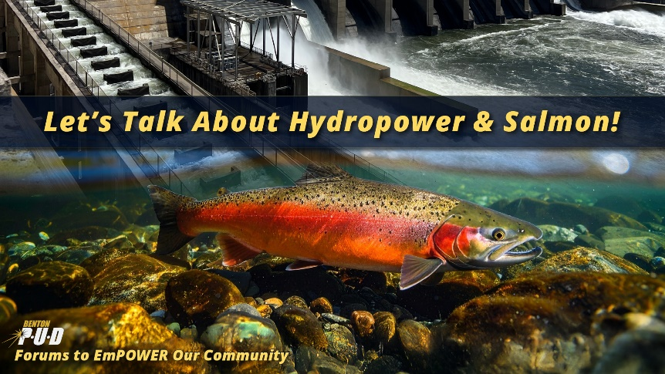

Pacific Northwest Hydropower Why Every Drop Matters
Rick Dunn, PE
General Manager/CEO
October 2025
Your Trusted Energy Partner

Slide 2
Agenda
Hydropower Perspective – National, Northwest & Local
Washington’s Clean Energy Transformation Act – Perspective & Impacts
Electricity Costs & Grid Reliability – How Hydro is Foundational to Both
Hydropower Threats & Risks – Federal/State Action plus Fish & Wildlife Funding

Slide 3
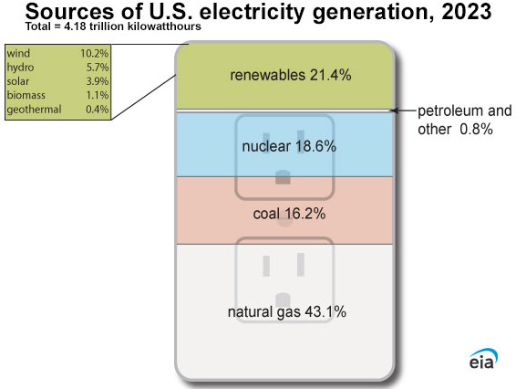
U.S. Electricity Generation
Fossil Fuels = 60%
Renewables = 21.4%
Wind & Solar = 14.1%
Hydro = 5.7%
Nuclear = 18.6%
39% Non-CO₂ Emitting
Source: https://www.eia.gov/energyexplained/electricity/

Slide 4
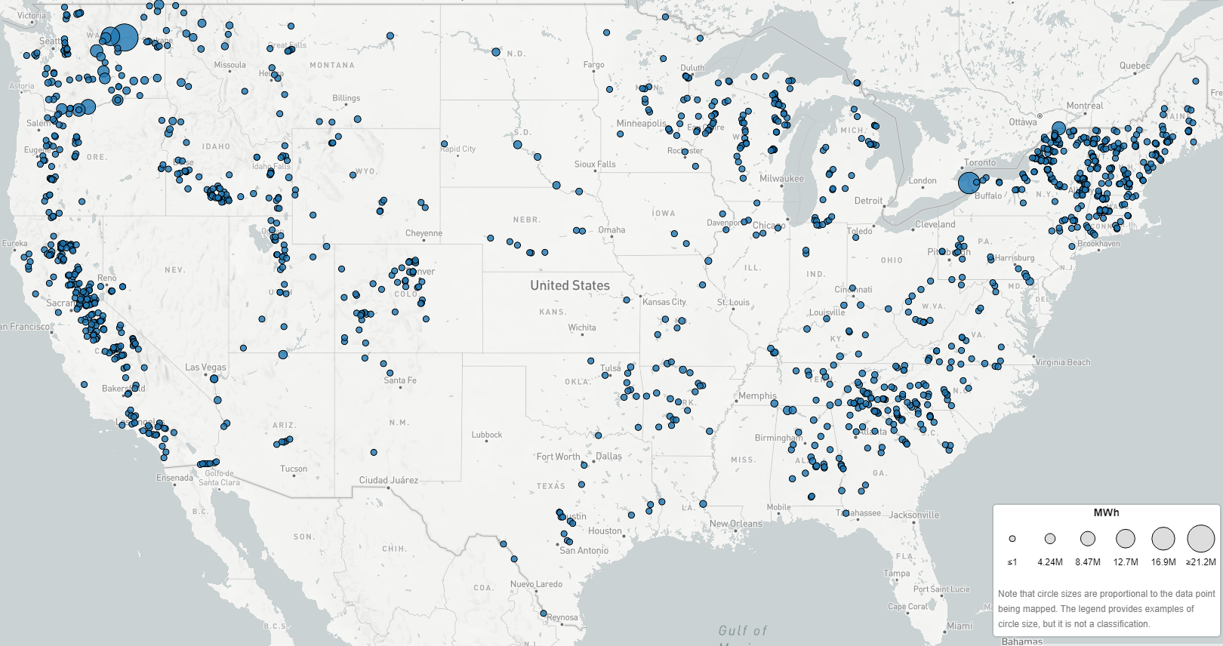
Hydropower = 5.7% of U.S. Electricity
Northwest Hydropower Like Nowhere Else:
Electricity Provided
50% of PNW Region
60% of Washington
Hydro-Based
100% CO₂-Free Electricity does not scale to the rest of the U.S.
Total generation (MWh)
by plant
Source: epa.gov/egrid/data-explorer

Slide 5
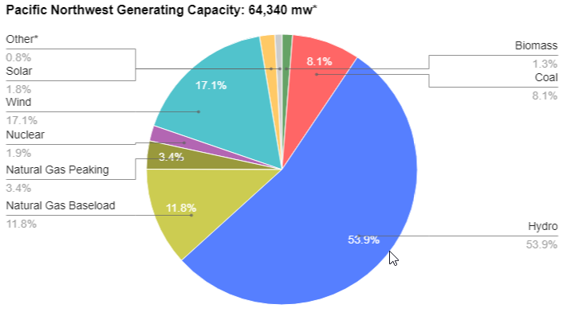
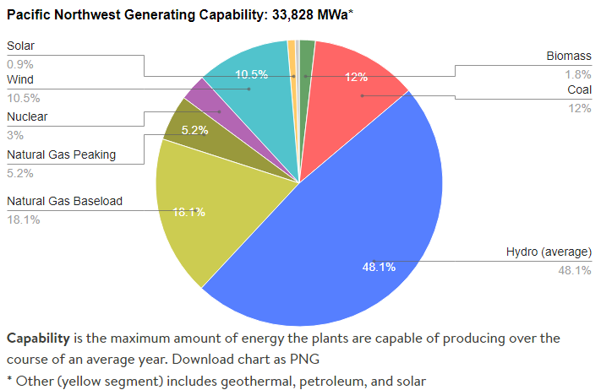
Hydropower: Foundation of Pacific Northwest Electricity Supply
PNW Nameplate Capacity
PNW Annual Electricity Production
16,271 MWa
Bonneville Power Administration
≈ 50% of hydro generation in average year
Source: https://www.nwcouncil.org/energy/energy-topics/power-supply

Slide 6
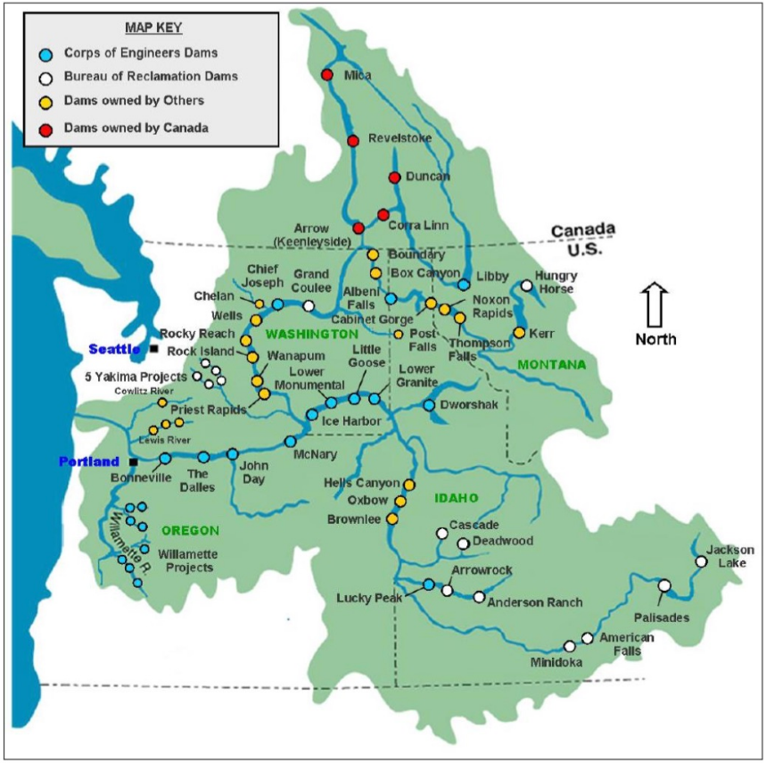



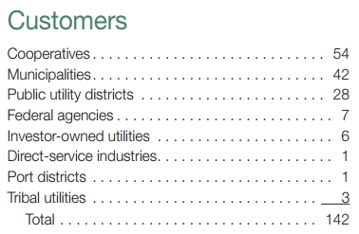
BPA Hydropower: Foundation of Public Power Supply
Federal Power Marketer
31 Federal Hydroelectric Dams
Columbia Generating Station Nuclear Plant
“Preference Customers”
Lowest Cost Generation
BPA Must Meet Utility Firm Net Load when Requested
Investor-Owned Utilities are not preference customers & do not receive physical firm electricity today
Receive financial payments on behalf of residential & farm customers (residential exchange program)

Slide 7
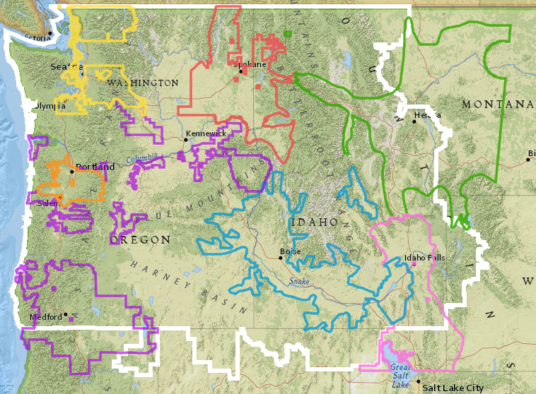
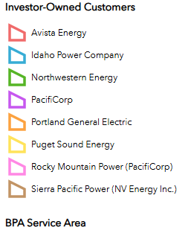
Northwest Utilities: Investor Owned
52% of Electricity Demand
https://data-bpagis.hub.arcgis.com/apps/90811a3f226041bf8657d73ff81e949c/explore

Slide 8
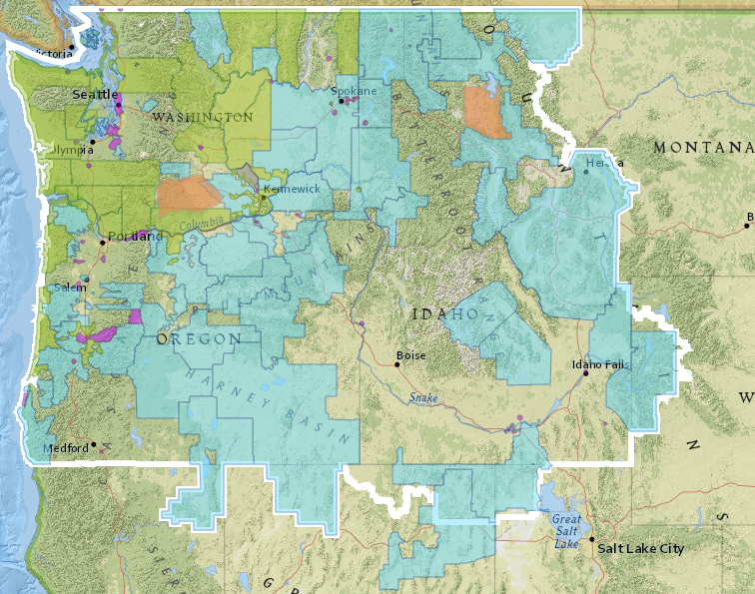
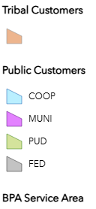
Northwest Utilities: Public & Tribal
43% of Electricity Demand
https://data-bpagis.hub.arcgis.com/apps/90811a3f226041bf8657d73ff81e949c/explore

Slide 9
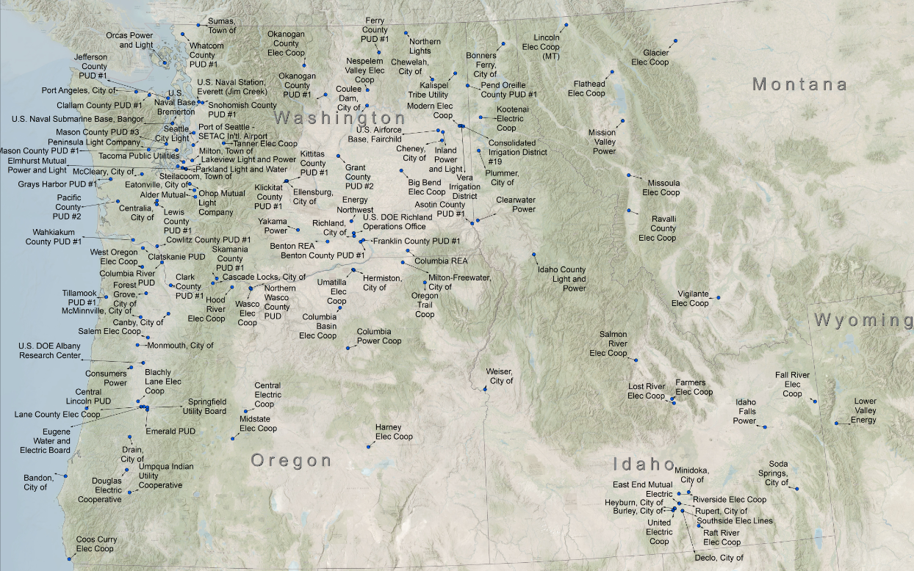
Tri-Cities Area: 2028 Electricity Demand
Utility | 2028 Forecast MWa
Benton PUD | 215
Franklin PUD | 147
City of Richland | 113
Benton REA | 76
Big Bend Electric Coop | 75
TOTAL | 626
6% of Total State Demand
2023 Electricity Sales
≈ 10,200 MWa

Slide 10
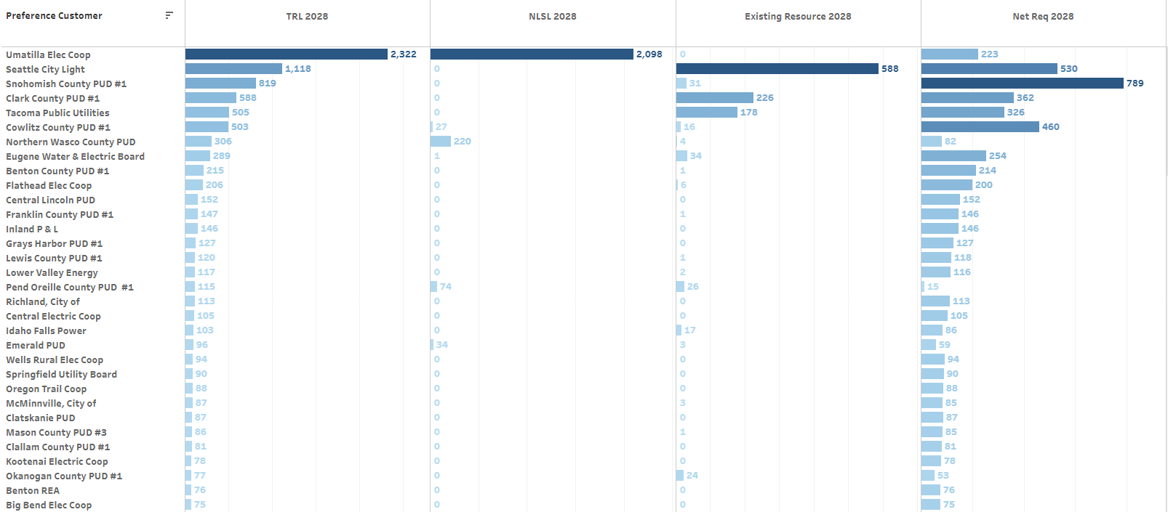


BPA Firm Energy: Where it Flows & Doesn’t
Load Not Served by BPA
Load Served by BPA
>99% BPA

Slide 11
Agenda
Hydropower Perspective – National, Northwest & Local
Washington’s Clean Energy Transformation Act – Perspective & Impacts
Electricity Costs & Grid Reliability – How Hydro is Foundational to Both
Hydropower Threats & Risks – Federal/State Action plus Fish & Wildlife Funding

Slide 12
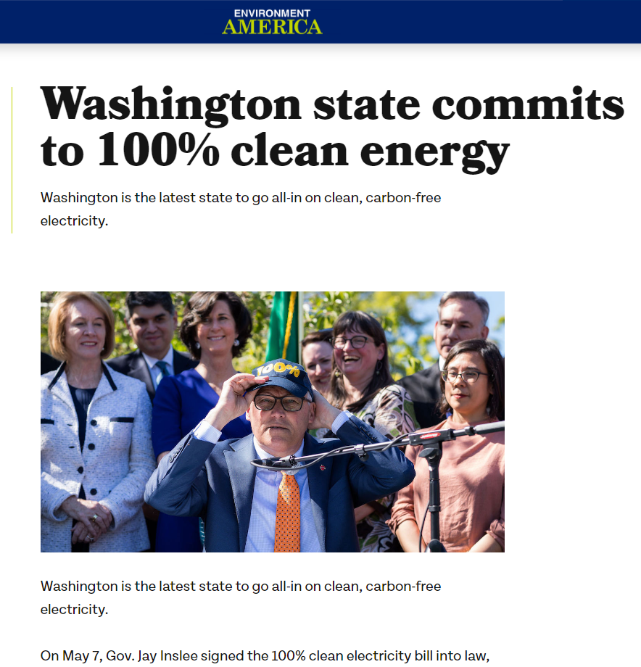
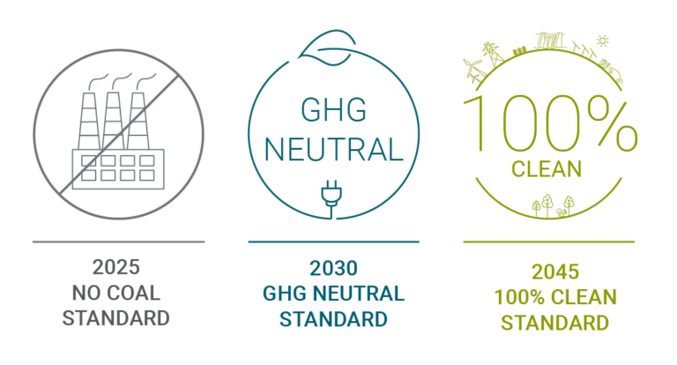
WA Clean Energy Transformation Act (CETA)
CETA Requirements
20% of utility portfolio can be CO₂ emitting generation with offsets
Has effectively eliminated investment in new natural gas generation so far

Slide 13
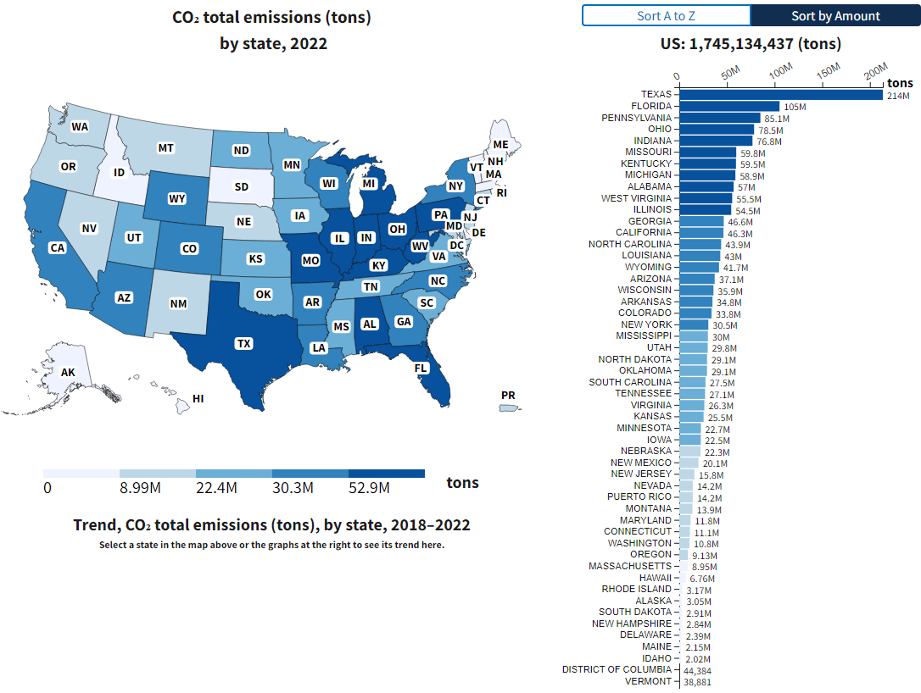
Washington & Oregon: What Dirty Energy Problem?
Hydropower Like Nowhere Else
% of U.S. Total (1,745 MMT)
WA = 10.8 MMT (0.62%)
OR = 9.13 MMT (0.52%)
Source: https://www.epa.gov/egrid/data-explorer

Slide 14
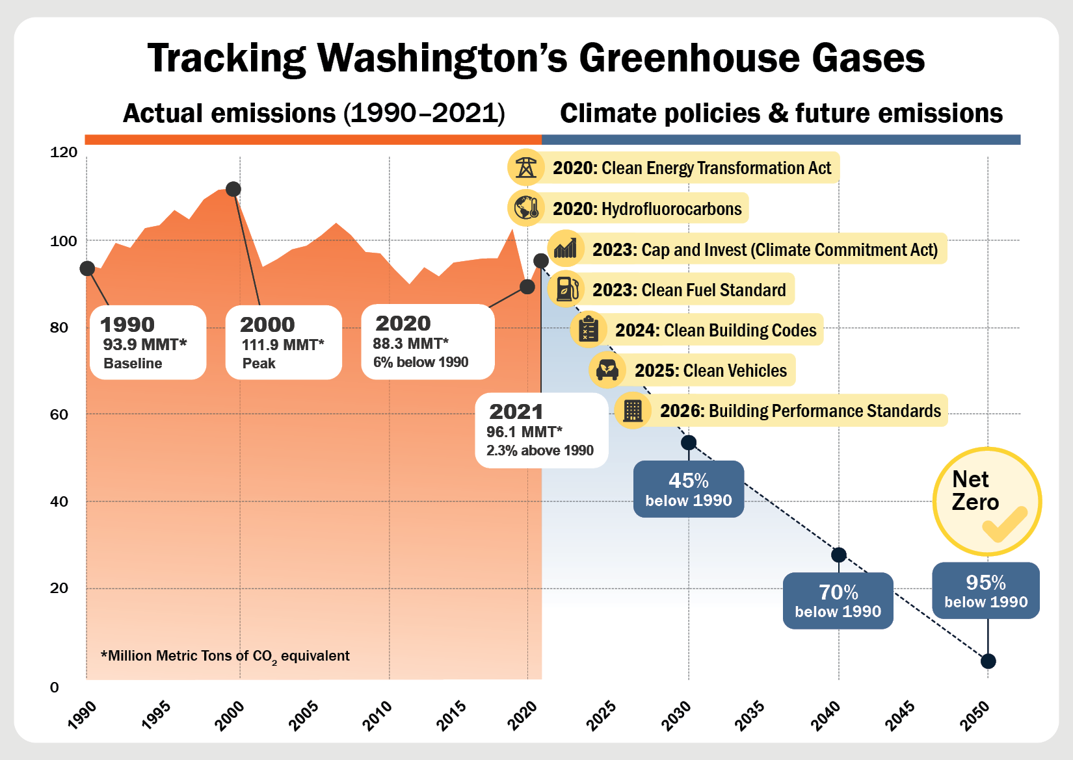

WA CO₂ Reduction: Local versus Global
“…cuts are necessary to prevent the worst effects of climate change on our state’s coastlines, water supplies, forests, environment, and economy.”
Poor Hydro Year
US EIA 2021 Data
Cap-and-Invest Quarterly Auctions
$3 billion in CO₂ taxes
CETA & CCA increasing price of natural-gas-fired electricity by 50% to 100% so far.
Total Energy ≈ 74 MMT
Electricity ≈ 11 MMT
Other ≈ 11 MMT
https://ecology.wa.gov/air-climate/reducing-greenhouse-gas-emissions/tracking-greenhouse-gases/ghg-inventories

Slide 15
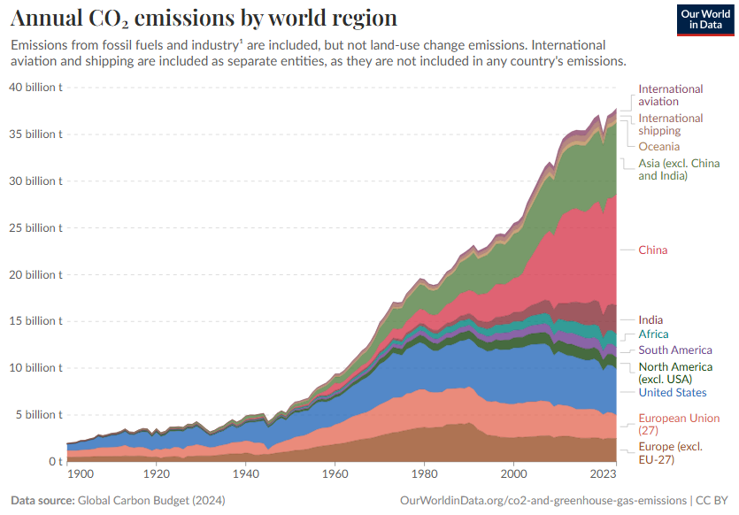
CO₂ Emissions: Global Perspective
Since 2007
U.S. decreased by 1.22 billion t
Mostly due to Coal-to-natural gas fuel switching in electricity generation
China increased by 4.92 billion t
CO₂ from Energy Sector
Washington = 0.074 billion t
United States = 4.91 billion t
China = 11.9 billion t
China
Currently has more than 200 new coal-fired power plants under construction and permitted
Western Civilization is not going to convince poor people to stay poor
changing climate vs. climate catastrophe?
costs versus benefits & lifecycle environmental impacts
Human innovation and adaptation
No such thing as clean energy, only trade offs
Source: https://ourworldindata.org/grapher/annual-co-emissions-by-region

Slide 16
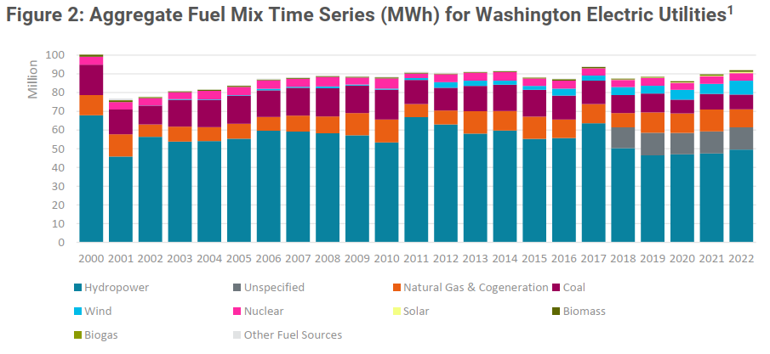
Washington Electricity: Demand & Fuel Mix
Demand Flat for +15 Years
2022 Fuel Mix
68% Clean
32% Dirty
CETA 2030
80% Clean
20% Dirty w/
RECs
CETA 2045
100% Clean
“Dirty”
Very Often Includes Hydropower Market Purchases
Source: Washington Electric Utility 2023 Fuel Mix Disclosure Report – Washington State Department of Commerce

Slide 17
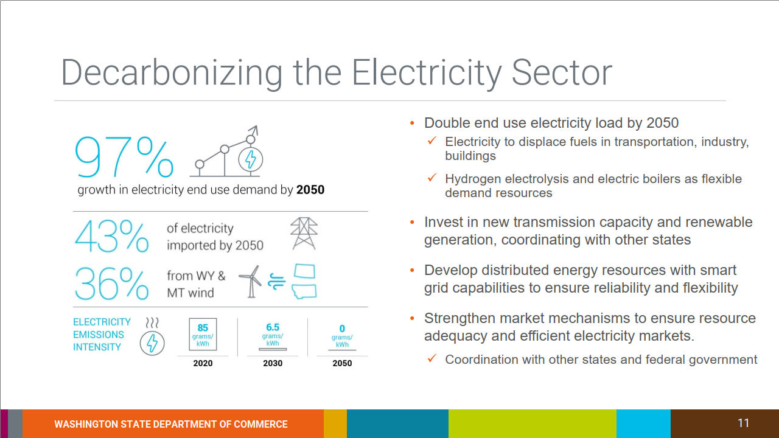
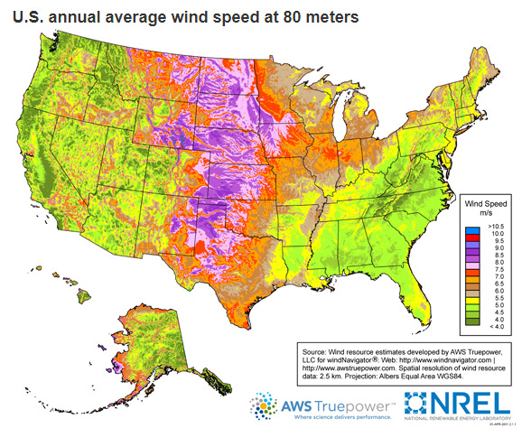
WA Energy Strategy: Out of State Imports
Transmission Lines in Coordination with Other States?
7,200 aMW = WY & MT Wind
1,400 aMW = Other Imports
Sales in 2023 = 10,200 aMW

Slide 18
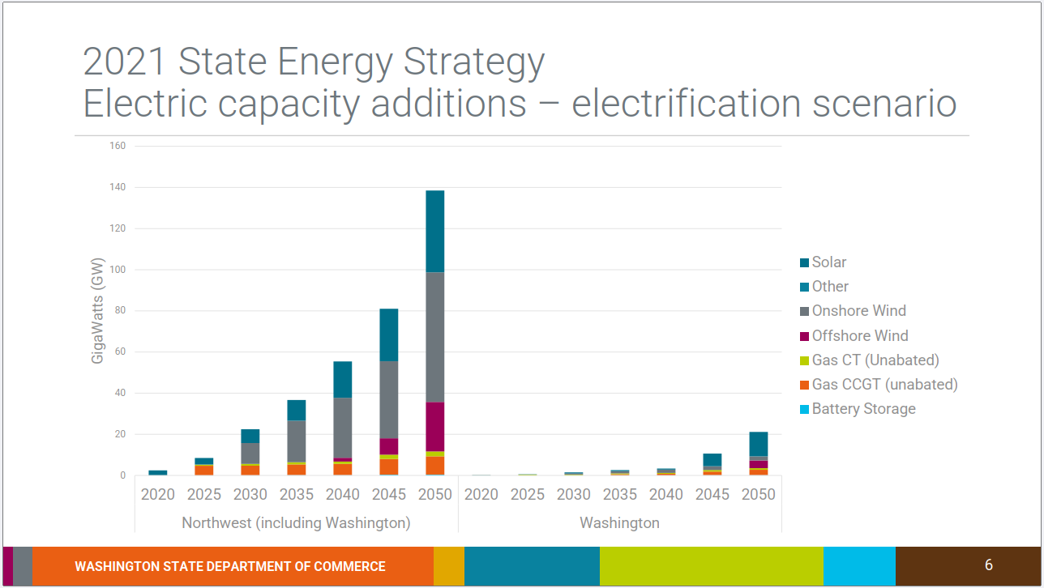
WA Energy Strategy: Out of State Imports
39,300 MW solar
+116 million panels
62,500 MW onshore wind
+100 Seattle-sized farms
Builds in other states highest priority
Wa Solar = 28% of total solar
Wa Wind = 3.2% of total wind

Slide 19
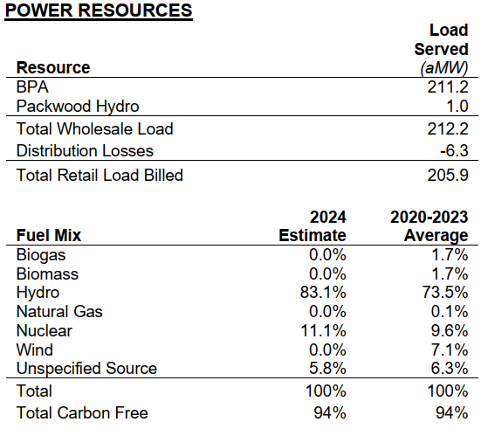
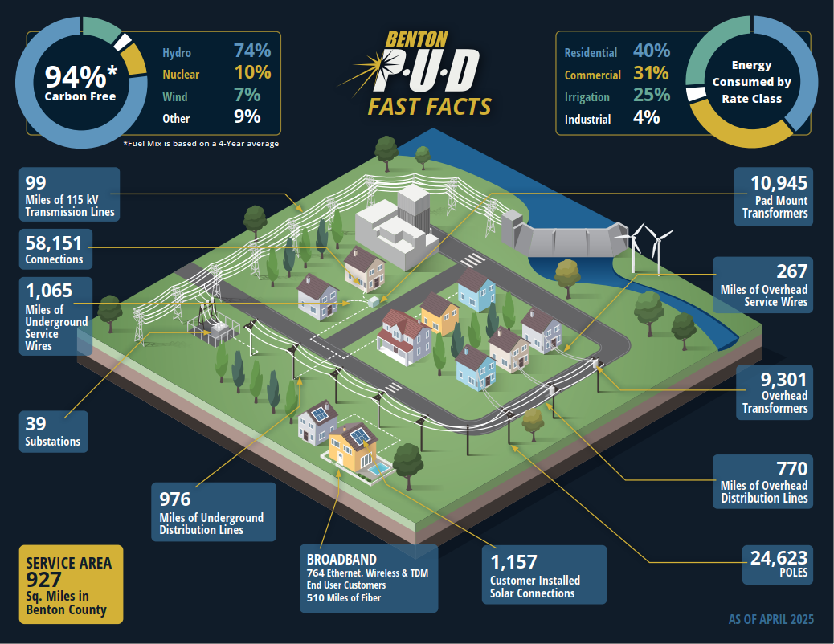
Benton PUD CETA Compliance: Looking Good

Slide 20
Agenda
Hydropower Perspective – National, Northwest & Local
Washington’s Clean Energy Transformation Act – Perspective & Impacts
Electricity Costs & Grid Reliability – How Hydro is Foundational to Both
Hydropower Threats & Risks – Federal/State Action plus Fish & Wildlife Funding

Slide 21
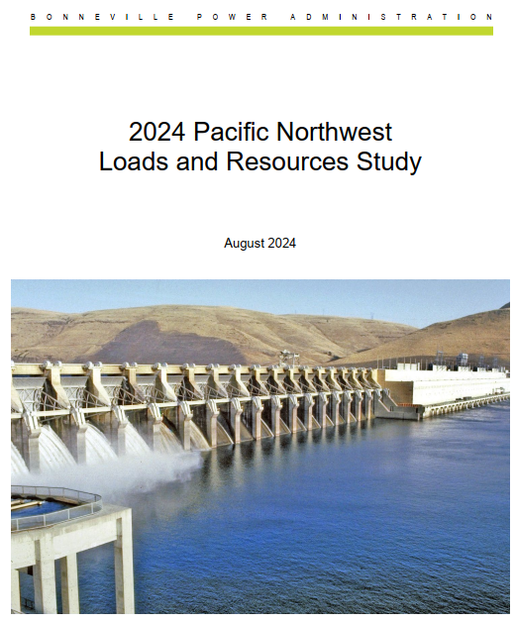
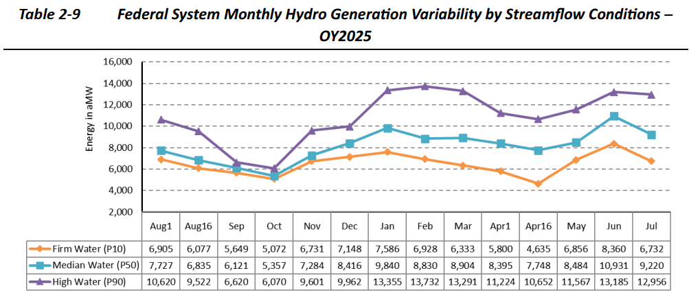
BPA Hydropower: Firm Energy is Spoken For
Surplus
Firm is “guaranteed” & lowest cost power
Lowest-cost firm Tier-1 Federal Hydropower is spoken for: < $40 per MWh (45% of BPUD Residential Electric Bill)
Surplus meets firm demand above Tier-1 (new demand < 10 aMW): $67 to $70 per MWh (+75% higher than Tier-1)
Electricity Intensive Demand > 10 aMW (NLSL): $92 to $144 per MWh based on month (130 to 260% higher than Tier-1)

Slide 22
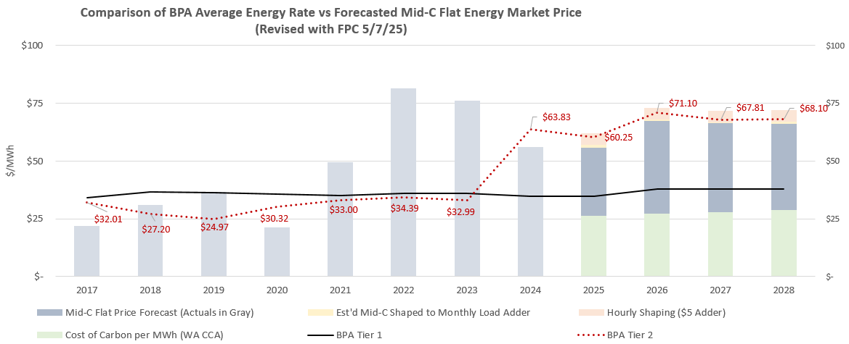
BPA Tier 2 Rates: +170% Increase Since 2019
This is the wholesale cost of electricity to serve new customers
CCA Carbon Tax

Slide 23
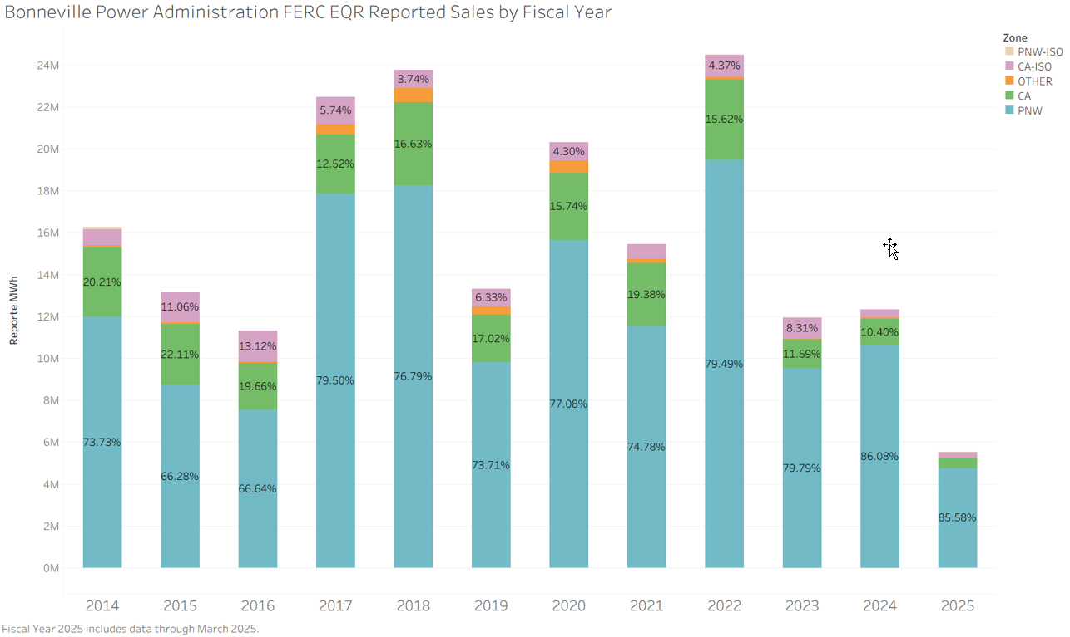
BPA Hydro: Surplus Energy Sales Energy
BPA Sales
Mostly sold in Pacific NW 75% to 85%
California buys 10% to 20%
CGS Nuclear Plant
Annual Energy
1,100 aMW

Slide 24
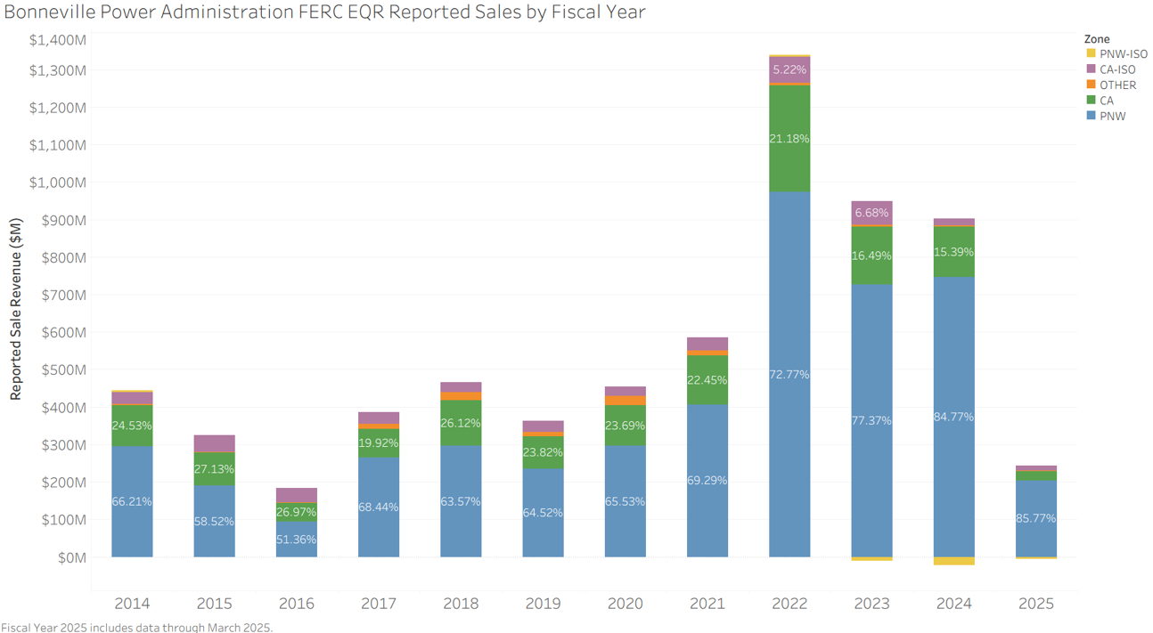
BPA Hydro: Surplus Energy Sales Revenue
Hundreds of Millions $
BPA also purchases, particularly during low water periods

Slide 25
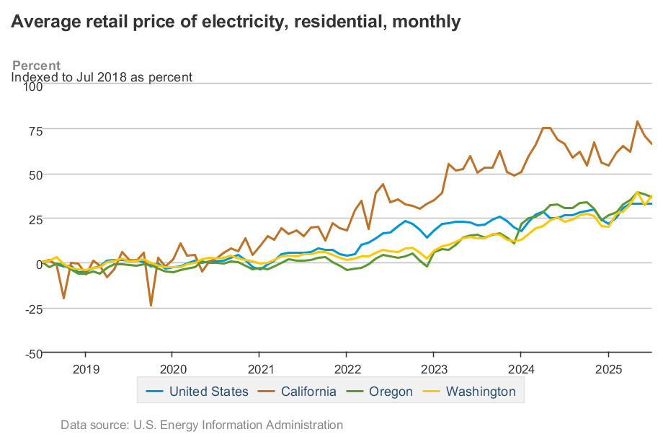

Affordable Hydro: Has Mitigated Rate Increase %
+37% Increase in WA & OR
July 2018 to July 2025
Driven by Investor-Owned Utilities
5% increase
0% increase 2020 thru April 2025

Slide 26
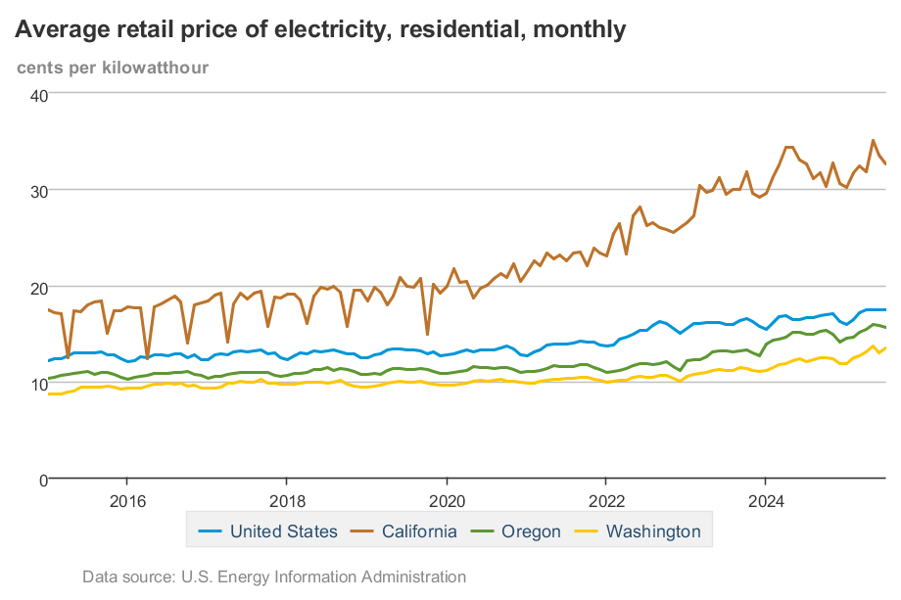
Affordable Hydro: Has Mitigated Rising ¢ per kWh
8.79¢ per kWh

Slide 27
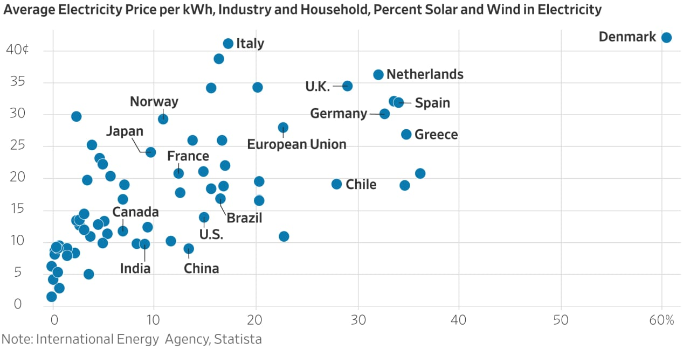
Increased Costs: “Cheap” Wind & Solar is a Lie
Wind & Solar Intermittency & Variability Requires Overbuild for Reliability
Extensive Transmission Lines to Remote & Distributed Wind & Solar Farms
Still Need Significant Back Up Generation Standing By
Washington
“For every 10% increase in solar and wind share, the electricity cost increases by more than 5 cents a kilowatt-hour.”
Bjorn Lomborg
WA is Here
CA is Here
% Solar & Wind

Slide 28
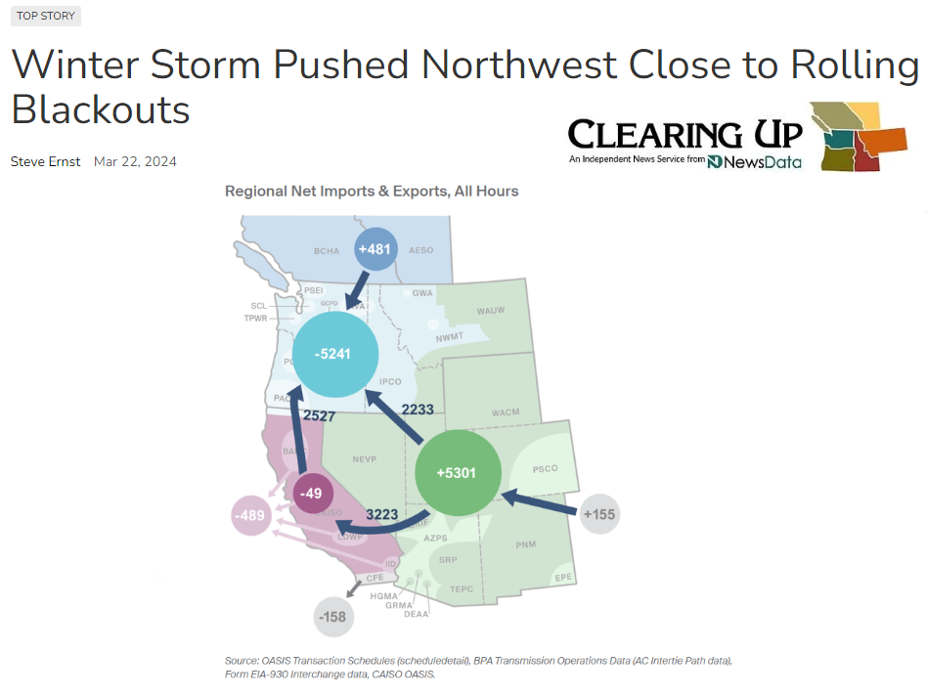

Northwest Close to Blackouts
Northwest Imported Electricity for all 120 Hours of Cold Snap
Hydro short on water, natural gas maxed out & wind power collapsed to zero
+2,000 MW of coal retirements so far
Demand grew 2% to 6% since December 2022 winter event
Northwest electric grid & natural gas pipeline systems are at immediate risk with no margin for the unexpected
Multiple Utilities Declared Energy Emergencies
No Net Energy from California Generation
Nuclear, Natural Gas & Coal Imports
January 12 – 16, 2024

Slide 29
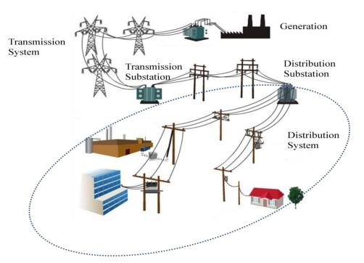
Power Grid Basics: A Service Like No Other!
Electricity is simultaneously:
Produced
Delivered
Consumed

Slide 30
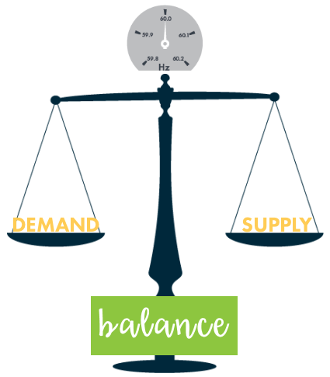
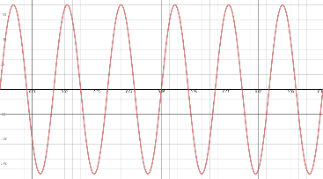
Demand/Supply Balancing: Physics
Electrical Demand and Supply Must Be Equal at All Times
‘Cruise Control’ set at 60
No over supply
No under supply
The Laws of Power Grid Physics are Unforgiving
Consequences of not maintaining supply & demand balance are blackouts
60 cycles per second
Notes:
4,000 MW OF FIRM GENERATION IS BEING RETIRED IN THE NWPP. THERE IS NO ORGANIZATION IN THE NORTHWESTERN UNITED STATES RESPONSIBLE FOR RESOURCE ADEQUACY PLANNING
ONLY RELIABILITY REQUIREMENTS ARE OPERATIONAL
ANTI FOSSIL FUEL AND ANTI NUCLEAR SENTIMENT COMBINED WITH STRONG WIND AND SOLAR POWER ADVOCACY HAS PUSHED UTILITIES INTO A GAME OF CHICKEN.

Slide 31
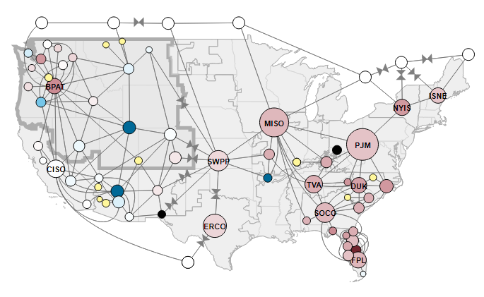
Electricity Supply & Demand: Balancing Area Authorities
Transmission Lines enable electricity to flow within & between Balancing Areas
38 Balancing Area Authorities in Western Power Grid
Maintain supply & demand balance using scheduled generation imports and exports
Expanded “Northwest” Footprint

Slide 32
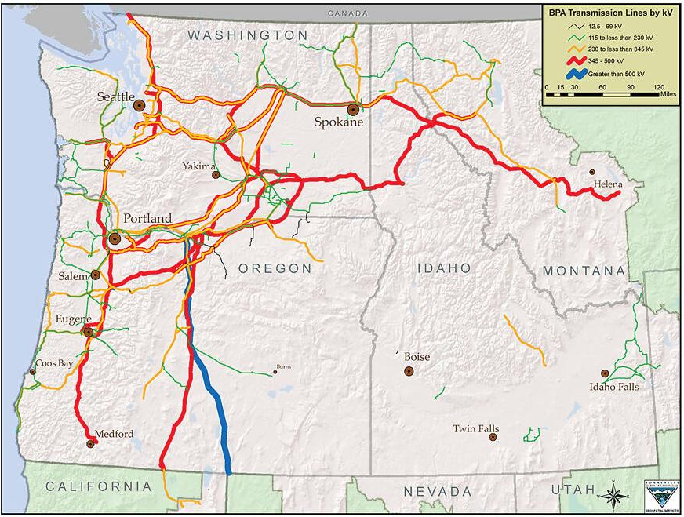
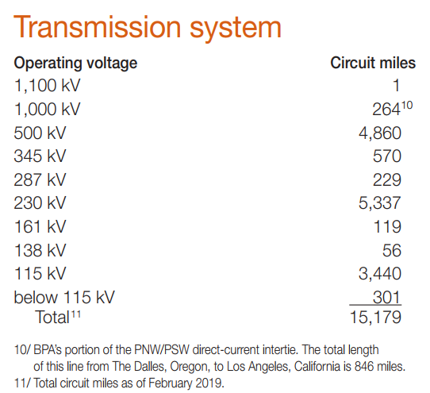
BPA Transmission: 75% of NW Grid
Arteries ≈ 11,261 miles (74%)
Veins ≈ 3,916 miles (26%)

Slide 33
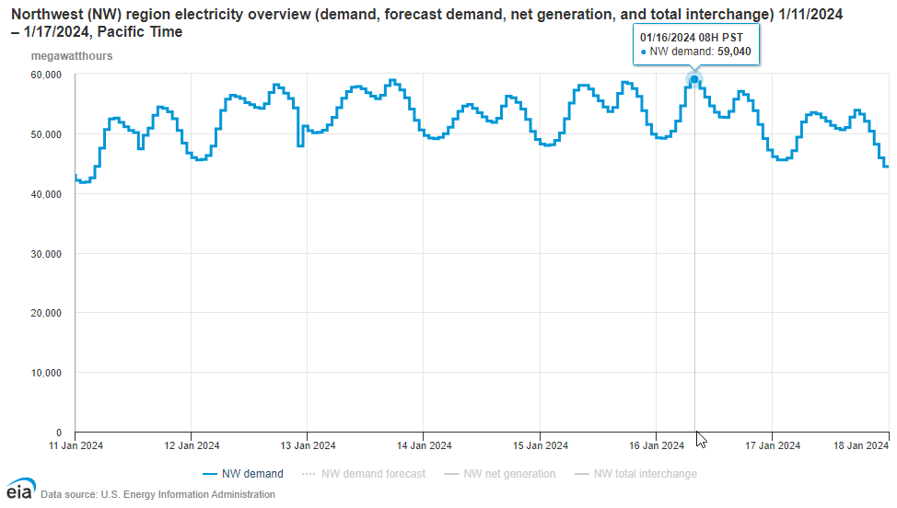
NW Electricity Demand: January 2024 Cold Snap
Demand Curve is Power & Must be Precisely Matched
Controllable Generator Output (Capacity)
Area Under Curve is Energy
Electricity Demand Cold Winter Days January 2024
Daily Rhythm of Life
Note: y-axis is megawatt-hours (energy) per hour or average megawatts (power)

Slide 34
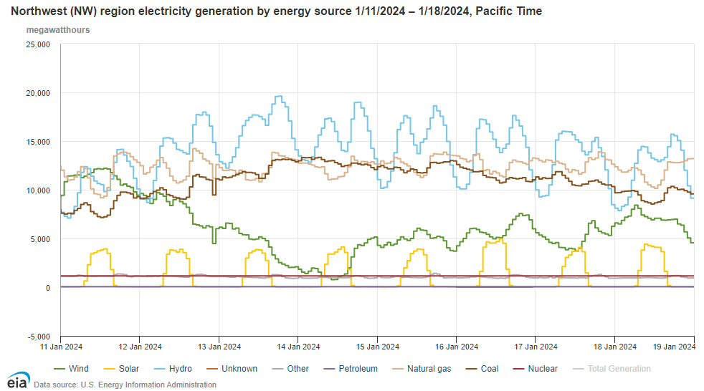
NW Electricity Supply: January 2024 Cold Snap
Energy Policies Driving Deeper Dependence on Hydropower
Natural Gas is Next Best for Balancing the Grid
“Clean Grid” can be energy rich but capacity poor
Increasingly Risky & Costly Probability Game
“Averages are the enemy of reliability planning” Randy Hardy
Wind Energy Drops by 94%
Always On
CGS Nuclear
Solar 0% during hours of darkness
Note: y-axis is megawatt-hours (energy) per hour or average megawatts (power)

Slide 35
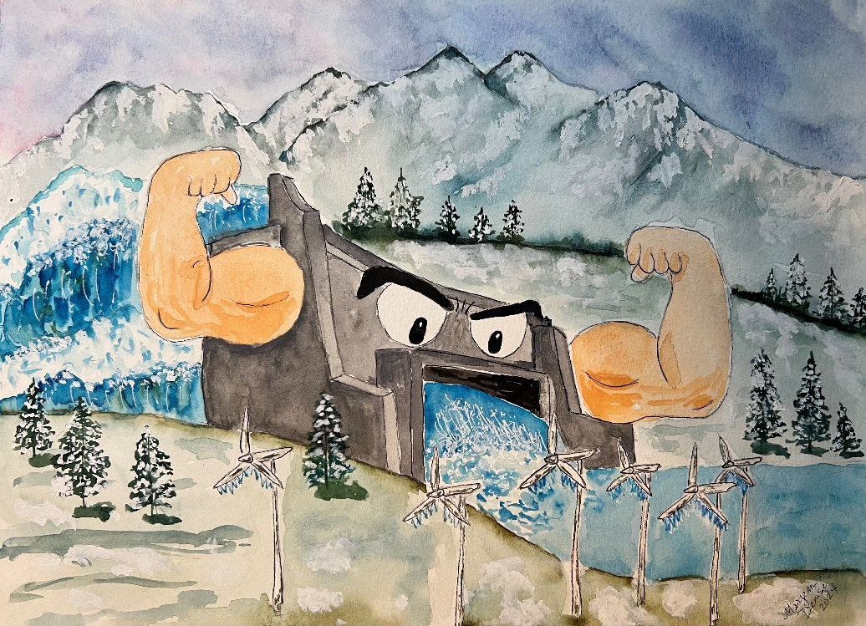
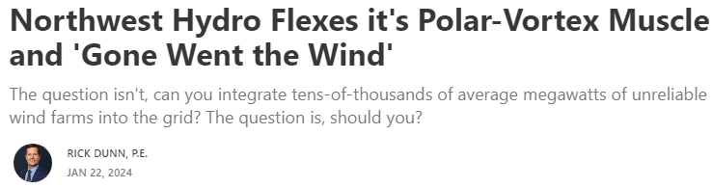
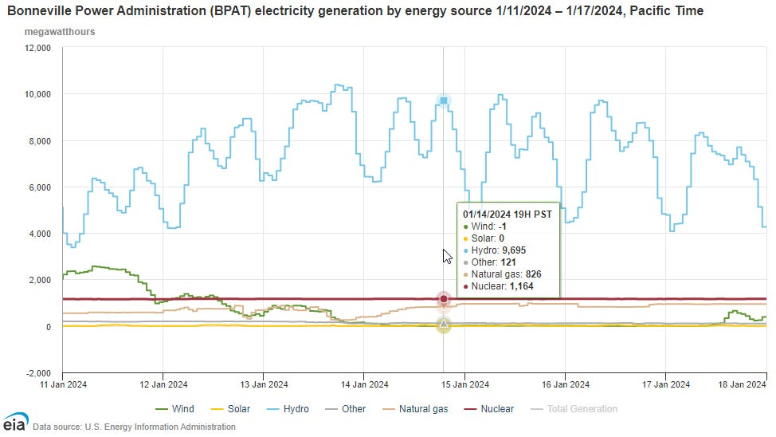
NW Hydro: Flexes Polar Vortex Muscle
https://rickdunn.substack.com/p/northwest-hydro-flexes-its-polar
WA & OR Wind Power at Zero or Less During Coldest Temperatures

Slide 36
Agenda
Hydropower Perspective – National, Northwest & Local
Washington’s Clean Energy Transformation Act – Perspective & Impacts
Electricity Costs & Grid Reliability – How Hydro is Foundational to Both
Hydropower Threats & Risks – Federal/State Action plus Fish & Wildlife Funding

Slide 37
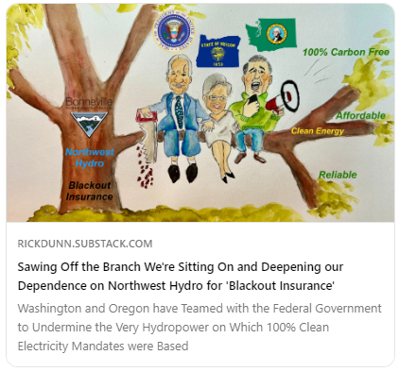
Federal & State: Threats to Hydro
Risky & Excessive Spillway Flows
125% Total Dissolved Gas
Water Temperature Regulation
Washington Stds. may be Impossible to Meet
Lower Snake River Dam Breaching
“Centerpiece Action” for Salmon Recovery
U.S. Government Commitments
“12/14 Agreement” with “6 Sovereigns”
Washington, Oregon & 4 Tribes - NOT MT or ID
Failed to Engage Utility Sector

Slide 38
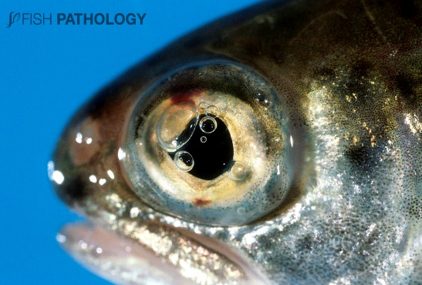
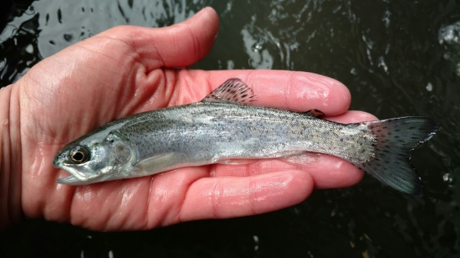
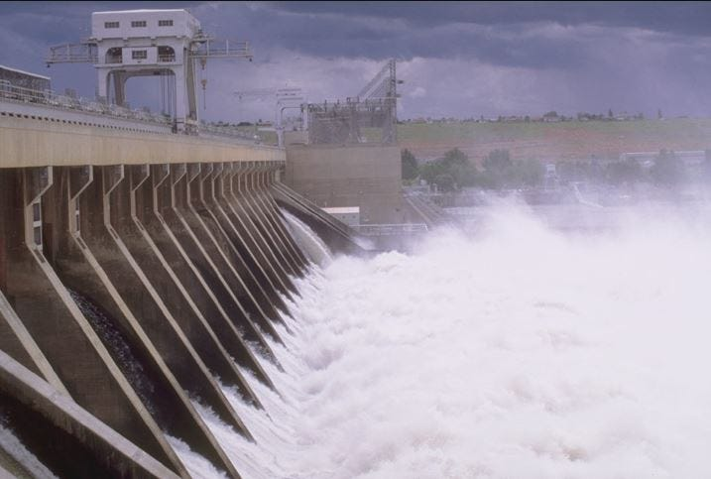
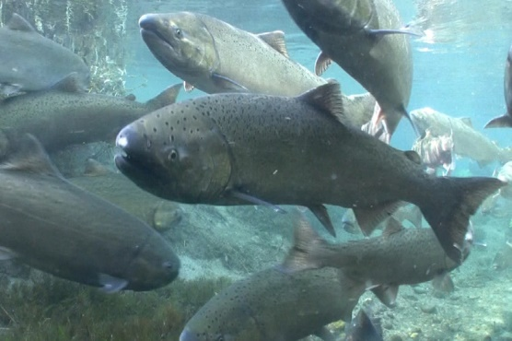
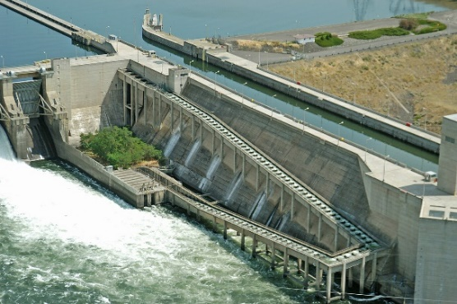
High Spill: Risks to Smolt & Adult Salmon
125% Total Dissolved Gas
Super Saturation of Water
Gas Bubble Disease
(Smolt)
Downstream Migration
Ladder Confusion & Fallback (Adults)
Upstream Migration

Slide 39

High Spill: Worse than LSRD Breaching
Multiple Objective Alternative 4 (MO4)
Highest volume and longest duration spill considered in EIS alternatives
125% total dissolved gas during spring & summer
Average hydropower decreases 1,300 aMW
Highest probability of power shortages
Blackouts or emergency conditions in roughly 1 in 3 years

Slide 40

Hydro: Pays for Fish & Wildlife Programs
Credits are U.S. Treasury reimbursements to BPA for the share of fish & wildlife mitigation costs attributable to non-power purposes

Slide 41

Hydro: Pays for Fish & Wildlife Programs
$15 billion since 1999
¼ of BPA wholesale power rates

Slide 42

Hydro: Pays for Fish & Wildlife Programs

Slide 43


Hydro: Salmon are Highest Priority

Slide 44

Hydro: Salmon Restoration Efforts
4 H’s
Habitat
Hatcheries
Hydro
Harvest

Slide 45

Dam Passage: Fish Survival Rates

Slide 46

Salmon Returns: Ups, Down & Trends
Source: Public Power Council based on Columbia River DART (University of Washington)

Slide 47



Chinook Salmon Struggling: Dams or Not
Smolt-to-Adult Return
Sustainable runs >2%
Smolt
Puget Sound
Snake River Basin
Adult

Slide 48

Hydropower: Back in the Courts
Columbia River System Operations Federal Lawsuit
Federal Oregon District Court (Judge Michael Simon)
Plaintiffs = 10 nonprofit groups (National Wildlife Federation, et al.,) + Oregon + Washington (as of October 9th)
Proposed Order Granting Oregon’s Motion for Injunctive Relief (October 8, 2025) = Year-Round 24/7 Spill

Slide 49

Balancing Act: Increasingly Difficult
Hydropower Erosion
Increased spill & threats of dam breaching
Eliminating CO₂ valued above all factors
Coal-plant retirements & no new natural gas in WA & OR
Wind & Solar: Weather Dependent & Energy Dilute
Located remotely from population centers & require vast swaths of land due to need for extreme overbuild
Increasing Costs & Risk of Blackouts
Electricity
Health, Safety & Well Being
Affordable
Reliable
Environmentally Responsible

Slide 50
Conclusions/Questions
Pacific Northwest needs every drop of hydropower we can get!
Firm and low-cost hydro is spoken for . . . the glory days are over
Hydro & Salmon can co-exist . . . but what does it mean for salmon to be “abundant”
100% CO₂-Free Electricity Mandates
Deepening dependence on hydro Capacity & flexibility
Increasing blackout risk = drought + cold/hot weather
Desperately need more firm (dependable) capacity
New Nuclear is long-game solution with Natural Gas as a bridge fuel

Slide 51
Agenda
New Nuclear
Challenges and Opportunities

Slide 52





Big Tech Knows: Reliable = Natural Gas + Nuclear
Driving Nuclear Renaissance
Big Tech’s “Dirty Little Secret”
Natural Gas Power + Renewable Energy Certificates
“Greenwashing”
https://rickdunn.substack.com/p/wind-and-solar-green-industry-fantasyland

Slide 53

Artificial Intelligence: Driving Power Demand
U.S. AI power capacity estimated at 5 GW today
Could reach 50 GW by 2030
Capacity increase equivalent to 37 CGS Nuclear Plants
Source: Electric Power Research Institute August 2025

Slide 54




AWS Funding New Nuclear: Site-1 SMR
54
4 Modules Initially with up to 12 Total
80 Megawatts per Module
Amazon providing development funding for 4 modules
Energy Northwest has option to build additional 8 modules
Additional power available to Amazon and northwest utilities
On-Line Goal = Early 2030s

Slide 55


“Long Game” Solution: Scalable, CO2-Free & Safe
High Initial Cost, Supply-Chain Constrained & Operationally Unproven
Meltdown-Proof
Walk-Away-Safe

Slide 56


Land-Use vs. CO₂ Footprint: Finding Common Ground
Energy contained in a gummy bear pellet of uranium fuel
= 2,000 pounds of coal

Slide 57

Benefits of zero-emitting firm capacity at 100% GHG reductions
Avoids 80 to 150 Seattle-Sized Wind Farms & 112 M solar panels
100% GHG Reduction Portfolios
Adding
Avoids
+1.2 GW CGS
-9.5 GW Storage
+5.3 GW SMRs
-44.8 GW Wind
-37 GW Solar
+6.5 GW Firm
-91 GW Non-firm
$-1.4B
CGS + NuScale SMRs reduce system costs by almost $8B per year relative to RE + Storage

Slide 58
Agenda
21st Century Power Grid

Slide 59

Western Power Grid: Interconnected Transmission Lines
Pacific Interties went into service 1968 - 1970
Path for Hydropower surpluses in the Northwest to flow to California
Western Interconnection
Transmission Lines
Pacific
AC & DC Interties
8,000 MW
PNW Transmission Interconnections to:
Montana
Wyoming
Nevada
Becoming more important with Washington & Oregon Electricity Imports Expected to Increase from remote wind and solar farms

Slide 60
BPA Transmission Lines: 75% of NW Grid
Arteries ≈ 11,000 miles (74%)
Veins ≈ 4,000 miles (26%)

Slide 61

BPA Transmission: What “We” want BPA to Do
“The Evolving Grid Update on the State of Transmission”
Source: BPA April 2023 Presentation “The Evolving Grid Update on the State of Transmission”

Slide 62

BPA Transmission: East-to-West Flowgates
Total West Peak Load = 21,000 MW
(62% of Northwest)
Seattle/West
11,000 MW
+9,000 MW
Portland/Vancouver/West
10,000 MW
+6,000 MW
East-to-West Flowgates = +15,000 MW
(74% of West Load Served from East)

Slide 63

BPA Transmission: Cascades Bottleneck
WA & OR Policies Double Demand & Reduce/Eliminate Natural Gas
Feasible Capacity in existing ROW?
How much New ROW & Where?
+9,000 MW
What does adding +20,000 MW look like?
+6,000 MW

Slide 64

Transmission Lines: Anatomy & Megawatts
500 kilovolts
3-Phase AC Apparent Power
8,000 to 10,000 MW
Thermal Rating
S = √3 x V x I [cosØ + j sinØ]
Megawatts (MW)
500 kilovolts
2,000 to 3,000 MW
Thermal Rating
How to Double Power (MW)
Double Voltage (V) - pressure
increase insulator length
tower height & width
right-of-way width
Double Current (I) - flow
increase conductor (cable) size
cost & weight
tower size & strength
Note:
To maintain an operationally stable power grid, electricity flows (Megawatts) on transmission lines are often limited to levels well below thermal ratings.

Slide 65

New Transmission: Lines to Other States
Very Limited New Transmission Lines to Best Wind & Solar
Montana, Wyoming & Nevada
Boardman-to-Hemingway 500 kV(1,000/3,000 MW)
MW limited system/thermal
Project defined 2006
Complete by 2027?
Cascade Renewable 320 kV (1,100 MW)
High Voltage Cable Buried in Columbia River downstream of Bonneville Dam
North Plains Connector 525 kV HVDC (3,000 MW)
4
3
2
1

Slide 66



Western Transmission: Expansion Coalition

Slide 67

BPA’s Transmission Queue: Overwhelming # of Requests
Analysis Paralysis
Current NW winter Demand 35 GW

Slide 68

BPA’s Transmission Queue: Mostly WA/OR Wind & Solar

Slide 69


BPA Transmission: “Artery” Miles per Decade
“Arteries”
BPA hasn’t built significant new 500 kV transmission lines in decades

Slide 70



BPA Transmission: How far do “We” want BPA to Go?
Eminent Domain = Last Resort or Required Strategy?
Transmission Lines are Not Popular (NIMBY)
Proposed 79 miles of new 500 kV Line
$722 million Budget
9 years & Gave Up

Slide 71

NW/BPA Transmission: Issues to Watch Closely
State Transmission Authorities?
Divergent State & Federal Energy Policies
Washington & Oregon Energy Policies Driving Needs
Cascade Bottleneck - ROW Acquisition & Development
Exercising Eminent Domain: BPA, Utilities and/or State?
BPA Transparency More Important than Ever
Resource/Planning priorities & execution metrics
Why, Where, How Much & When (& Who is Paying?)

Slide 72
Agenda
Salmon in Depth

Slide 73

Salmon Returns: Historical Perspective

Slide 74


Chinook Salmon: Life Cycle
Smolt take 10 to 50 days to travel rivers and get to the estuary/ocean
Delayed mortality hypothesis is driving calls for LSRD breaching w/o scientific evidence
“If delayed mortality doesn’t exist…then other approaches to getting more salmon should be considered”.

Slide 75



Salmon Competition: Non-Native Species
Bass
Walleye

Slide 76

Technology Investments: Bypass
Fish Friendly Turbines Improved to +98% at Ice Harbor Dam

Slide 77


Technology Investments: Raised Spillway Weirs

Slide 78



Technology Investments: Fish Friendly Turbines
“…biological testing using balloon tagged fish in October 2019 resulted in a 98.25% direct survival rate.”
https://www.nww.usace.army.mil/Media/News-Stories/Article/2991190/modernizing-hydropower-on-the-snake-river/

Slide 79


Killer Whales and Snake River Chinook
JKL Orca populations declined during time of increasing Snake River Chinook Salmon abundance

