Slide 1



Grid Modernization
2022 Strategic Planning
Commission Work Session
June 7, 2022
Your Trusted Energy Partner

Slide 2
Agenda: Journey to the Modern Grid
What is a “modern grid”?`
What is our focus?
What have we been doing?
Where do we go from here?
Notes:
In today’s Work Session we want to reground the Commission with what it means to own and operate a modern electrical power grid infrastructure and we hope to answer these four questions…

Slide 3
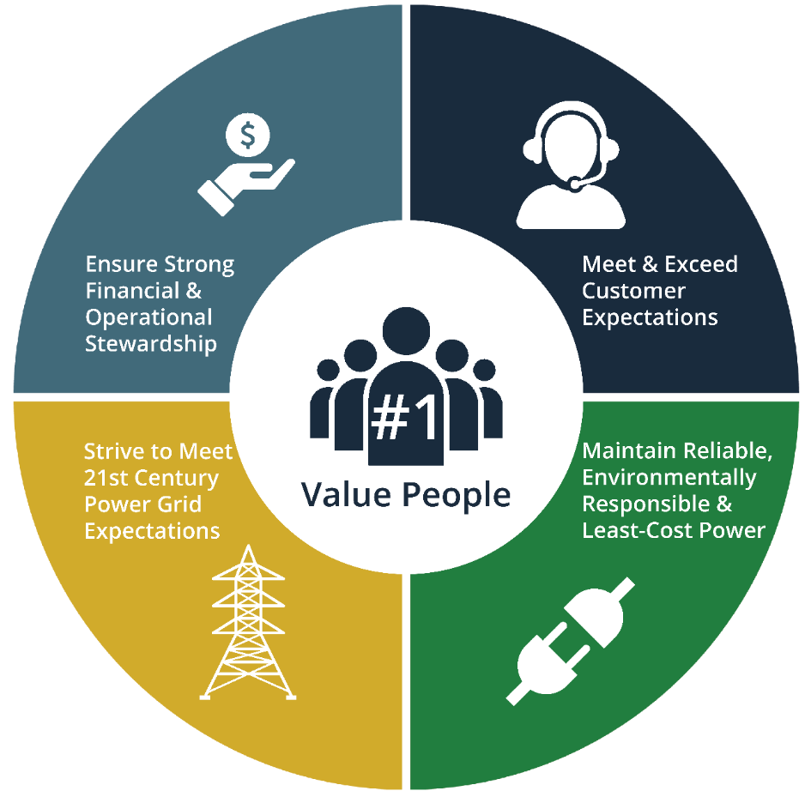
Modernized Grid is Fundamental to Strategic Focus
3

Slide 4
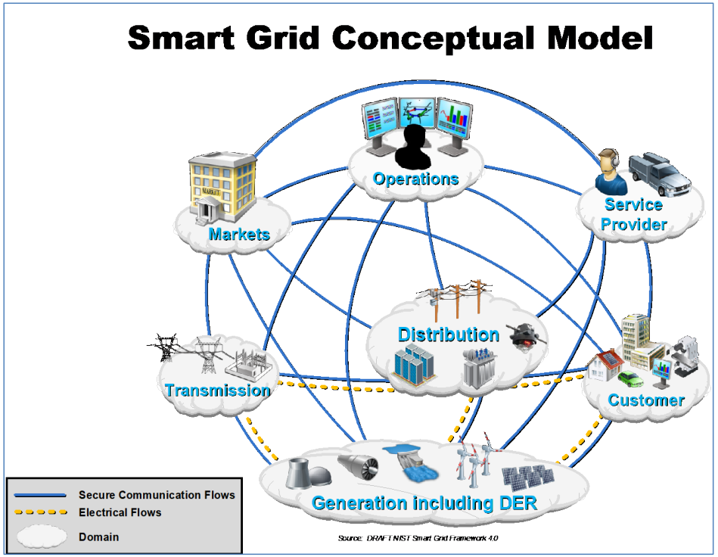
Consumer participation
Real-time pricing
Integration of renewable energy
Power system efficiency
Power quality
Better integration of customer-owner power generation
Quicker restoration of electricity after power disturbances
Reduced utility operations & management costs
Reduced peak demand
Notes:
Consumer Participation.
Real Time Pricing.
Distributed Generation: Incorporation of renewable energy resources into the grid.
Power System Efficiency.
Power Quality.
New products in terms of Value Added Services (VAS)
More efficient transmission of electricity
Quicker restoration of electricity after power disturbances
Reduced operations and management costs for utilities, and ultimately lower power costs for consumers
Reduced peak demand, which will also help lower electricity rates
Increased integration of large-scale renewable energy systems
Better integration of customer-owner power generation systems, including renewable energy systems
Improved security

Slide 6
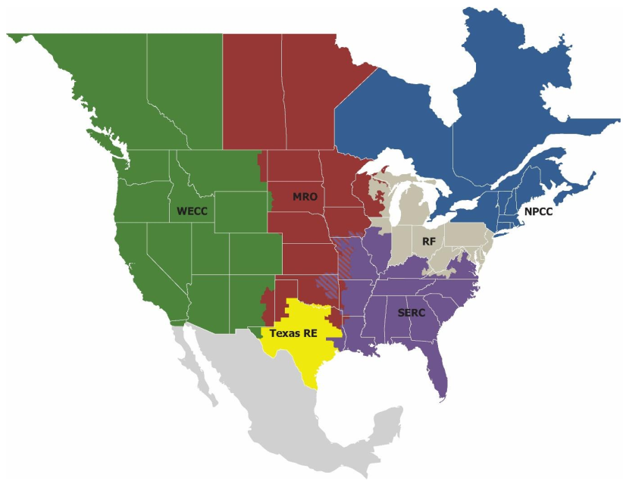
NERC 2022 Summer Reliability Assessment
North American Electric Reliability Corporation (NERC)
Reliability Coordinators
2022 Summer Reliability Assessment
Energy output from hydro generators throughout most of the Western United States is being affected by widespread drought and below-normal snowpack. Dry hydrological conditions threaten the availability of hydroelectricity for transfers throughout the Western Interconnection.
Some assessment areas….depend on substantial electricity imports to meet demand on hot summer evenings and other times when variable energy resource output is diminishing. In the event of wide-area extreme heat event, all U.S. assessment areas in the Western Interconnection are at risk of energy emergencies due to the limited supply of electricity available for transfer.

Slide 7
NERC 2022 Summer Reliability Assessment
North American Electric Reliability Corporation (NERC)
Reliability Coordinators
2022 Summer Reliability Assessment
FERC Chairman Richard Glick
  “These issues aren’t going away – they are more serious”
FERC Member James Danly
  “Our markets are not doing a great job of ensuring resource adequacy.”
FERC Member Marc Christie
  “I think what came through the NERC report is we have to deal with reality, not ideology.”

Slide 8
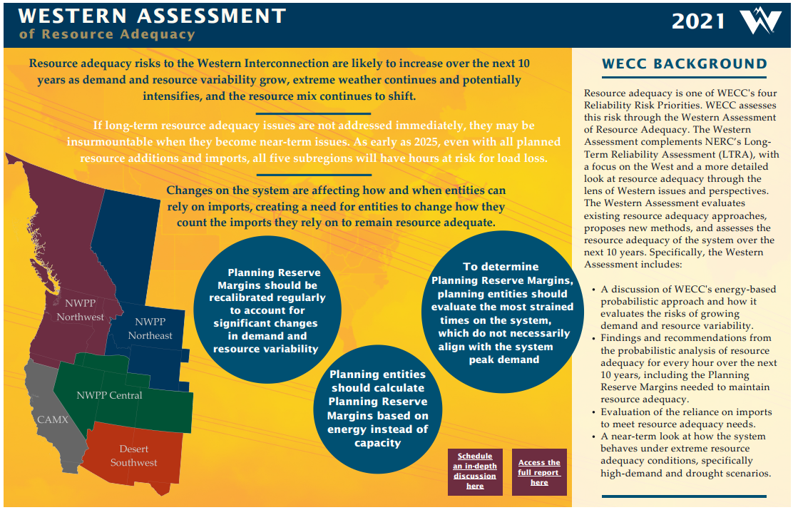

Western Interconnection Reliability Concerns
“If long-term resource adequacy issues are not addressed immediately, they may be insurmountable when they become near-term issues.”
“As early as 2025, even with all planned resource additions and imports, all five subregions will have hours at risk for load loss.”

Slide 9
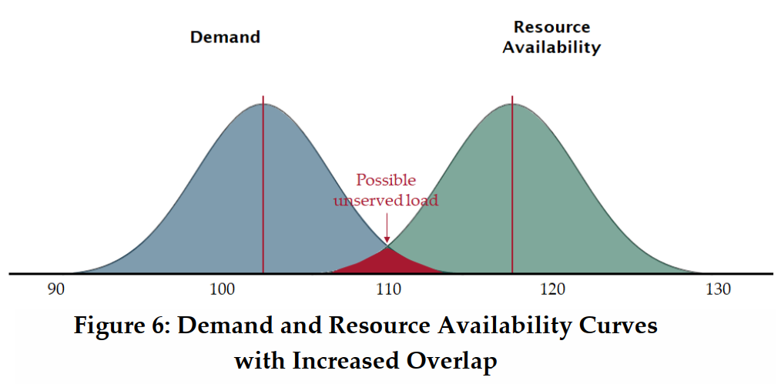
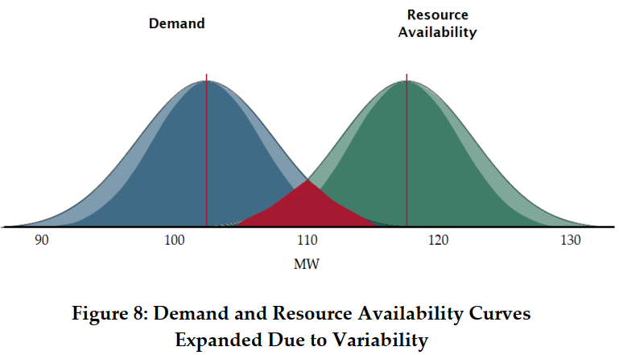
Variable Resources & Extreme Weather Concerns
Playing the probability game
“When one or both of the curves change shape, and nothing else changes, the overlap of the two curves can increase, boosting the likelihood that demand will exceed resource availability”
“Planning entities should calculate Planning Reserve Margins based on energy instead of capacity”

Slide 10
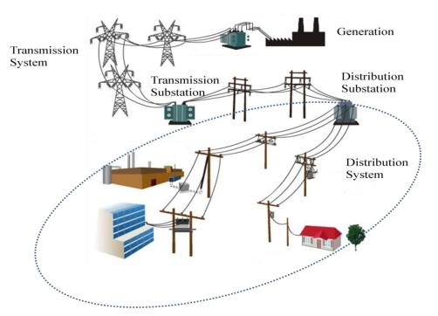
Electricity is Simultaneously…
Produced
Delivered
Consumed

Slide 11

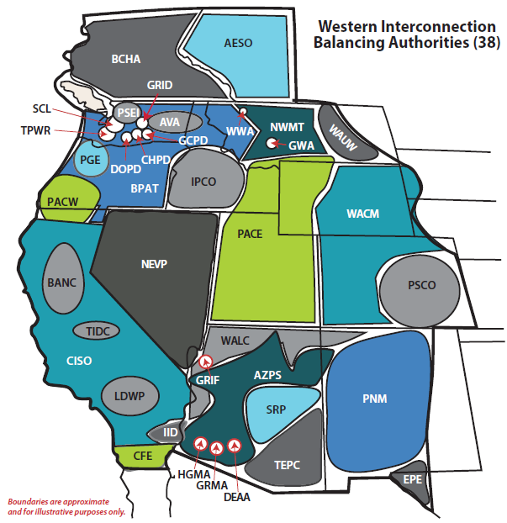
Load/Resource Balancing in the West
Electrical Demand and Supply Must Be Equal at All Times
Resource Adequacy: Is there enough supply to meet demand across a range of foreseeable conditions?
“Balkanized” Planning
No mandatory or voluntary national planning standard
Each Balancing Authority establishes its own standard
Utilities, state commissions and local governing bodies ultimately responsible
Notes:
4,000 MW OF FIRM GENERATION IS BEING RETIRED IN THE NWPP. THERE IS NO ORGANIZATION IN THE NORTHWESTERN UNITED STATES RESPONSIBLE FOR RESOURCE ADEQUACY PLANNING
ONLY RELIABILITY REQUIREMENTS ARE OPERATIONAL
ANTI FOSSIL FUEL AND ANTI NUCLEAR SENTIMENT COMBINED WITH STRONG WIND AND SOLAR POWER ADVOCACY HAS PUSHED UTILITIES INTO A GAME OF CHICKEN.

Slide 12
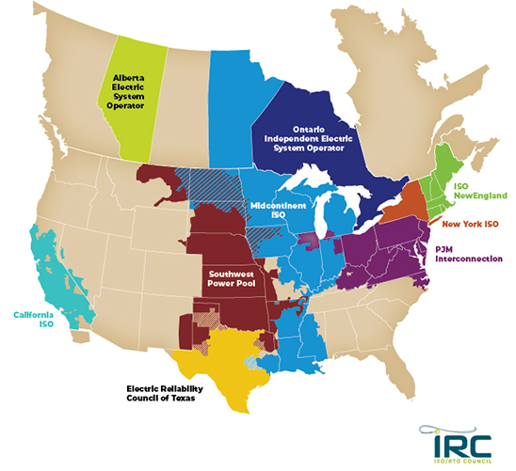
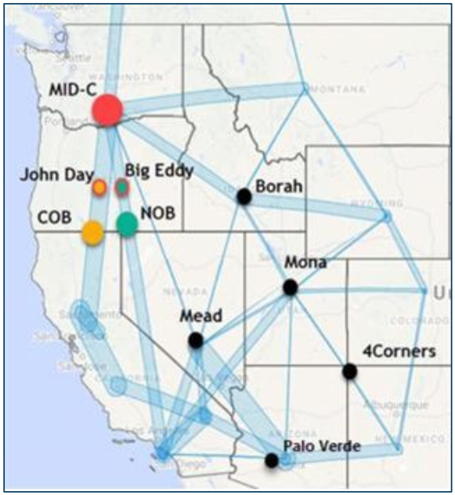
ISO & RTO - Integrated Grid Planning & Ops
Western Interconnection
Not Fully Integrated, however:
Bilateral trading in the Western Interconnection happens across various time horizons and at several trading hubs
Over 400,000 GWh of electricity is traded & delivered between BAA every year (45,662 aMW)
Trade represents ≈$20 billion per year

Slide 13
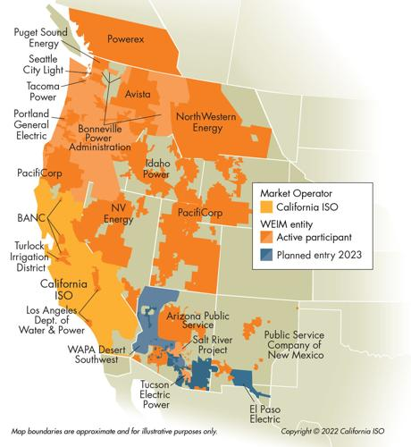
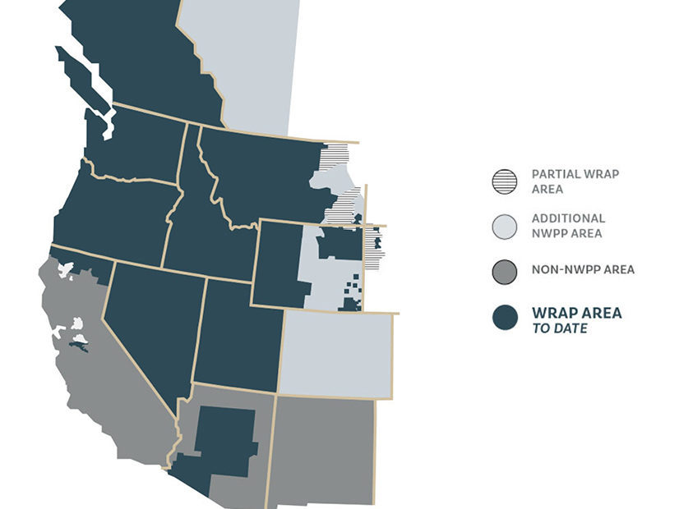
Western Interconnection Integration (Underway)
Western Energy Imbalance Market (WEIM)
Within the hour Balancing – “Small” $ Transactions
Western Resource Adequacy Program (WRAP)
Contractually Binding Planning Commitment 2024?

Slide 14

Western Interconnection Integration (Possible)
Western Energy Imbalance Market (WEIM)
Within the hour Balancing – “Small” $ Transactions
Extended Day Ahead Market (EDAM)
“Big” $ Transactions
Additional voluntary market service offered to WEIM entities
Does not require full integration into the California ISO balancing area
Improve market efficiency by integrating renewable resources using day-ahead unit commitment and scheduling across a larger area
Challenges
Governance (California Centric)
  Preserving preference rights of Bonneville Power Administration customers
Price Formation
  Properly accounting for natural gas ( & other fast start) pricing
  Overall value of hydro

Slide 15

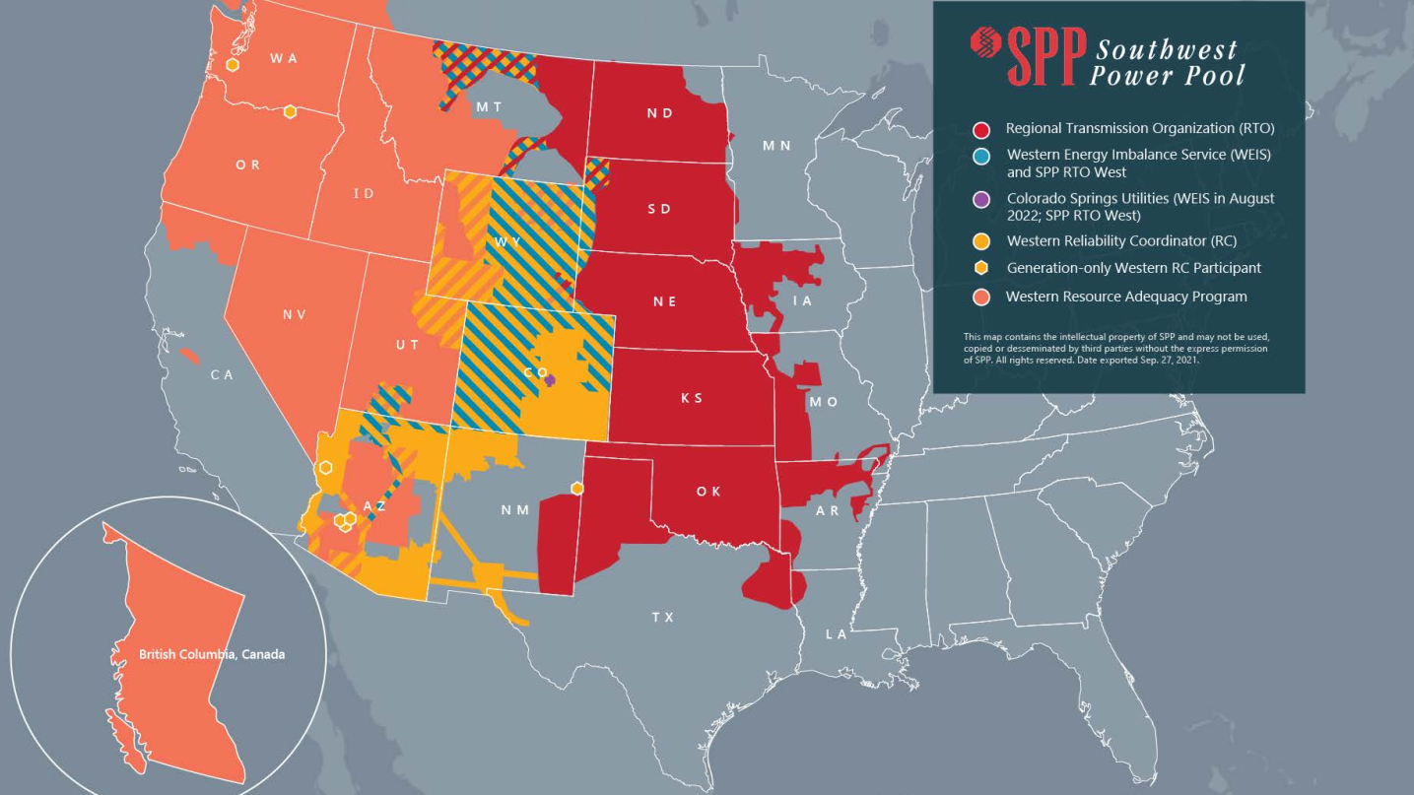
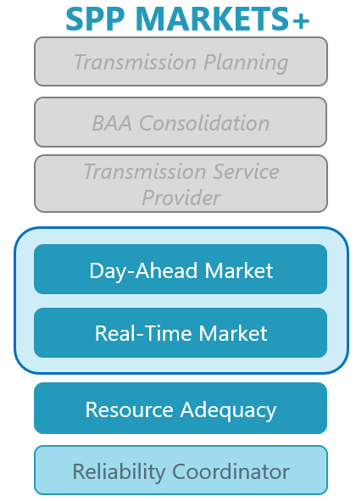
Western Interconnection Integration (Possible)
Option being considered
WRAP Underway

Slide 16
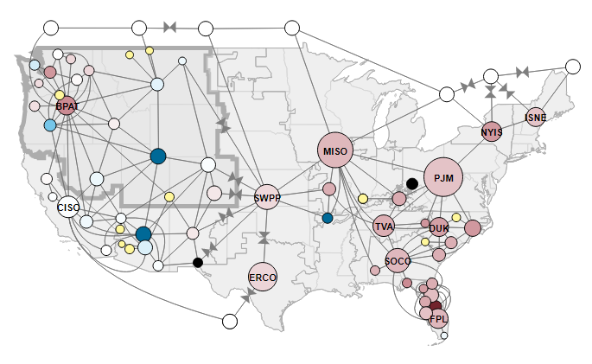
Sharing Capacity Between Balancing Authorities
High level of operational coordination
Maintain demand (Load) & supply (Resource) balance through scheduled generation imports and exports
Expanded “Northwest” Footprint

Slide 17
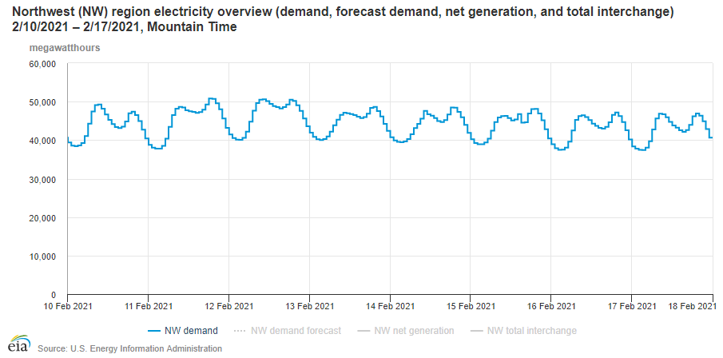
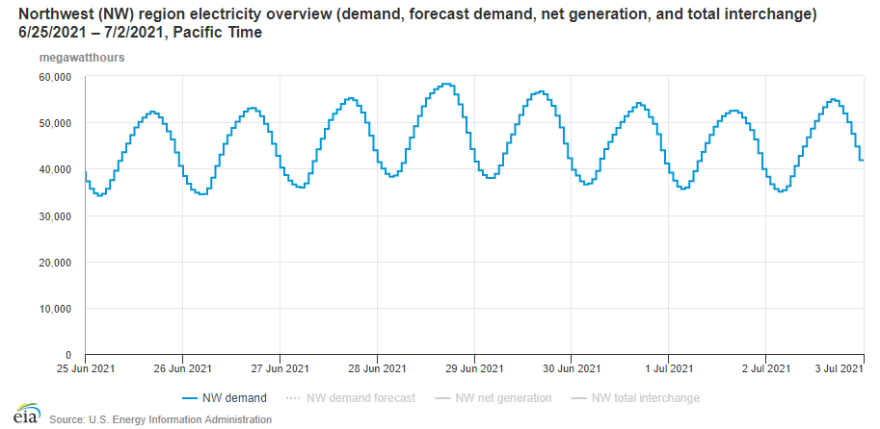
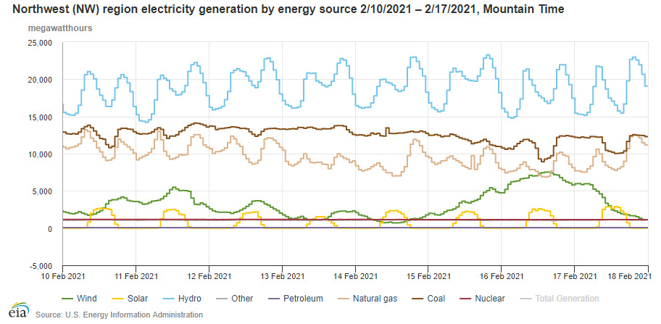
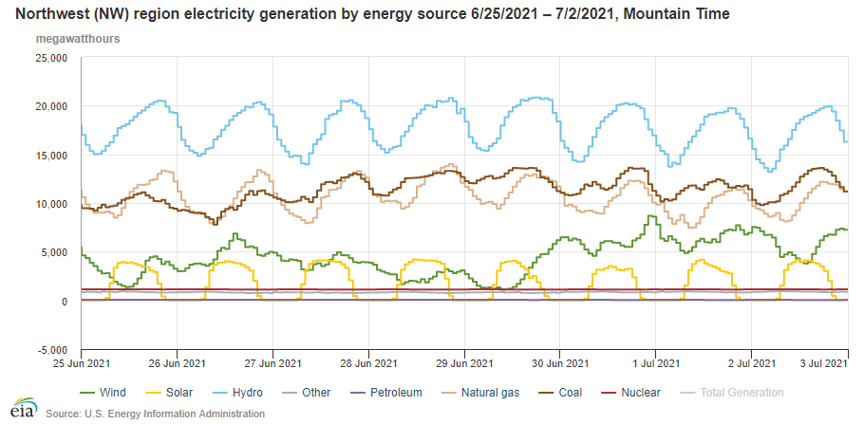
Hydro Dominates Load/Resource Balance in NW
Electricity Demand
Coldest Winter Days Feb 2021
Electricity Demand
“Heat Dome” June 2021
Electricity Demand is the
Rhythm of Life
Energy is area under curve (must be filled in precisely)
Capacity is energy plus contribution to following demand curve
Hydro is premier baseload & load following energy & capacity resource in the “Northwest”
Base Load & Load Following (Capacity)
Hydro
Coal/NG
Nuclear
Wind
Solar
Looks Like
“Negative Load”
Wind/Solar Low Effective Capacity

Slide 18
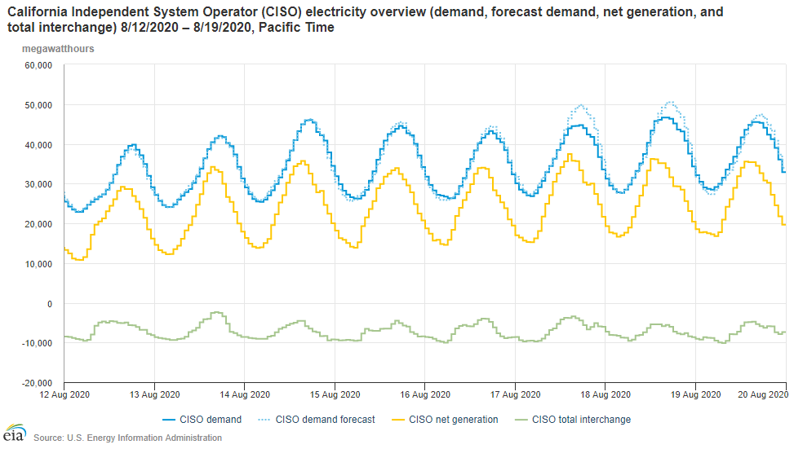
California Demand/Supply Already Fragile?
Electricity (Demand)
46,024 MW @ 6 pm
Net Generation within CISO
(Supply)
Rolling Blackouts
August 15 and 16
Total Generation
Imported into CISO
(Supply)
What if it doesn’t show up?

Slide 19
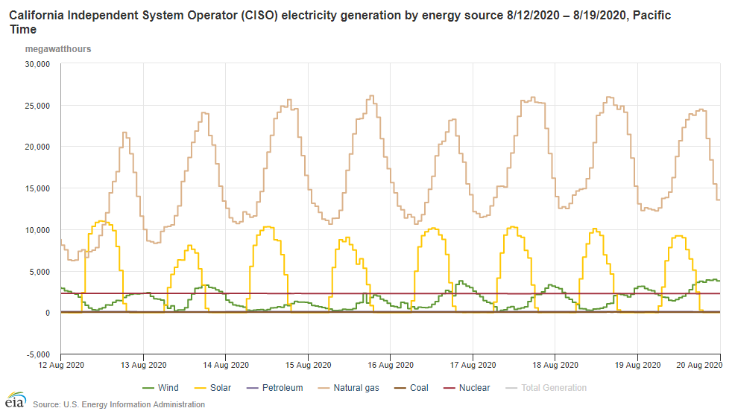
CA Depends on Natural Gas & Imports for Reliability
Load/Resource Balance Requires both Capacity and Energy
There is no free lunch when it comes to reliable grid operations
Rolling Blackouts
August 15 and 16

Slide 20
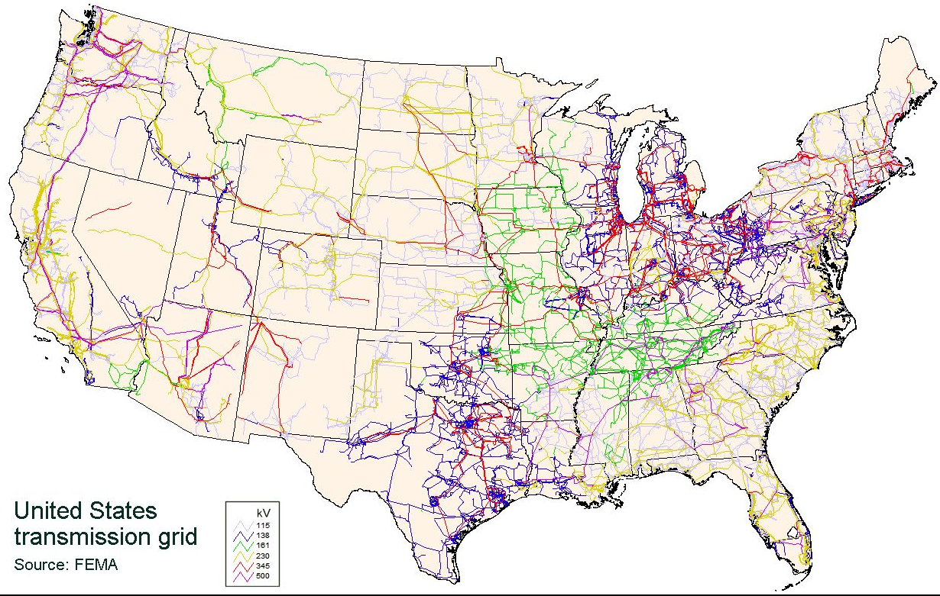
PNW & California Exports/Imports
Transmission lines move electricity from generating plants to population centers
Take advantage of generation and load diversity
Electricity flows according to the laws of physics not energy policies
Pacific
DC & AC Interties
8,000 MW

Slide 21
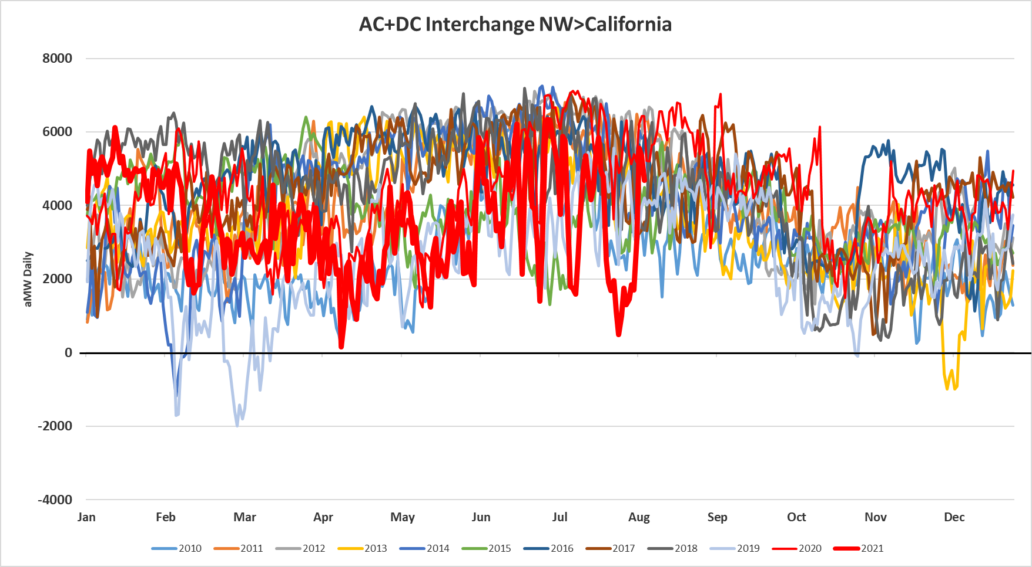
PNW & California Exports/Imports
PNW exports to CA almost always

Slide 22
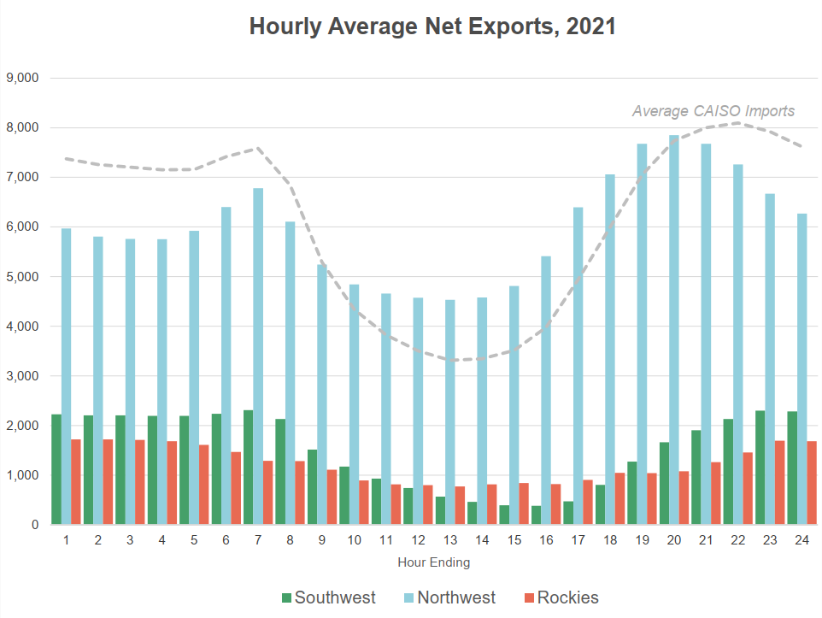

CAISO Trade Relative to Rest of West
CAISO Balancing Area Authority:
was a net exporter in only 3% of 5-minute intervals in 2021
In vast majority of hours is a purchaser and the rest of the west is a seller of wholesale electricity
energy imports greatest outside of solar hours

Slide 23
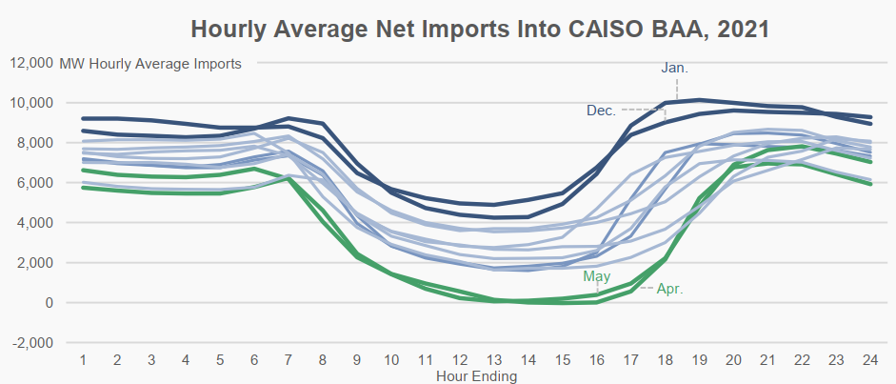
CAISO Trade Relative to Rest of West
CAISO Balancing Area Authority:
Requires imports to meet peak demand and ramping needs in evening, and sometimes in morning of some months
Internal resources insufficient to meet demand in critical hours:
  Some imports procured in advance
  Capacity “gap” of up to 4,000 MW must be filled in CAISO spot markets
  imports represent key source of additional potential supply

Slide 24
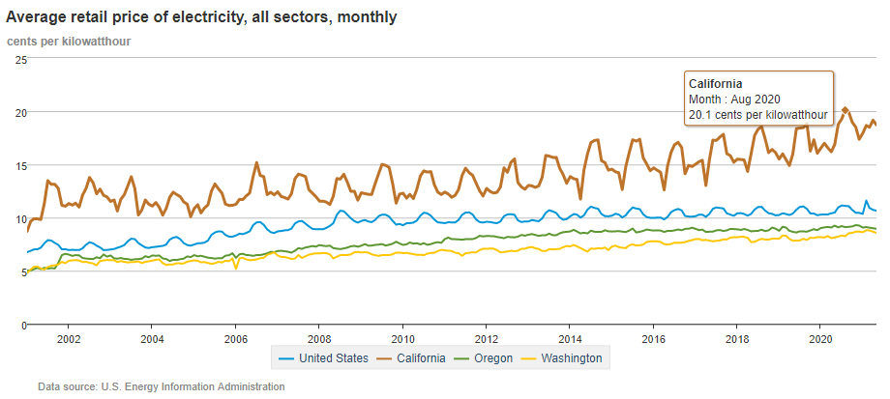
Low-Cost Renewables & Increasing Retail Rates?

Slide 25
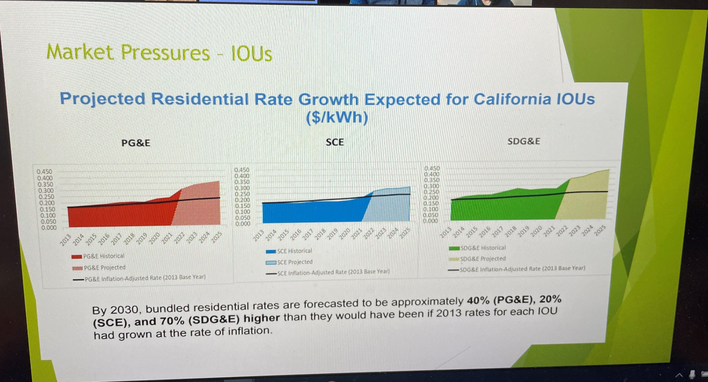
Low-Cost Renewables & Increasing Retail Rates?
Residential Rates Expected to Increase:
$0.30 to $0.42 /kWh

Slide 26
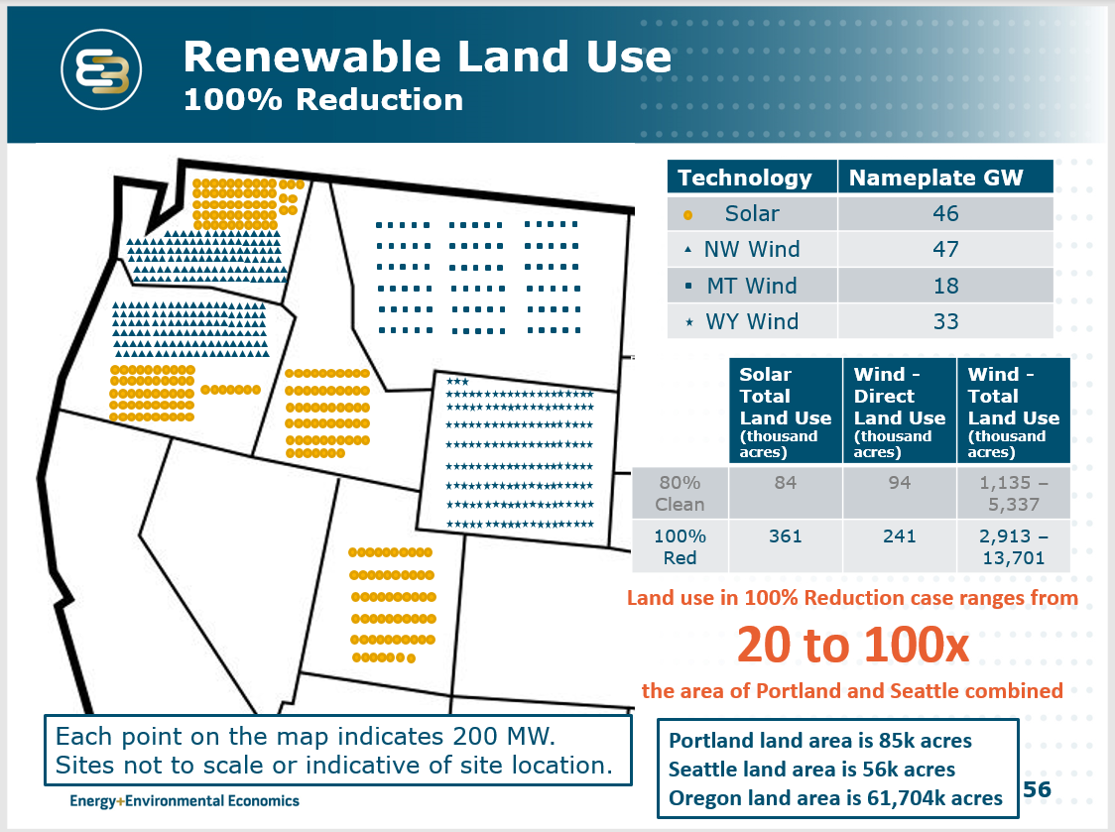

Land Use Impacts of Wind & Solar
Transmission Lines Needed to Bring
Wind and Solar Power to Population Centers
Assumes 100% of Existing Hydropower stays in Place

Slide 27
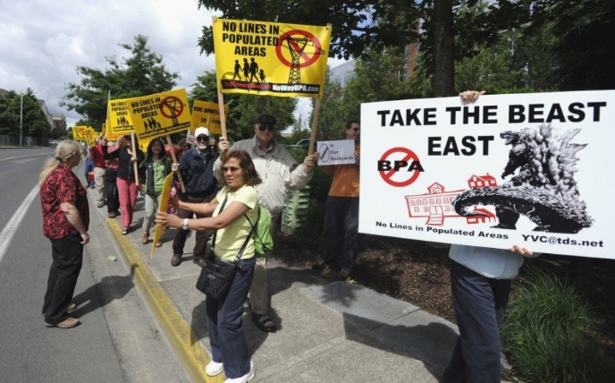
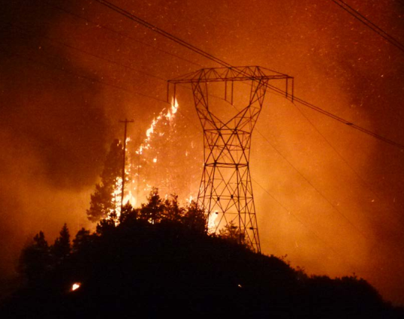
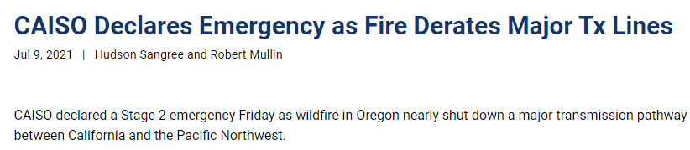
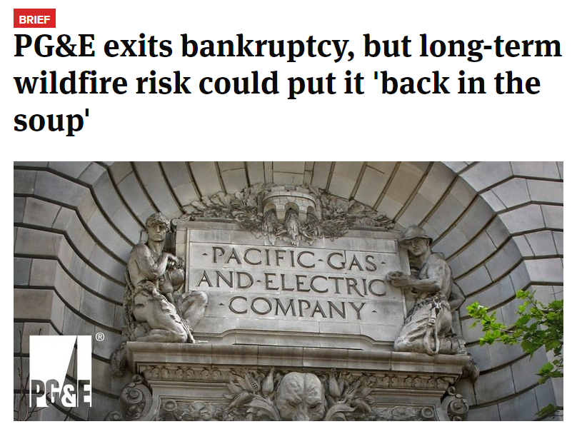
Transmission Line Development Friction
Preemptive power line shutoffs and blackouts
Increased utility legal and financial risks
Historical View: Avoid building if at all possible
Current View: Building more transmission lines is critical to clean energy future
Dispersed wind and solar multiplies needed transmission line corridors
Rural and scenic areas will bear the burden
Long lead times for permitting and construction (+20 years?)

Slide 28
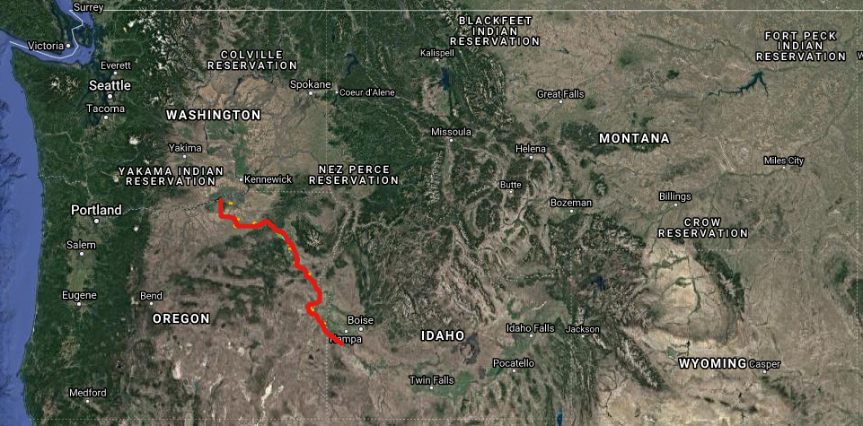
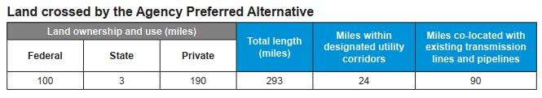
Boardman-to-Hemingway 500 kV Line
300 miles
Need identified 2002
Project defined 2006
Complete by 2026?
Raises serious questions about WA doubling electricity capacity and counting on Montana & Wyoming Wind & Solar
Are MT and WY on board with WA strategy?

Slide 29


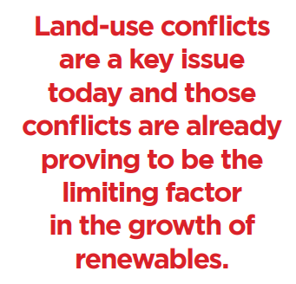
Land-Use Conflicts
Source: https://www.americanexperiment.org/reports/not-in-our-backyard

Slide 30
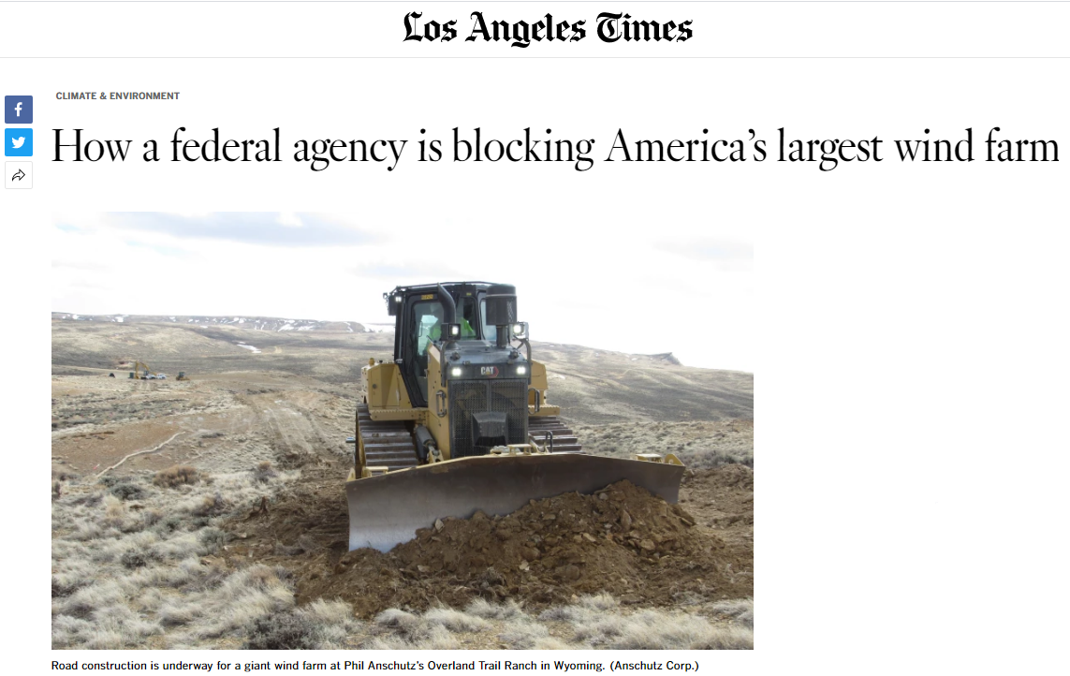
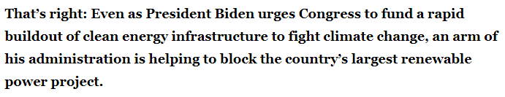

Policies in Conflict
Renewables vs. Conservation

Slide 31
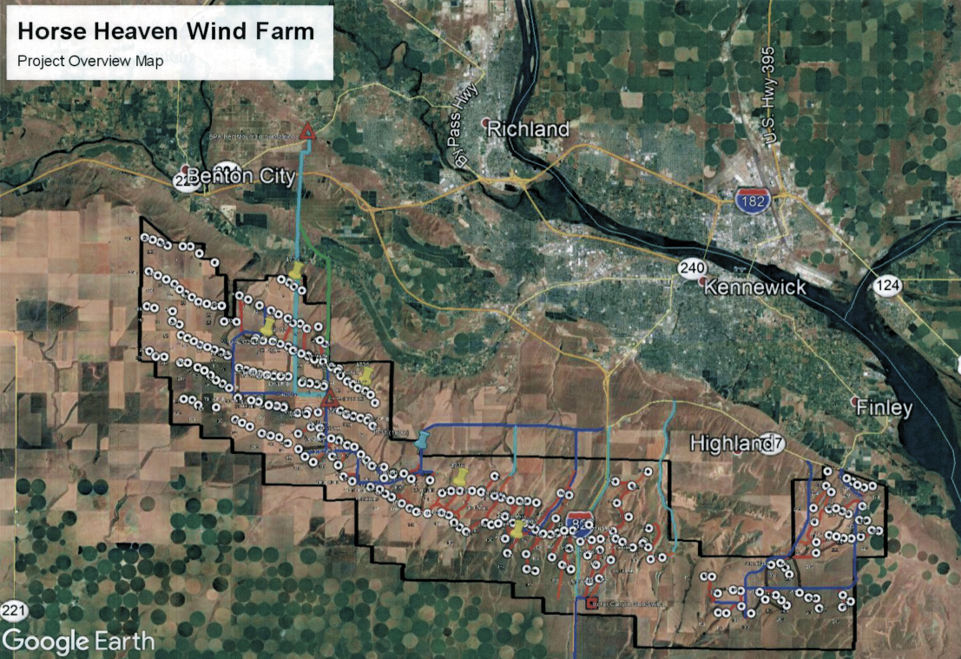
Benton County Wind Farm: A WA Case Study
850 MW Wind Project
Benton County
244 Wind Turbines
Up to 600 feet tall
72,428 acres (113 square miles)
Developer using EFSEC process to gain Governor Inslee’s approval
Overwhelming local opposition

Slide 32
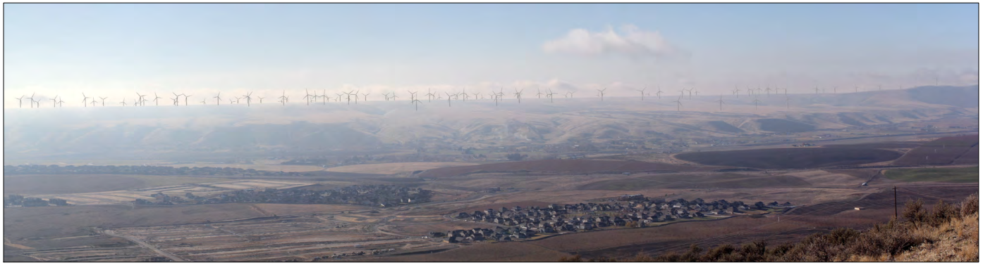

Benton County Wind Farm: A Case Study
Deserts and arid lands are habitats too . . . for animals & people
“These areas, as well as the entire Horse Heaven Hills ridgeline, are used seasonally and year-round by a variety of avian species, some of which are State, Priority, Candidate, and Threatened Species. In fact, the entire Horse Heaven Hills ridgeline is an important area for avian species and other wildlife, including reintroduced Pronghorn antelope. It is a strategic location that provides suitable habitat for a variety of native plant and wildlife species and has been recognized as such through a variety of scientifically validated stakeholder publications.”

Slide 33
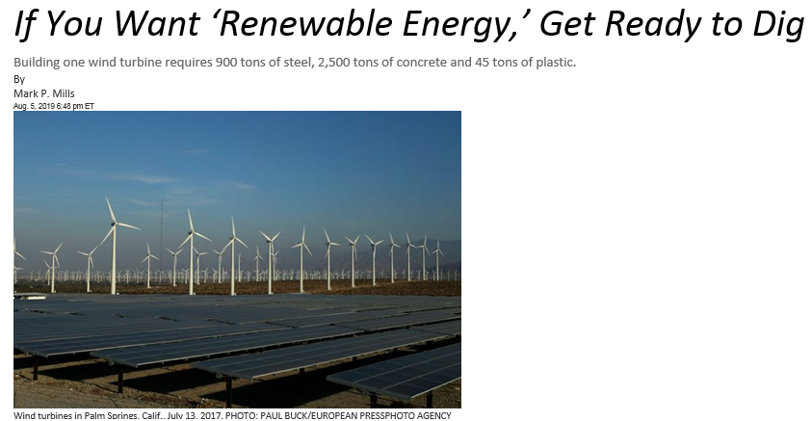
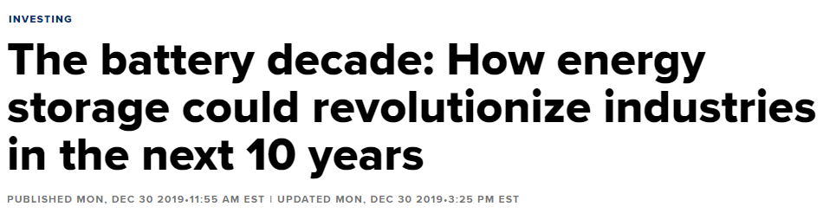
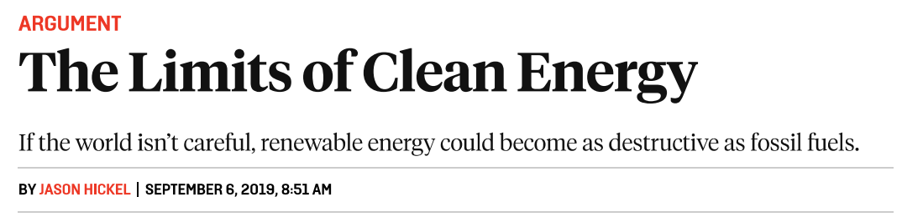
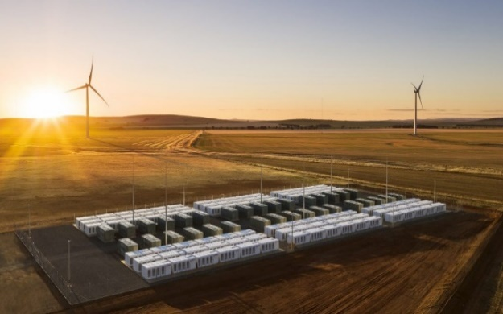
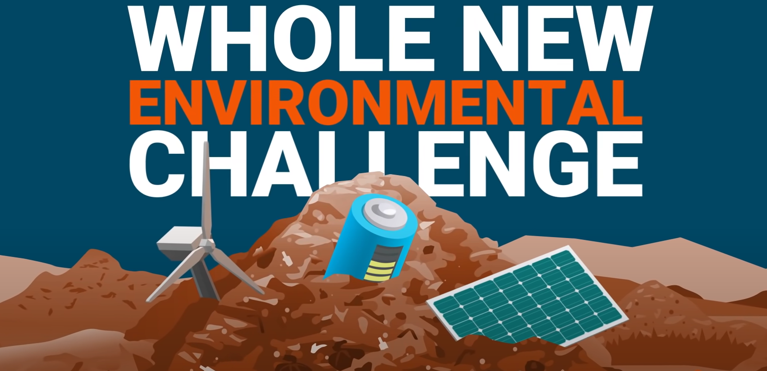
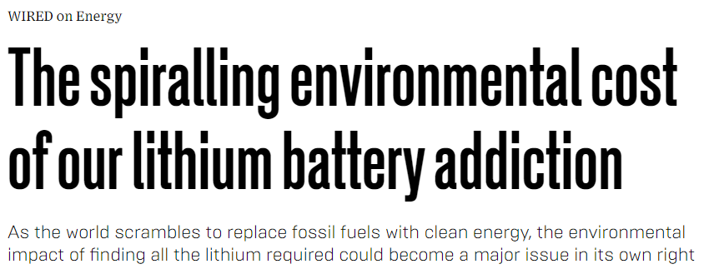
Unspoken Environmental Costs
We should at least be talking about this
Is social cost of carbon the only environmental cost worth considering?
Are there stricter limits we should be putting on wind/solar development?
Source: https://www.prageru.com/video/whats-wrong-with-wind-and-solar/

Slide 34
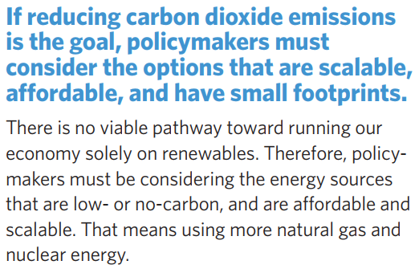
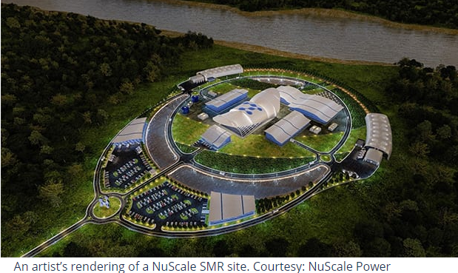
Power/Energy Density Matters to the Environment
Source: https://www.americanexperiment.org/reports/not-in-our-backyard
1,000 aMW of wind power = 500 to 1,000 square miles of land
720 MW NuScale Small Modular Reactor Complex = 0.05 square miles of land

Slide 35
Path Forward Worth Considering
Keep hydro in place & continue investments in habitat, hatcheries and harvest
Build new natural gas (some) to replace coal
Cap wind and solar development (eliminate in some areas)
Support development of advanced nuclear power
  Large amounts of reliable (always on) and non-emitting energy on a small footprint
  Reduced need for long-distance transmission lines
    Ultimately could be built near population centers
  Responsive to strong push for electrification of transportation and natural-gas end uses
  Export technology to other nations (true global leadership)

Slide 37
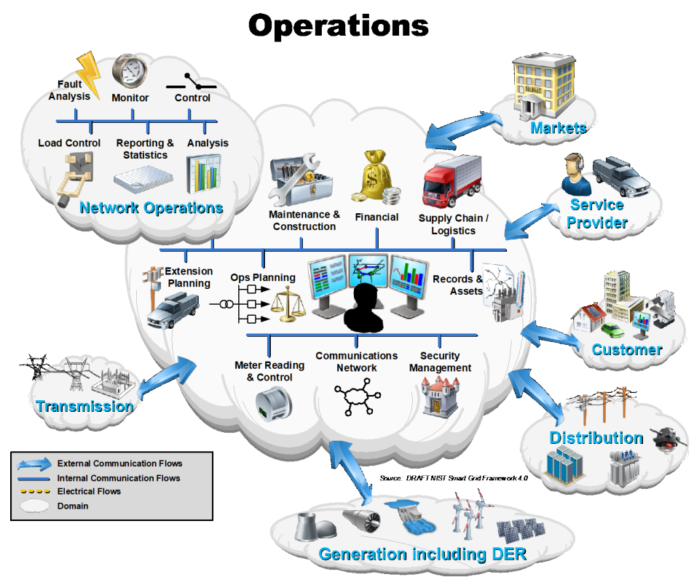

Slide 38
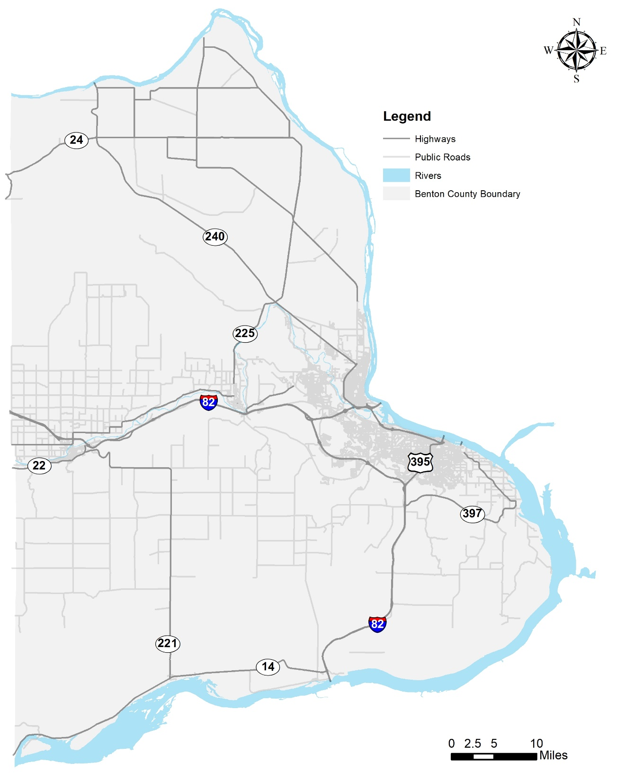
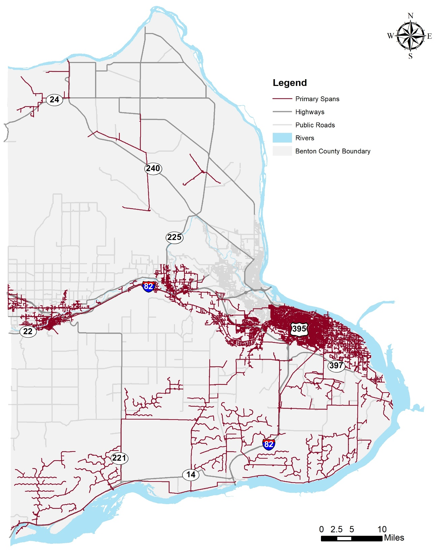
Benton PUD Service Territory
38
Service Connections: 55,725
939 Square Miles
  Kennewick
  Finley
  Benton City
  Prosser
Miles of Line:
  Transmission - 98
  OH Distribution – 781
  UG Distribution – 949
Substations: 39
Notes:
Start with overview of where Benton PUD serves. Define where our “GRID” is.

Slide 39
Technology Integration - Smart Grid Planning
Notes:
We have engaged for a number of years starting in 2006 with formal Strategic Technology Planning. This diagram from 2008 showcased our thoughts on a conceptual smart grid framework that tightly integrated information systems in the office to the various sensors, components, and equipment in the field throughout our service territory. These integrated systems would interact over a ubiquitous communications platform made up of a number of technologies that would enable us to offer better system visibility, customer services, etc

Slide 40

“Operations” Focus
Maximize Telecommunications Capability
Notes:
Visualization and control of critical system devices
Real-time awareness of system load/peak
Customer information and awareness

Slide 41



Telecommunications History 1950-1989
41
Radio Communications for crews
VHF FM Analog, Voice Only
FCC-licensed Spectrum
Prosser
Kennewick Ops
Prosser Butte
Joe Butte
VHF FM Radio Communications
Notes:
Benton PUD was approached by the Department of Community Development (now Washington State Emergency Management) in 1992 to partner with them to develop an emergency communications system to support the Chemical Stockpile Emergency Preparedness Program (CSEPP)
The Microwave Network is a communication ring around Benton County that provides the backhaul for data transport for public agencies in Benton County
The District entered an agreement to build three radio tower sites and agreed to operate and maintain the sites: Prosser Butte, Umatilla, and Jump Off Joe.
The Microwave Network is a communication ring around Benton County that provides the backhaul for data transport for public agencies.
When the CSEPP project concluded in 2010, ownership of the Microwave Network was transferred to Benton County Emergency Services (BCES).
The Energy Northwest (ENW) facility at Rattlesnake completes the ring.
The microwave provides the backhaul to the 800 MHz system that is used for radio communications between District crews and Operations and other Emergency entities.
The District uses the microwave for Supervisor Control and Data Acquisition (SCADA) backhaul from the District to our substations and line devices.
The District uses the microwave for the information backhaul for Automated Meter Infrastructure (AMI) from the Tower Gateway Base Stations(TGB) to the District servers Regional Network Interface (RNI’s).
The District has installed fiber connections to Rattlesnake, Jump Off Joe and Prosser Butte for added reliability of the system.
Another “vehicle” for communications is through the VHF radio network.
This communication tool is being used by the Fire Districts which utilizes BCES Microwave Network but works separately from the 800 MHz radio system.

Slide 42
Telecommunications History 1989
42
Voltage Reduction Project
SCADA Master at Rattlesnake Mt.
10 Substations connected by radio
SCADA: 952 MHz
FCC-licensed Spectrum
1200 bps
Couldn’t reach S. Benton County!
Rattlesnake
Prosser
Kennewick Ops
Prosser Butte
Joe Butte
SCADA Communications
Notes:
Benton PUD was approached by the Department of Community Development (now Washington State Emergency Management) in 1992 to partner with them to develop an emergency communications system to support the Chemical Stockpile Emergency Preparedness Program (CSEPP)
The Microwave Network is a communication ring around Benton County that provides the backhaul for data transport for public agencies in Benton County
The District entered an agreement to build three radio tower sites and agreed to operate and maintain the sites: Prosser Butte, Umatilla, and Jump Off Joe.
The Microwave Network is a communication ring around Benton County that provides the backhaul for data transport for public agencies.
When the CSEPP project concluded in 2010, ownership of the Microwave Network was transferred to Benton County Emergency Services (BCES).
The Energy Northwest (ENW) facility at Rattlesnake completes the ring.
The microwave provides the backhaul to the 800 MHz system that is used for radio communications between District crews and Operations and other Emergency entities.
The District uses the microwave for Supervisor Control and Data Acquisition (SCADA) backhaul from the District to our substations and line devices.
The District uses the microwave for the information backhaul for Automated Meter Infrastructure (AMI) from the Tower Gateway Base Stations(TGB) to the District servers Regional Network Interface (RNI’s).
The District has installed fiber connections to Rattlesnake, Jump Off Joe and Prosser Butte for added reliability of the system.
Another “vehicle” for communications is through the VHF radio network.
This communication tool is being used by the Fire Districts which utilizes BCES Microwave Network but works separately from the 800 MHz radio system.

Slide 43


Telecommunications History 1992
43
WSEM Proposal for CSEPP
BPUD rebuilt Joe Butte & Prosser
PUD built Umatilla Ridge
WSEM Rebuilt Rattlesnake Mt.
Ring Architecture
800 MHz radio now simulcast
SCADA: Rattlesnake and Umatilla
Rattlesnake
Prosser
Kennewick Ops
Prosser Butte
Joe Butte
1992: WSEM Microwave Ring
Umatilla
Umatilla Chemical Depot
Notes:
Benton PUD was approached by the Department of Community Development (now Washington State Emergency Management) in 1992 to partner with them to develop an emergency communications system to support the Chemical Stockpile Emergency Preparedness Program (CSEPP)
The Microwave Network is a communication ring around Benton County that provides the backhaul for data transport for public agencies in Benton County
The District entered an agreement to build three radio tower sites and agreed to operate and maintain the sites: Prosser Butte, Umatilla, and Jump Off Joe.
The Microwave Network is a communication ring around Benton County that provides the backhaul for data transport for public agencies.
When the CSEPP project concluded in 2010, ownership of the Microwave Network was transferred to Benton County Emergency Services (BCES).
The Energy Northwest (ENW) facility at Rattlesnake completes the ring.
The microwave provides the backhaul to the 800 MHz system that is used for radio communications between District crews and Operations and other Emergency entities.
The District uses the microwave for Supervisor Control and Data Acquisition (SCADA) backhaul from the District to our substations and line devices.
The District uses the microwave for the information backhaul for Automated Meter Infrastructure (AMI) from the Tower Gateway Base Stations(TGB) to the District servers Regional Network Interface (RNI’s).
The District has installed fiber connections to Rattlesnake, Jump Off Joe and Prosser Butte for added reliability of the system.
Another “vehicle” for communications is through the VHF radio network.
This communication tool is being used by the Fire Districts which utilizes BCES Microwave Network but works separately from the 800 MHz radio system.

Slide 44

Telecommunications Today
44
Some Substations use Radio
Fiber connected to:
  Joe Butte
  Rattlesnake Mt.
  Prosser Butte
  Kennewick Ops
  Prosser Ops
  26 substations
Wireless cellular to Line Devices
Rattlesnake
Prosser
Kennewick Ops
Prosser Butte
Joe Butte
``
Fiber, Cellular, Radio Communications
Umatilla
Notes:
Benton PUD was approached by the Department of Community Development (now Washington State Emergency Management) in 1992 to partner with them to develop an emergency communications system to support the Chemical Stockpile Emergency Preparedness Program (CSEPP)
The Microwave Network is a communication ring around Benton County that provides the backhaul for data transport for public agencies in Benton County
The District entered an agreement to build three radio tower sites and agreed to operate and maintain the sites: Prosser Butte, Umatilla, and Jump Off Joe.
The Microwave Network is a communication ring around Benton County that provides the backhaul for data transport for public agencies.
When the CSEPP project concluded in 2010, ownership of the Microwave Network was transferred to Benton County Emergency Services (BCES).
The Energy Northwest (ENW) facility at Rattlesnake completes the ring.
The microwave provides the backhaul to the 800 MHz system that is used for radio communications between District crews and Operations and other Emergency entities.
The District uses the microwave for Supervisor Control and Data Acquisition (SCADA) backhaul from the District to our substations and line devices.
The District uses the microwave for the information backhaul for Automated Meter Infrastructure (AMI) from the Tower Gateway Base Stations(TGB) to the District servers Regional Network Interface (RNI’s).
The District has installed fiber connections to Rattlesnake, Jump Off Joe and Prosser Butte for added reliability of the system.
Another “vehicle” for communications is through the VHF radio network.
This communication tool is being used by the Fire Districts which utilizes BCES Microwave Network but works separately from the 800 MHz radio system.

Slide 45







Fiber Network
45
Fiber Miles: >400
Customers: +750
Key Partners:
  DOE
  PNNL
  Energy Northwest
  Franklin PUD
  City of Richland
Substations: 26
Planned fiber extension

Slide 46

Expanding Fiber Network
46
Fiber Build: ~15 mi.
Substations: 6
  Paterson 1
  Paterson 2
  Sunheaven River
  Sandpiper
  Whitcomb
  Carma

Slide 47

Telecommunications Study
47
Improve operational visibility
Evaluate data throughput
Two-way communications
Device control capability
Remote programming
Fault data recovery
Fiber, wireless, cellular options
21st Century Telecommunications
Notes:
Benton PUD was approached by the Department of Community Development (now Washington State Emergency Management) in 1992 to partner with them to develop an emergency communications system to support the Chemical Stockpile Emergency Preparedness Program (CSEPP)
The Microwave Network is a communication ring around Benton County that provides the backhaul for data transport for public agencies in Benton County
The District entered an agreement to build three radio tower sites and agreed to operate and maintain the sites: Prosser Butte, Umatilla, and Jump Off Joe.
The Microwave Network is a communication ring around Benton County that provides the backhaul for data transport for public agencies.
When the CSEPP project concluded in 2010, ownership of the Microwave Network was transferred to Benton County Emergency Services (BCES).
The Energy Northwest (ENW) facility at Rattlesnake completes the ring.
The microwave provides the backhaul to the 800 MHz system that is used for radio communications between District crews and Operations and other Emergency entities.
The District uses the microwave for Supervisor Control and Data Acquisition (SCADA) backhaul from the District to our substations and line devices.
The District uses the microwave for the information backhaul for Automated Meter Infrastructure (AMI) from the Tower Gateway Base Stations(TGB) to the District servers Regional Network Interface (RNI’s).
The District has installed fiber connections to Rattlesnake, Jump Off Joe and Prosser Butte for added reliability of the system.
Another “vehicle” for communications is through the VHF radio network.
This communication tool is being used by the Fire Districts which utilizes BCES Microwave Network but works separately from the 800 MHz radio system.

Slide 50


Slide 51




“Transmission” Focus
Enhanced Substation Communications
Predictive Maintenance
Transmission Reliability
Facility Inspection Capability
Notes:
Voltage optimization - efficiency
Outage detection and response
System prediction and proactive response to failing infrastructure
T&D – looping distribution, replacing old relays, 24x7 reliability

Slide 52







Substation Communications
52
Real Time Automation Control (RTAC)
Feeder Relays
Remote Terminal
Unit (RTU)
UPGRADE
Fiber andCell Router
Yagi SCADA Antenna
Notes:
Show pic of rugged fiber router, cell net router, radio, yagi antenna – these are diff ways we communicate with devices and AMI
IT/Ot convergence – IT staff out in field working with field personnel to make it possible; Get pic of IT and OT guys in field setting

Slide 53

Substation Devices
53
SCADA Connected:
  Substations - 39

Slide 54


Increased BPA Operational Visibility
54
BPA 115kV Breaker Position Status

Slide 55




Substation Maintenance & Improvements
11 (urban) substations now fully upgraded
6 more to complete
New Metalclad at Ely
Upgrade of LTC
Relays at Ely
Circuit
Switcher
Notes:
What do previous and current efforts enable us to do?
Demand Response
FLISR
BB small cell
Communications study radios/SCADA
Voltage optimization
Further device automation
System Analytics planned (Tableau)
Visibility into BPA’s circuit breaker systems
Use of drones

Slide 56

Transmission Reliability Improvement Projects
56
BPA Red Mountain
Fall 2023
BPUD Budget: $0
Sunset to Dallas DELAYED
2023 Engr
2026 Construction
BPA Webber Canyon
2025
$80M
Completed 2018
City of Richland
115-kV Transmission Line Redundancy
Study Webber Canyon to Prosser and Horse Heaven
2022-23 Budget:
$6.5M total
Completed 2017
BPA McNary POD
Spring 2023
BPUD Budget: $463K
Notes:
The District has received and signed the construction agreements committing BPA to Construction of both the McNary POD in 2022, and the Red Mountain Breaker position in 2023 to coincide with the Sunset to Dallas transmission Line construction.

Slide 57




Expanded Use of Drone Technology
57

Slide 58

Drone Technology in Action – Facility Inspection
58

Slide 59

Drone Technology in Action – Infrared
59

Slide 62


Slide 63



“Distribution” Focus
Enhanced Line Device Communications
Increased Operational Visibility
Outage Detection and Response
Notes:
Voltage optimization - efficiency
Outage detection and response
System prediction and proactive response to failing infrastructure
T&D – looping distribution, replacing old relays, 24x7 reliability

Slide 64



“Distribution” Focus
Distribution Resiliency
Real-time Awareness/Peak load Analysis
Voltage optimization
Notes:
Voltage optimization - efficiency
Outage detection and response
System prediction and proactive response to failing infrastructure
T&D – looping distribution, replacing old relays, 24x7 reliability

Slide 65





Line Device Communications
65
Voltage Regulator
Sectionalizer
Faulted Circuit Indicators (FCI’s)
Line Recloser

Slide 66




Line Device Communications
66
SCADA Connected:
  Voltage Regulators - 50
  Reclosers - 34
  Sectionalizers - 4

Slide 67



Increased Operational Visibility
67
Faulted Circuit Indicators (FCI’s)
BPA 115kV Breaker Position
Control Capacitor Bank

Slide 68

Increased Visibility: Drone in Action – Rattlesnake Mt.
68

Slide 69




Fault Location, Identification – Outage Response
69

Slide 70

Distribution Resiliency
70
Resilience: How quickly the system recovers from a disruptive event
FLISR – Requires reliable communications & more devices

Slide 71

Analytics: Situational Awareness
71

Slide 72





Creating Virtual Meters – Anywhere!
72
KW
KW
KW
KW

Slide 73




Voltage Optimization
73
End of Line Voltage Sensing
New Cap Bank
End of Line Meter

Slide 74

Voltage Optimization
74
Remove/Upgrade Capacitor Banks
ANSI Utility Standard Operating Range 114V-126V
Power = Volts x Current
BPUD currently operates 124V at Source correlating to 122V at EOL
Lowering and Managing the Voltage
Goal is to reduce source to 120V and 118V at EOL
EOL
EOL
Balance Loading
Source
Source

Slide 77


Slide 78






“Customer” Focus
Optimize AMI Capability
Advanced Analytics
Enhanced Customer Interaction
Renewable Energy (Solar)
Electric Vehicles
Demand Response
Notes:
Voltage optimization - efficiency
Outage detection and response
System prediction and proactive response to failing infrastructure
T&D – looping distribution, replacing old relays, 24x7 reliability

Slide 79



AMI Network Architecture
79
Cold Creek
55,960 AMI meters deployed
900 MHz
FCC-licensed spectrum
Proprietary protocol w/encryption
Point-to-multipoint architecture
Meter-to-buddy communications
Can use Ring as backhaul
Added Badger Mt. Base Station
Fiber network is primary backhaul
Added 4 - R100 Mini Base Stations
Meters communicate with Sensus
Successful operation since 2009
Seattle POP
Rattlesnake
Portland POP
Prosser
Benton City
Badger
Kennewick Ops
Prosser Butte
Finley
Joe Butte
Boise, Idaho
Berrian
Umatilla

Slide 80



AMI Coverage
80

Slide 81


Advanced Meters: Enabling Technology
81
Coming Soon: Stratus IQ
Open Neutral Detection
“ESM Lite”
  Select Meters (Enhanced Features can be Enabled)
Patented high-temperature detection
  Improved Hot Socket Detection
Improved Water Intrusion Prevention
6 energies, 6 demands
8 load profile channels
Four quadrant metering
Expanded LCD with multiple enunciators
  Voltage Display
20-year Time-of-Use calendar
Current Capabilities with AMI
Remote Service Connection & Disconnection
On-Demand Reads
Service Theft and Tamper Detection
Power Quality Monitoring
Outage Detection and Reporting
Hot Socket Detection

Slide 82

Analytics: AMI Meter Alerts
82

Slide 83

Analytics: Load Shape by Customer Class
83
Cold Winter Day Load Shape
Morning Peak Demand

Slide 84

Analytics: Load Shape by Customer Class
84
Hot Summer Day Load Shape
Evening Peak Demand
Solar “Duck Curve”

Slide 85

Customer Interaction: Smart Hub®
85
Enable Active Participation by Consumers
Internet Access to Energy Use Data
Tablet, Smart Phone, PC
24 x 7
Other

Slide 86




Customer Interaction: Smart Hub®
86
Outage Status
Customer Usage
Profiles
and Notifications

Slide 87



Customer Interaction: “Pay As You Go”
87
Customers monitor, manage and pay for electricity in advance with NISC’s Prepaid Metering.
Customers monitor their account and keep their meter full just like their car’s gas tank.

Slide 88

Renewable Energy - Solar
88
693 Customers
5.06 Peak MW
7.09 MW Nameplate

Slide 89

Locations of Renewable Energy Installations
89
693 Solar Installations

Slide 90

Electric Vehicles
90
68k+ in WA
722 in Benton County
4 aMW over 20 Yrs

Slide 91

Demand Response
91

Slide 94


Slide 96


Slide 97
Questions?

