Slide 1


BPA Provider of Choice
Above Contract High Water Mark (Above-CHWM) Election
June 23, 2026
Information Only

Slide 2
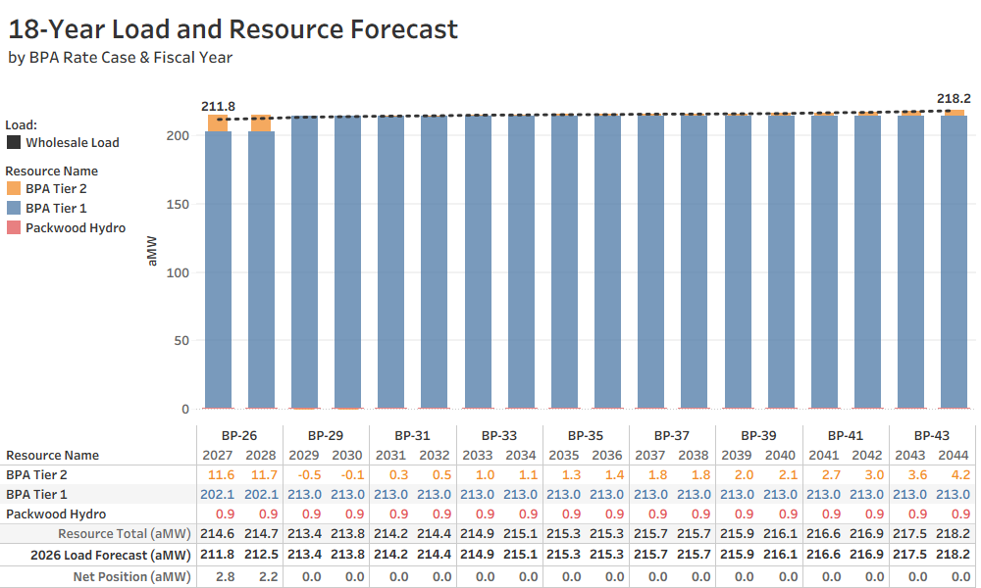
Benton PUD’s Resource Plan
16-Year Provider of Choice Contract
Resource Plan is to serve Above-CHWM with BPA Tier 2
Tier 2 load forecast is relatively small
BPA Tier 1 CHWM increases to 213.007 aMW effective 10/1/2028

Slide 3
Above-CHWM Forecast
BPA Above-CHWM Process
  Recurring process proceeds each 2-year rate period
  Load forecasts to be finalized every December prior to rate period
  Starting May 2027, then every May prior to rate period
Tier 2 Annual Cost Forecast
Fiscal Year | Tier 2 aMW | Tier 2 MWh | Tier 2 Rate ($/MWh) | Tier 2 Annual Cost | BPA Power Total Cost | Tier 2 % of Total Cost | *Estimated Retail Rate Impact %
FY 2027 (BP-26) | 11.564 | 101,301 | $67.40 | $6,827,663 | $69,220,368 | 9.9% | N/A
FY 2028 (BP-26) | 11.740 | 102,842 | $67.70 | $6,962,430 | $68,889,962 | 10.1% | N/A
FY 2029 (BP-29) | 0.000 | 0 | $75.00 | $0 | $69,881,791 | 0.0% | N/A
FY 2030 (BP-29) | 0.000 | 0 | $75.00 | $0 | $70,077,262 | 0.0% | N/A
FY Future 1 | 5.000 | 43,800 | $75.00 | $3,285,000 | $70,077,262 | 4.7% | 1.1%
FY Future 2 | 5.000 | 43,800 | $100.00 | $4,380,000 | $70,077,262 | 6.3% | 1.9%
FY Future 3 | 10.000 | 87,600 | $75.00 | $6,570,000 | $70,077,262 | 9.4% | 2.2%
FY Future 4 | 10.000 | 87,600 | $100.00 | $8,760,000 | $70,077,262 | 12.5% | 3.8%
Power Cost Forecast as of 6/22/2026
What-If
Scenarios
*Estimated retail rate impact assumes costs partially offset by increased retail revenue.

Slide 4
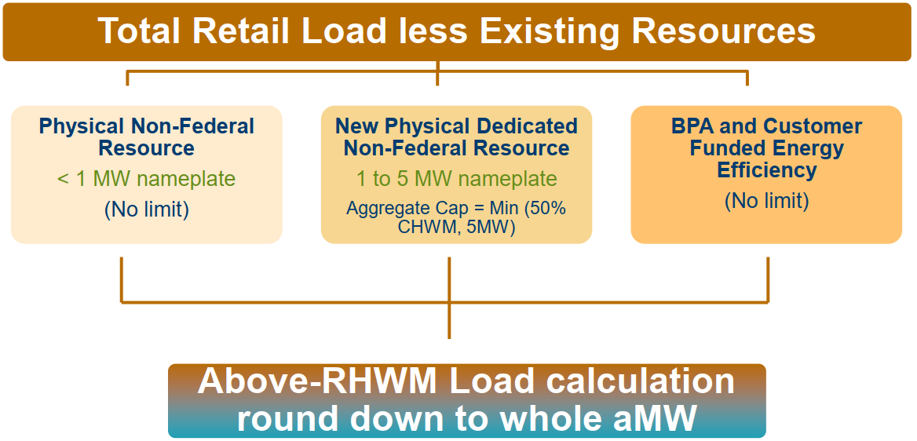
Before Above-CHWM Load Service Options
Notes:
2.3.3.1 PF Tier 1 Non-federal Resource Allowance
Bonneville will provide an allowance for customers to add qualifying non-federal resources to offset load that would have otherwise been served by federal power priced at a PF Tier 1 rate or would have been subject to take-or-pay provisions. Customers will be allowed to add up to an aggregate of 5 megawatts (MWs) of non-federal resources or 50% of their CHWM, whichever is less. When a customer applies a qualifying non-federal resource under this allowance, it will not reduce their CHWM, but it may reduce the amount of power they are eligible to purchase at a PF Tier 1 rate and may create headroom for the customer unless they have a firm load need such as Above-CHWM load. The non-federal resource allowance will be similar to the Small Non-dispatchable New Resource Treated Equivalently to an Existing Resource Exception (SNEER Exception) adopted under Regional Dialogue that allows Bonneville to treat a customer’s small renewable resources like existing resources.
To qualify for this allowance, the non-federal resource must be: 1) a new (does not exist pre-2028) identified customer-owned generating resource, 2) connected to a customer’s distribution system, and 3) dedicated under the customer’s Provider of Choice contract. Market purchases, or unspecified resources, will not be eligible for this allowance. Bonneville would not require a customer to purchase and apply resource support services (RSS) to support the non-federal resources that qualify for this allowance, but the customer could be subject to any additional capacity costs created by the addition of such resources. When determining the size of a resource relative to the aggregate 5 MW limit, Bonneville will use the nameplate capacity of the resource.
The non-federal resource allowance will provide customers flexibility to add certain non-federal resources even if their loads are not growing. However, the limitations to the total allowance granted (aggregate of 5 MWs or 50% of their CHWM, whichever is less) ensure that one customer’s resource decisions do not create significant cost shifts in the Tier 1 cost pool. The allowance is specific to each customer. Each utility within a joint operating entity would have its own allowance; the allowance will not be aggregated for the entity. The allowance thereby honors the foundational tenets of tiered rates and balances flexibility and costs.
2.3.3.2 Non-federal Resource Minimum Threshold
Bonneville will raise the minimum threshold required for a customer’s non-federal resource to be included and tracked in the power sales contracts from a nameplate of 200 kilowatts to 1 MW. There will be no limit to the number of non-federal resources a customer can add under 1 MW and these resources will not be counted towards the allowance described in Section 2.3.3.1. However, customers will continue to be required to comply with any requirements outlined in their transmission contracts, including any metering requirements.

Slide 5
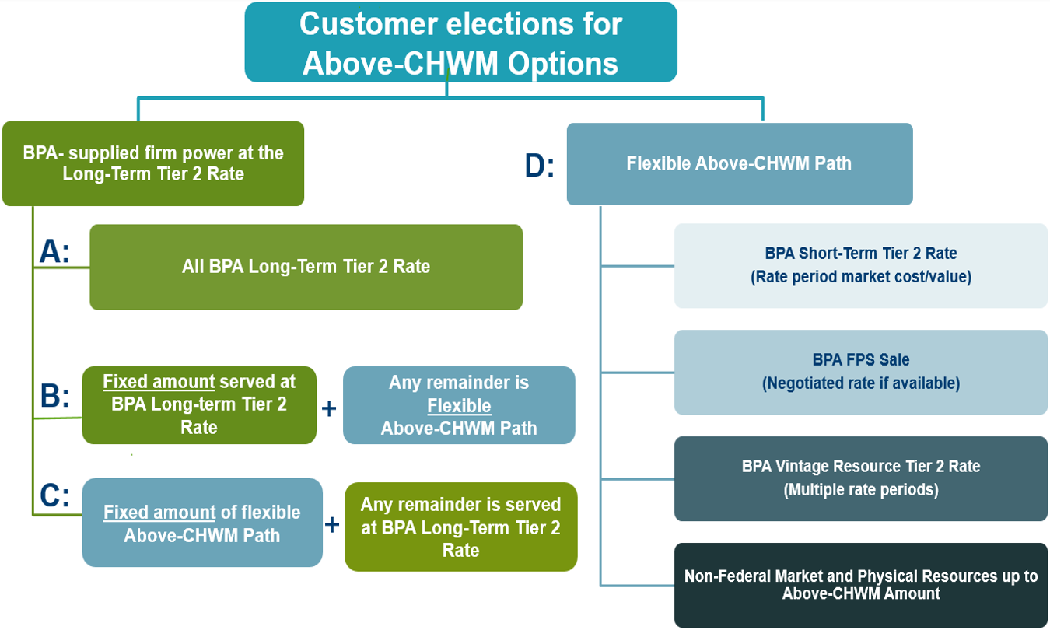
Above-CHWM Election Options
D: Default Option
if no election is made by the customer
2026 Resource Plan assumes Option A

Slide 6
Right to Reduce Tier 2 Long-Term
For Customers electing Options A, B, or C
  Change is only one-way, to reduce Long-Term (cannot add Long-Term)
Initial change option Without a Fee
  If requested before August 1, 2027, AND
  BPA has not acquired power for the purpose of serving Tier 2 Long-Term
One-time change option With a Fee & Potential Charges
  Change is binding for the remaining term of the Agreement
  Subject to 3-years notice and the start of a rate period
    6 possible change windows; earliest change effective date is 10/1/2032 for FY33-34
  Subject to Change Charge, if change results in cost shift to other customers
  Subject to Change Fee, set each rate period (Min. $0.05/MWh – Max. $0.10/MWh)
    @ $0.05/MWh = $186,594 = 2 years x (213.007 aMW x 8,760 hours/year) x $0.05/MWh
    @ $0.10/MWh = $373,188 = 2 years x (213.007 aMW x 8,760 hours/year) x $0.10/MWh
Notes:
Earliest change effective date is 10/1/2032, the 5th year of contract, commencing with BP-33 (FY33-34) – Notice due by 9/30/2029.
Product/Purchase change only has 5 windows (missing last one). Also requires 3 years notice and start of rate period.

Slide 7
Above-CHWM Election Considerations
BPUD 2026 Load Forecast – Approved by Resolution No. 2726 on May 26, 2026
BPUD 2026 Resource Plan – For Approval at Public Hearing #3 on July 14, 2026
BPA Resource Program - Final to be published December 2027
  “Full” Needs Assessment to be completed by February 2027
  “Light” Needs Assessment to be completed in Summer 2026
BPA Resource Acquisition - Needs assessment is prerequisite
  Tier 2 Long-Term is firm obligation - BPA may take commercial action by Fall 2026
  Tier 2 Short-Term is elected each rate period (not guaranteed available)
BPA Tier 2 Rates forecast uncertainty
  Tier 2 Long-Term has potential to be priced at Tier 1 rates, if existing firm inventory is serving (not applicable to Tier 2 Short-Term)
BPA Environmental Attributes accounting process determined in rate case

Slide 8
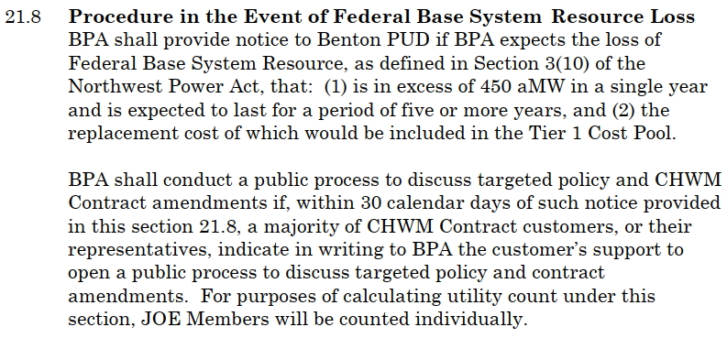
BPA Contract - Resource Loss

Slide 9
Above-CHWM Election Comparison
Criteria
A
All Long-Term
Tier 2
B
Long-Term;
then Flexible
C
Flexible;
then Long-Term
D
All Flexible
Fit with Benton PUD's current resource plan
Highest
Higher
Lower
Lowest
Supply certainty
Highest
Higher;
then Lower
Lower;
then Higher
Lowest
Flexibility
Lowest
Lower;
then Higher
Higher;
then Lower
Highest
Benton resource acquisition burden
Lowest
Lower;
then Higher
Higher;
then Lower
Highest
BPA Long-Term Tier 2
rate exposure
Highest
Higher;
then Lower
Lower;
then Higher
N/A
Market / BPA Short-Term
Tier 2 exposure
N/A
Lower;
then Higher
Higher;
then Lower
Highest
Implementation complexity
Lowest
Lower;
then Higher
Higher;
then Lower
Highest
Overall Benton PUD fit
BEST FIT
Possible hybrid
Weaker hybrid
Weakest fit
Note: Rankings reflect Benton PUD's current position: no near-term Above-CHWM, no near-term non-BPA resources, and no current plan to add resources. Options B and C depend heavily on the fixed/flexible aMW amount and timing of any planned resources.

Slide 10
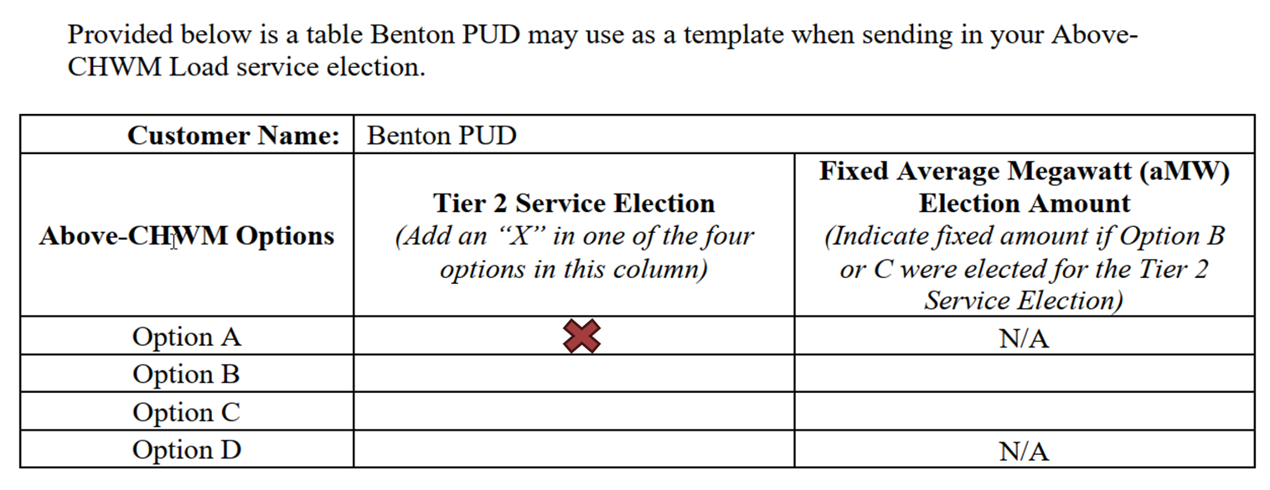
Above-CHWM Election Process
Today, 6/23/2026 Commission info only presentation
Next, 7/14/2026 Commission motion authorizing the General Manager to send Tier 2 election option to BPA
Then, 7/27/2026 deadline to submit election to BPA
After received, BPA will update Section 2.1 of Exhibit C of the District’s Power Sales Agreement (Contract #25-51-02)

Slide 11
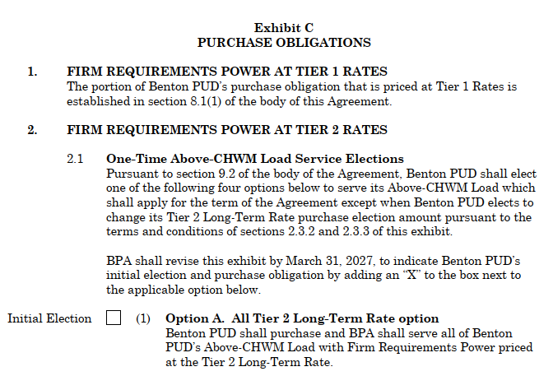
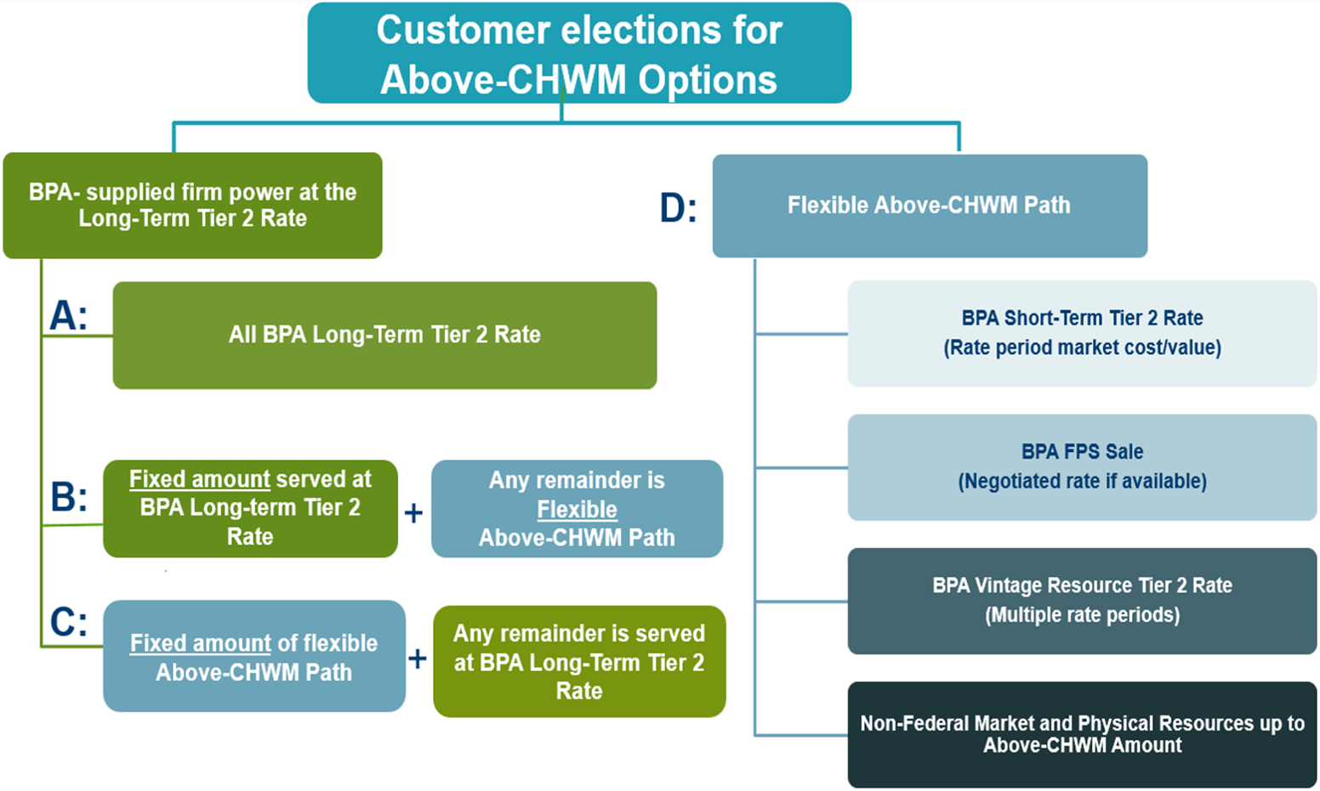
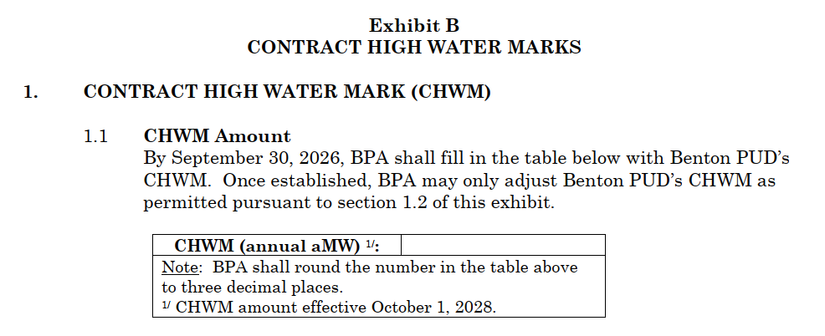
Above-CHWM Election Questions?

