Slide 1
State of the System
Operations & Maintenance
September 22nd, 2026

Slide 2

Operations & Maintenance
District O&M 2026 Budget
$15.9M
Focus
Accountability
Reliability
Asset Maintenance
Actual O/M
YTD Spent
$8.7M
% of
2026 Budget
54.6%
Notes:
NEED UPDATED MAP & GO OVER THE COSTS

Slide 3
Accountability
Joint Use NESC Compliance
Quality Assurance Program

Slide 4
Joint Use NESC Compliance Program
Pasco
Notes:
The yellow ones left in East/West Kennewick have been visited BUT still have violations that need to be addressed by the Contractor – typically it is Ziply, and they more than likely have Alden tickets out against them to correct.
2014, BPUD completed a system-wide audit of all joint-use attachments, covering 5,340 poles. That audit identified 15,740 compliance violations, establishing the baseline for the Joint Use/NESC Compliance Program.
Since that time, BPUD has added 2,149 poles to the distribution system, and as of August 1, 2026, 8,722 additional compliance violations have been identified through ongoing inspections.
It is important to note that the original 2014 audit was conducted from ground level and did not include cable tagging, grounding and bonding deficiencies, or guy marker replacements. These items are now evaluated during field inspection & corrections and account for a significant portion of the additional compliance violations identified since the original audit.

Slide 5
Joint Use NESC / Best Practices Compliance Program
As of August 1st, 2026:
1,858 Compliance Violations corrected by BPUD Contractor
Description | Violations
Unfinished Work (Tagging – Non NESC) | 48%
Bonding / Grounded Equipment | 22%
Guy / Anchor Issues (typically Guy Marker replacement) | 16%
Required 40” Clearance between Power and Comms | 8%
BPUD Fiber moved from Power Space to Comm Space | 2%
Climbing Space Correction | 1%
Riser Separation | 1%
Groundline Clearance | 1%
Service / Mid-Span Clearance | 1%
Notes:
Updated: JWV 8/5/2026 3:45pm
In 2014, BPUD completed a system-wide audit of all joint-use attachments, covering 5,340 poles. That audit identified 15,740 compliance violations, establishing the baseline for the Joint Use/NESC Compliance Program.
Since that time, BPUD has added 2,149 poles to the distribution system, and as of August 1, 2026, 8,722 additional compliance violations have been identified through ongoing inspections.
It is important to note that the original 2014 audit was conducted from ground level and did not include cable tagging, grounding and bonding deficiencies, or guy marker replacements. These items are now evaluated during field inspection & corrections and account for a significant portion of the additional compliance violations identified since the original audit.

Slide 6
Joint Use NESC / Best Practices Compliance Program
Description | Poles Visited | Violations Corrected
2026 YTD (August 1, 2026) One Touch | 470 | 1,858
2025 One Touch | 715 | 2,750
2024 One Touch | 552 | 2,391
2023 One Touch | 671 | 1,838
2022 One Touch | 846 | 2,806
2014-2021 One Touch | 4,235 | 12,819
LIFETIME | 7,489 | 24,462
Key Takeaways
~700 poles visited per year
~2,450 violations corrected annually
1,786 poles remain from the original audit
4,623 remaining known compliance violations
Program projected completion end of 2029
Notes:
Updated: JWV 8/5/2026 3:15pm
In 2014, BPUD completed a system-wide audit of all joint-use attachments, covering 5,340 poles. That audit identified 15,740 compliance violations, establishing the baseline for the Joint Use/NESC Compliance Program.
Since that time, BPUD has added 2,149 poles to the distribution system, and as of August 1, 2026, 8,722 additional compliance violations have been identified through ongoing inspections.
It is important to note that the original 2014 audit was conducted from ground level and did not include cable tagging, grounding and bonding deficiencies, or guy marker replacements. These items are now evaluated during field inspection & corrections and account for a significant portion of the additional compliance violations identified since the original audit.

Slide 7
Quality Assurance – Work Order Inspection
2025 Work Order Inspections
Work Orders | Trimester 1 | Trimester 2 | Trimester 3
Value | $2.13M | $3.05M | $6.66M
Number Planned | 29 of 135 | 37 of 139 | 38 of 126
% to Inspect | 21% | 26% | 30%
% to Inspect by $$ | 53% | 69% | 79%
% Inspected | 100% | 100% | 100%
Inspections performed by Engineering Dept. staff
Findings
  Equipment, cable and pole numbering errors and/or omissions
  Minor Variations in “As-Built” versus Design

Slide 8
Quality Assurance – Work Order Inspection
2026 Work Order Inspections
Work Orders | Trimester 1 | Trimester 2 | Trimester 3
Value | $2.98M
Number Planned | 31 of 125
% to Inspect | 25%
% to Inspect by $$ | 57%
% Inspected | 100%
Inspections performed by Engineering Dept. staff
Findings
  Equipment, cable and pole numbering errors and/or omissions
  Minor Variations in “As-Built” versus Design

Slide 9
Reliability
Wildfire Mitigation
Facility Inspections
Infrared Inspections
Vegetation Management
Pole Testing

Slide 10

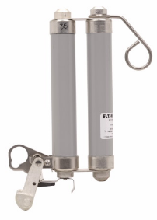
Wildfire Mitigation
Non-expulsion Current-limiting Fuses
Disabled Automatic Reclosing, “One-Shot”
Additional Line Patrols in June & August
Lightning Arrestors
Fire Wrapping Poles
Pole ground sterilization
Revised Construction Standards with increased phase spacing & wildlife cover

Slide 11
Wildfire Mitigation
Fire Mitigation Area
Lightning Arrestors
Total
534
Total
Completed
437
Total
2,426
Total
Completed
536
Total Remaining
97
Total Remaining
1,890
% Complete
82%
% Complete
22%
11
Notes:
In Area 7, a total of 534 arrestors – 437 have been replaced, 97 remaining to do.
Overall total arresters 2,426 – 536 have been replaced, 1890 remaining to do.

Slide 12




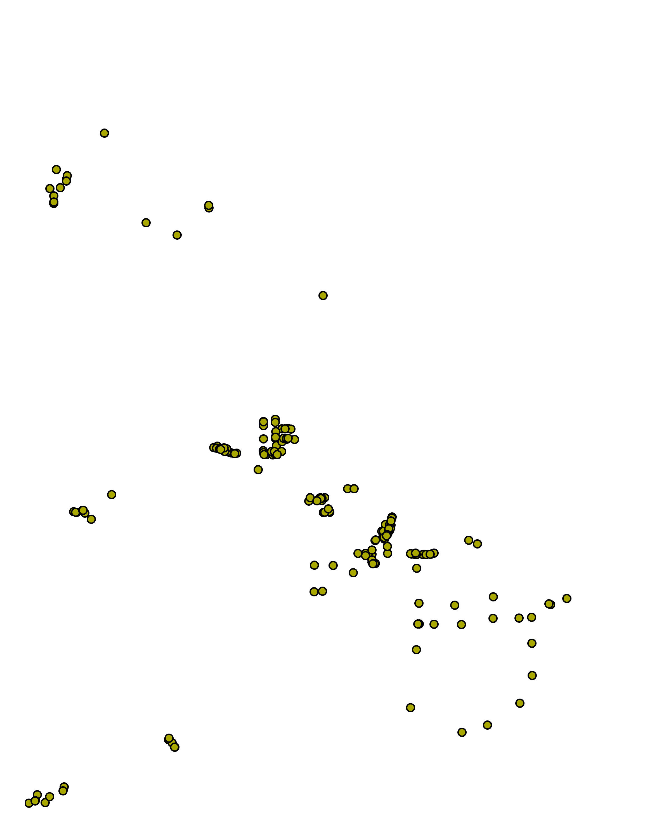
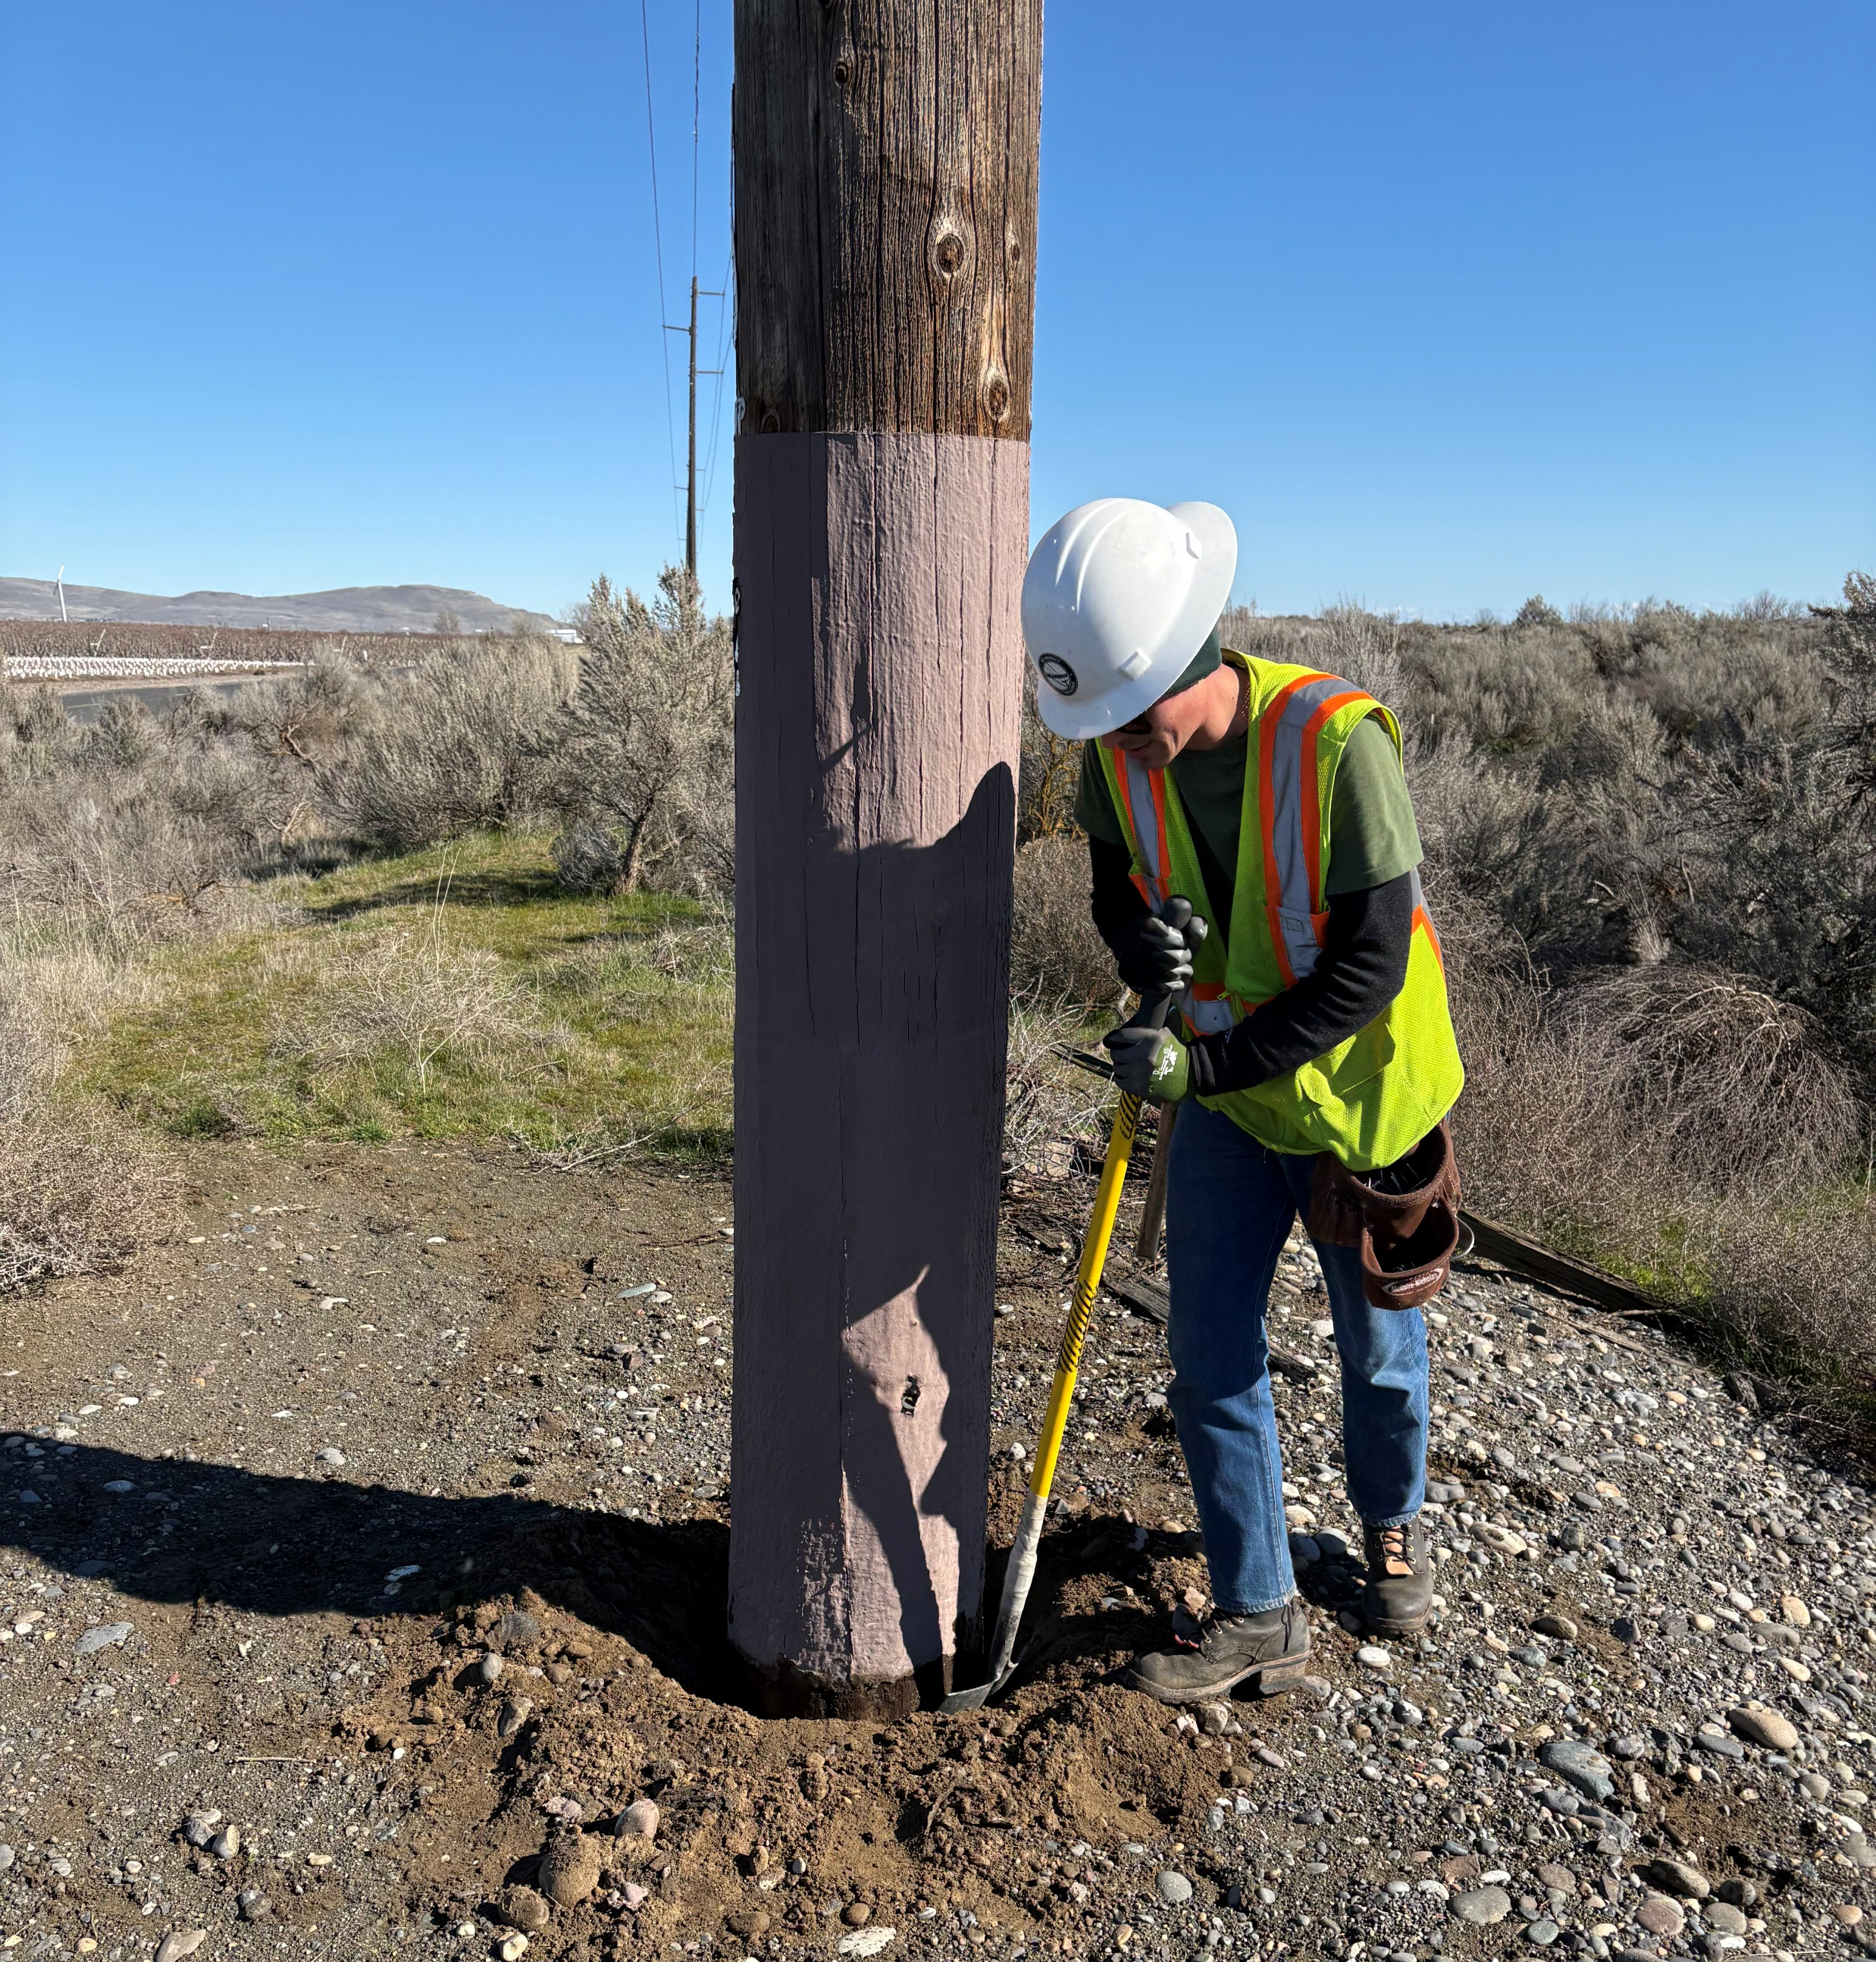
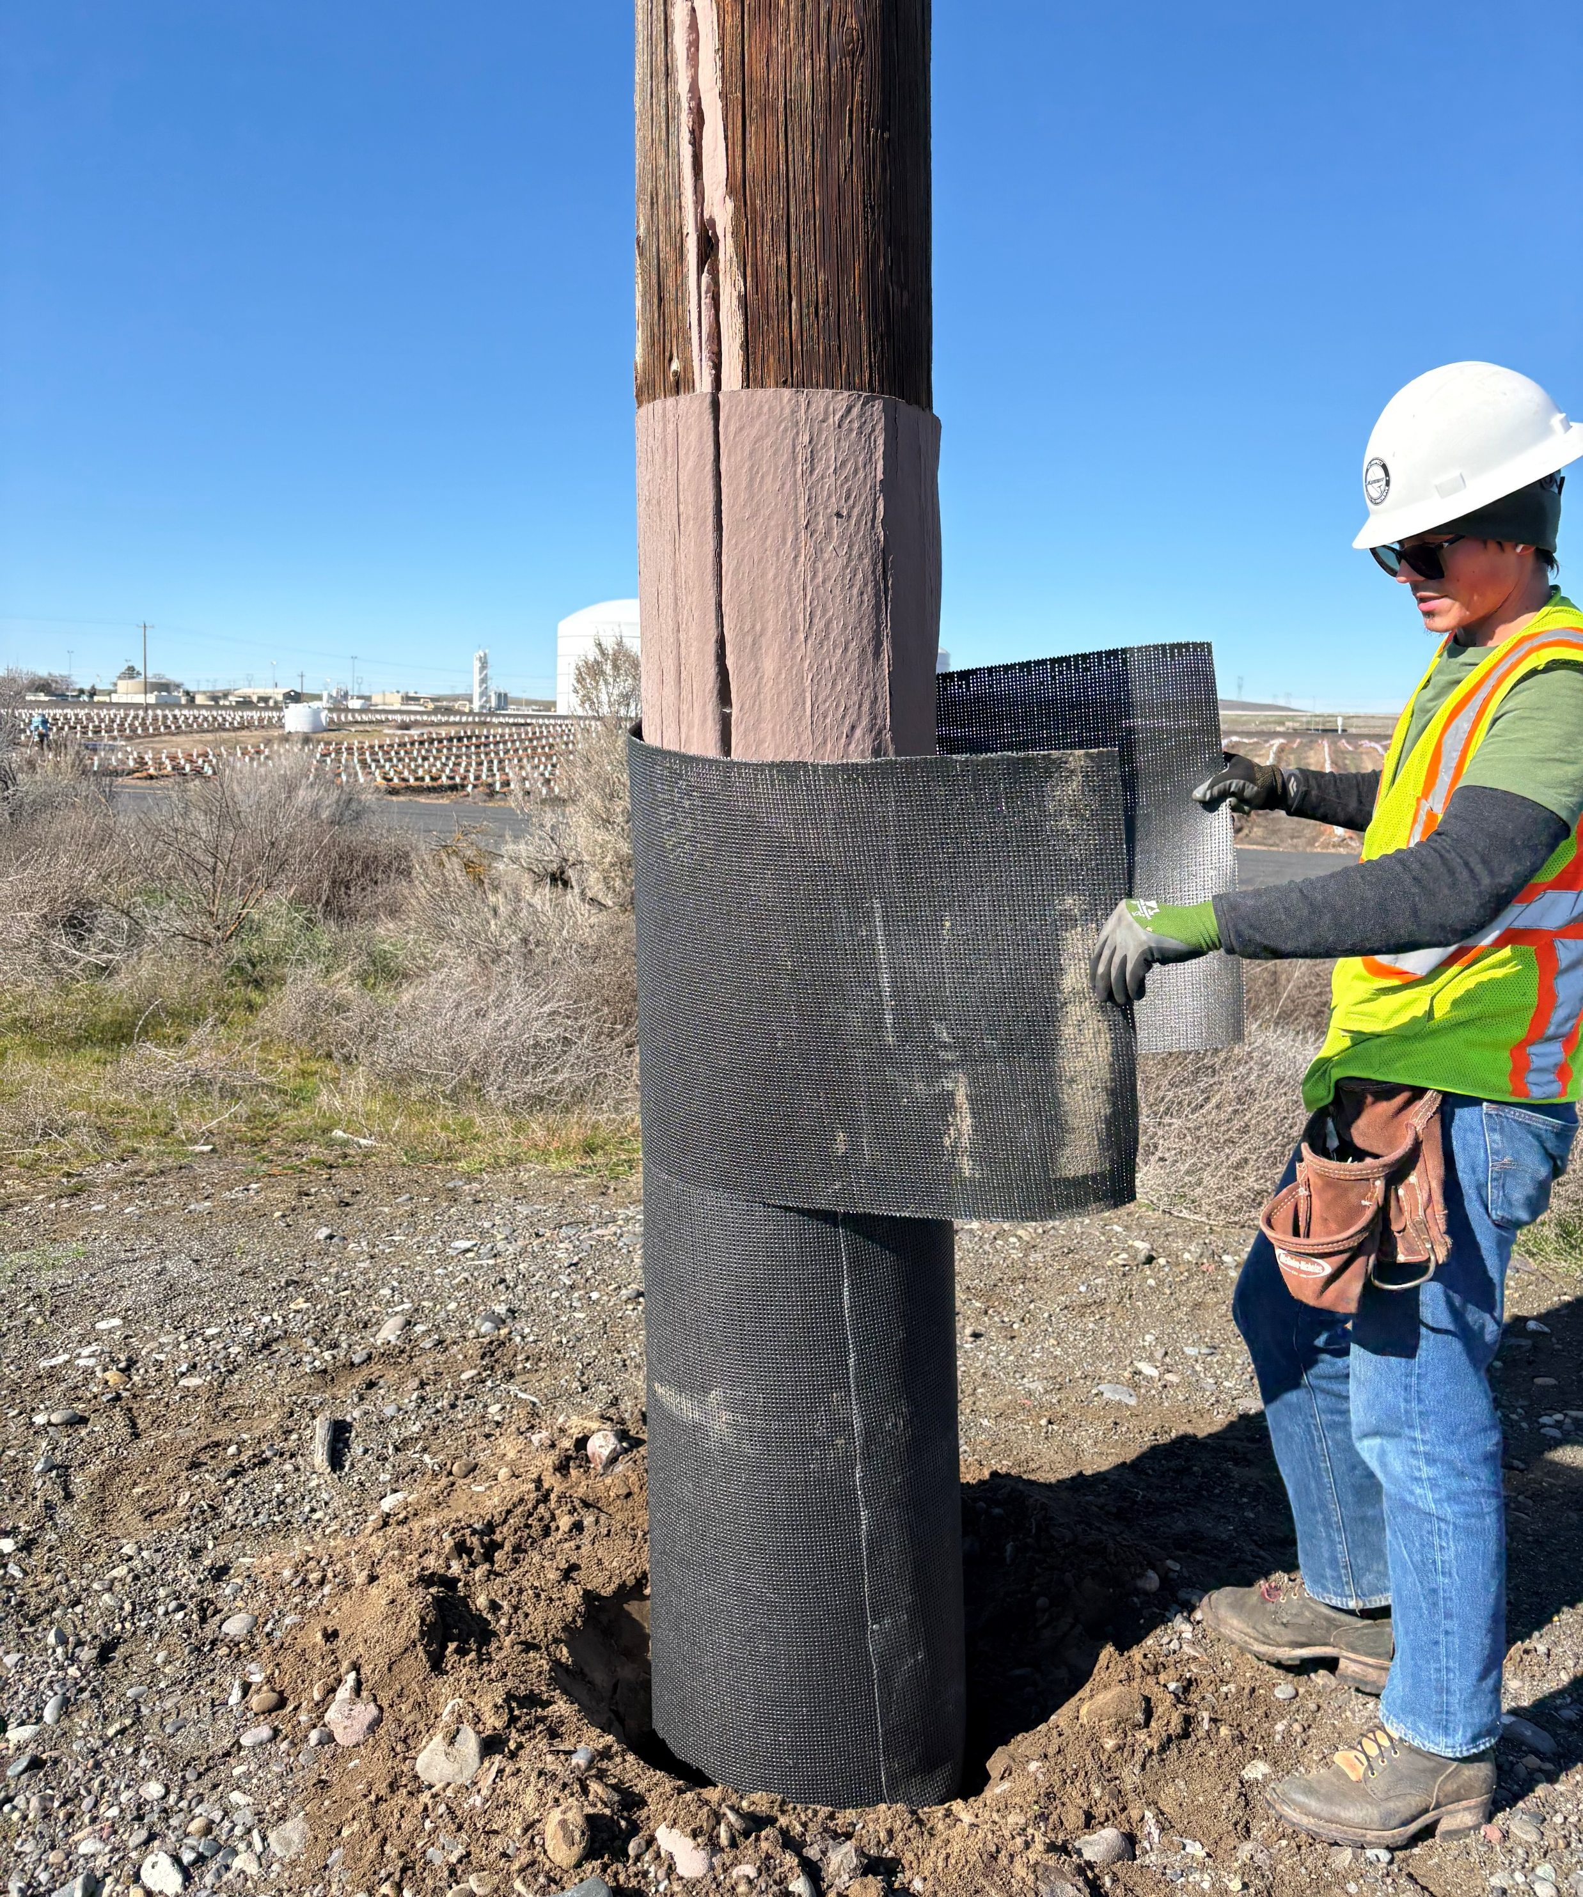
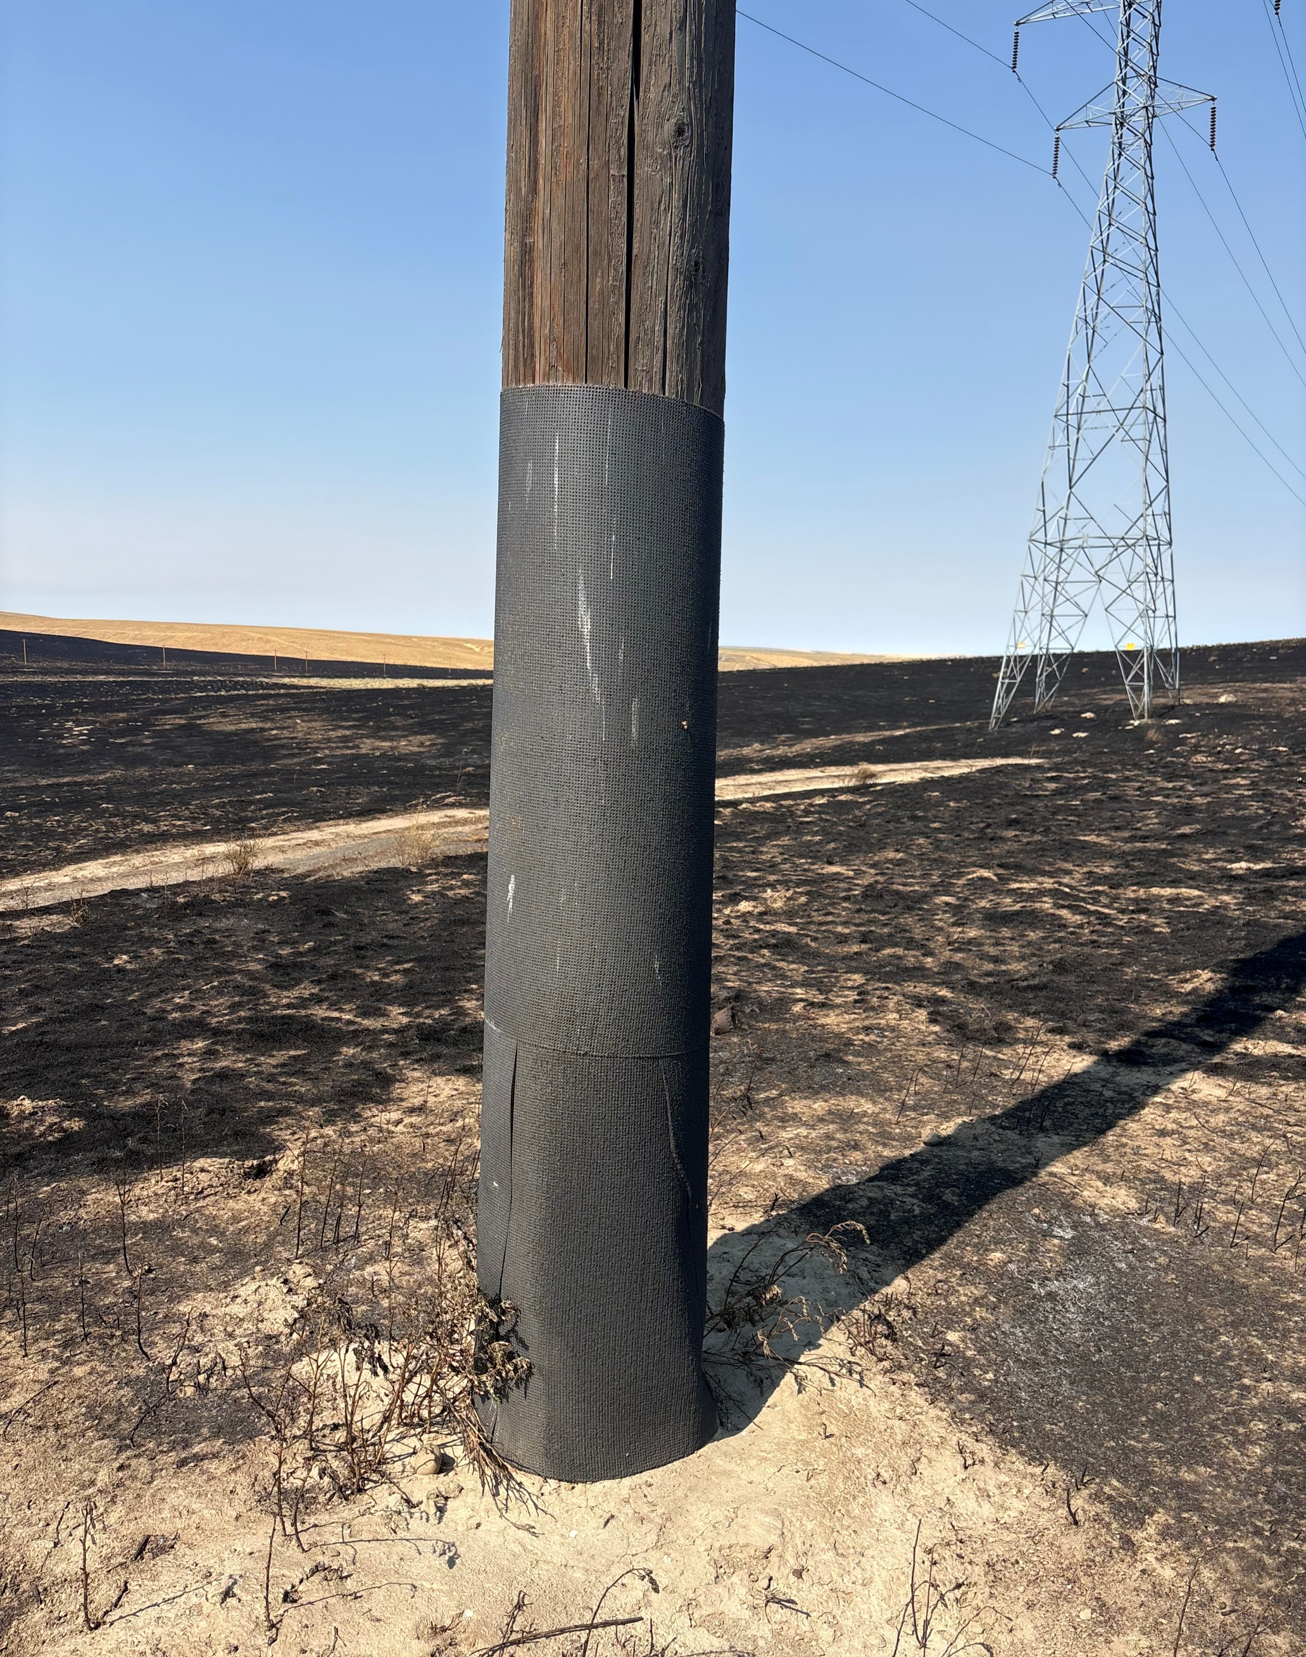
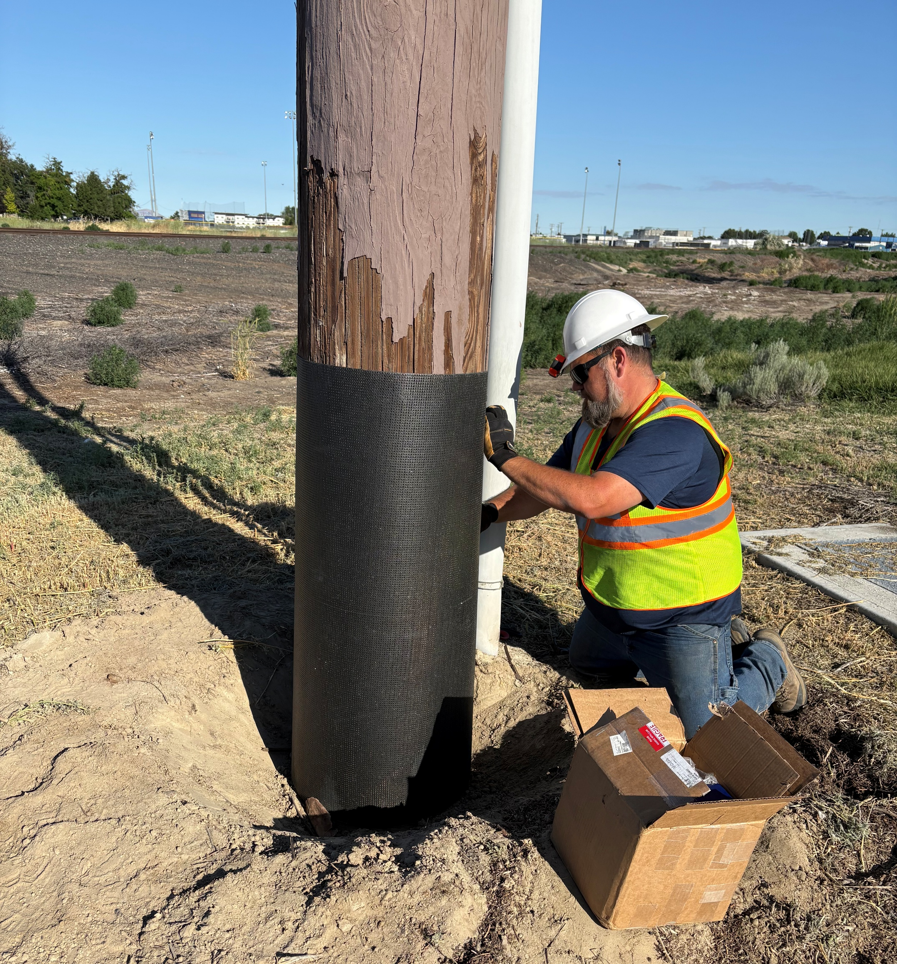
Wildfire Mitigation
Fire Wrapping Poles – Transmission & Distribution
2026 Transmission Fire Wrap Expense
  $64,514
  277 Transmission Poles
  $232 per pole
  30-year guarantee on the material
    One Time Use, Must be replaced after a fire

Slide 13
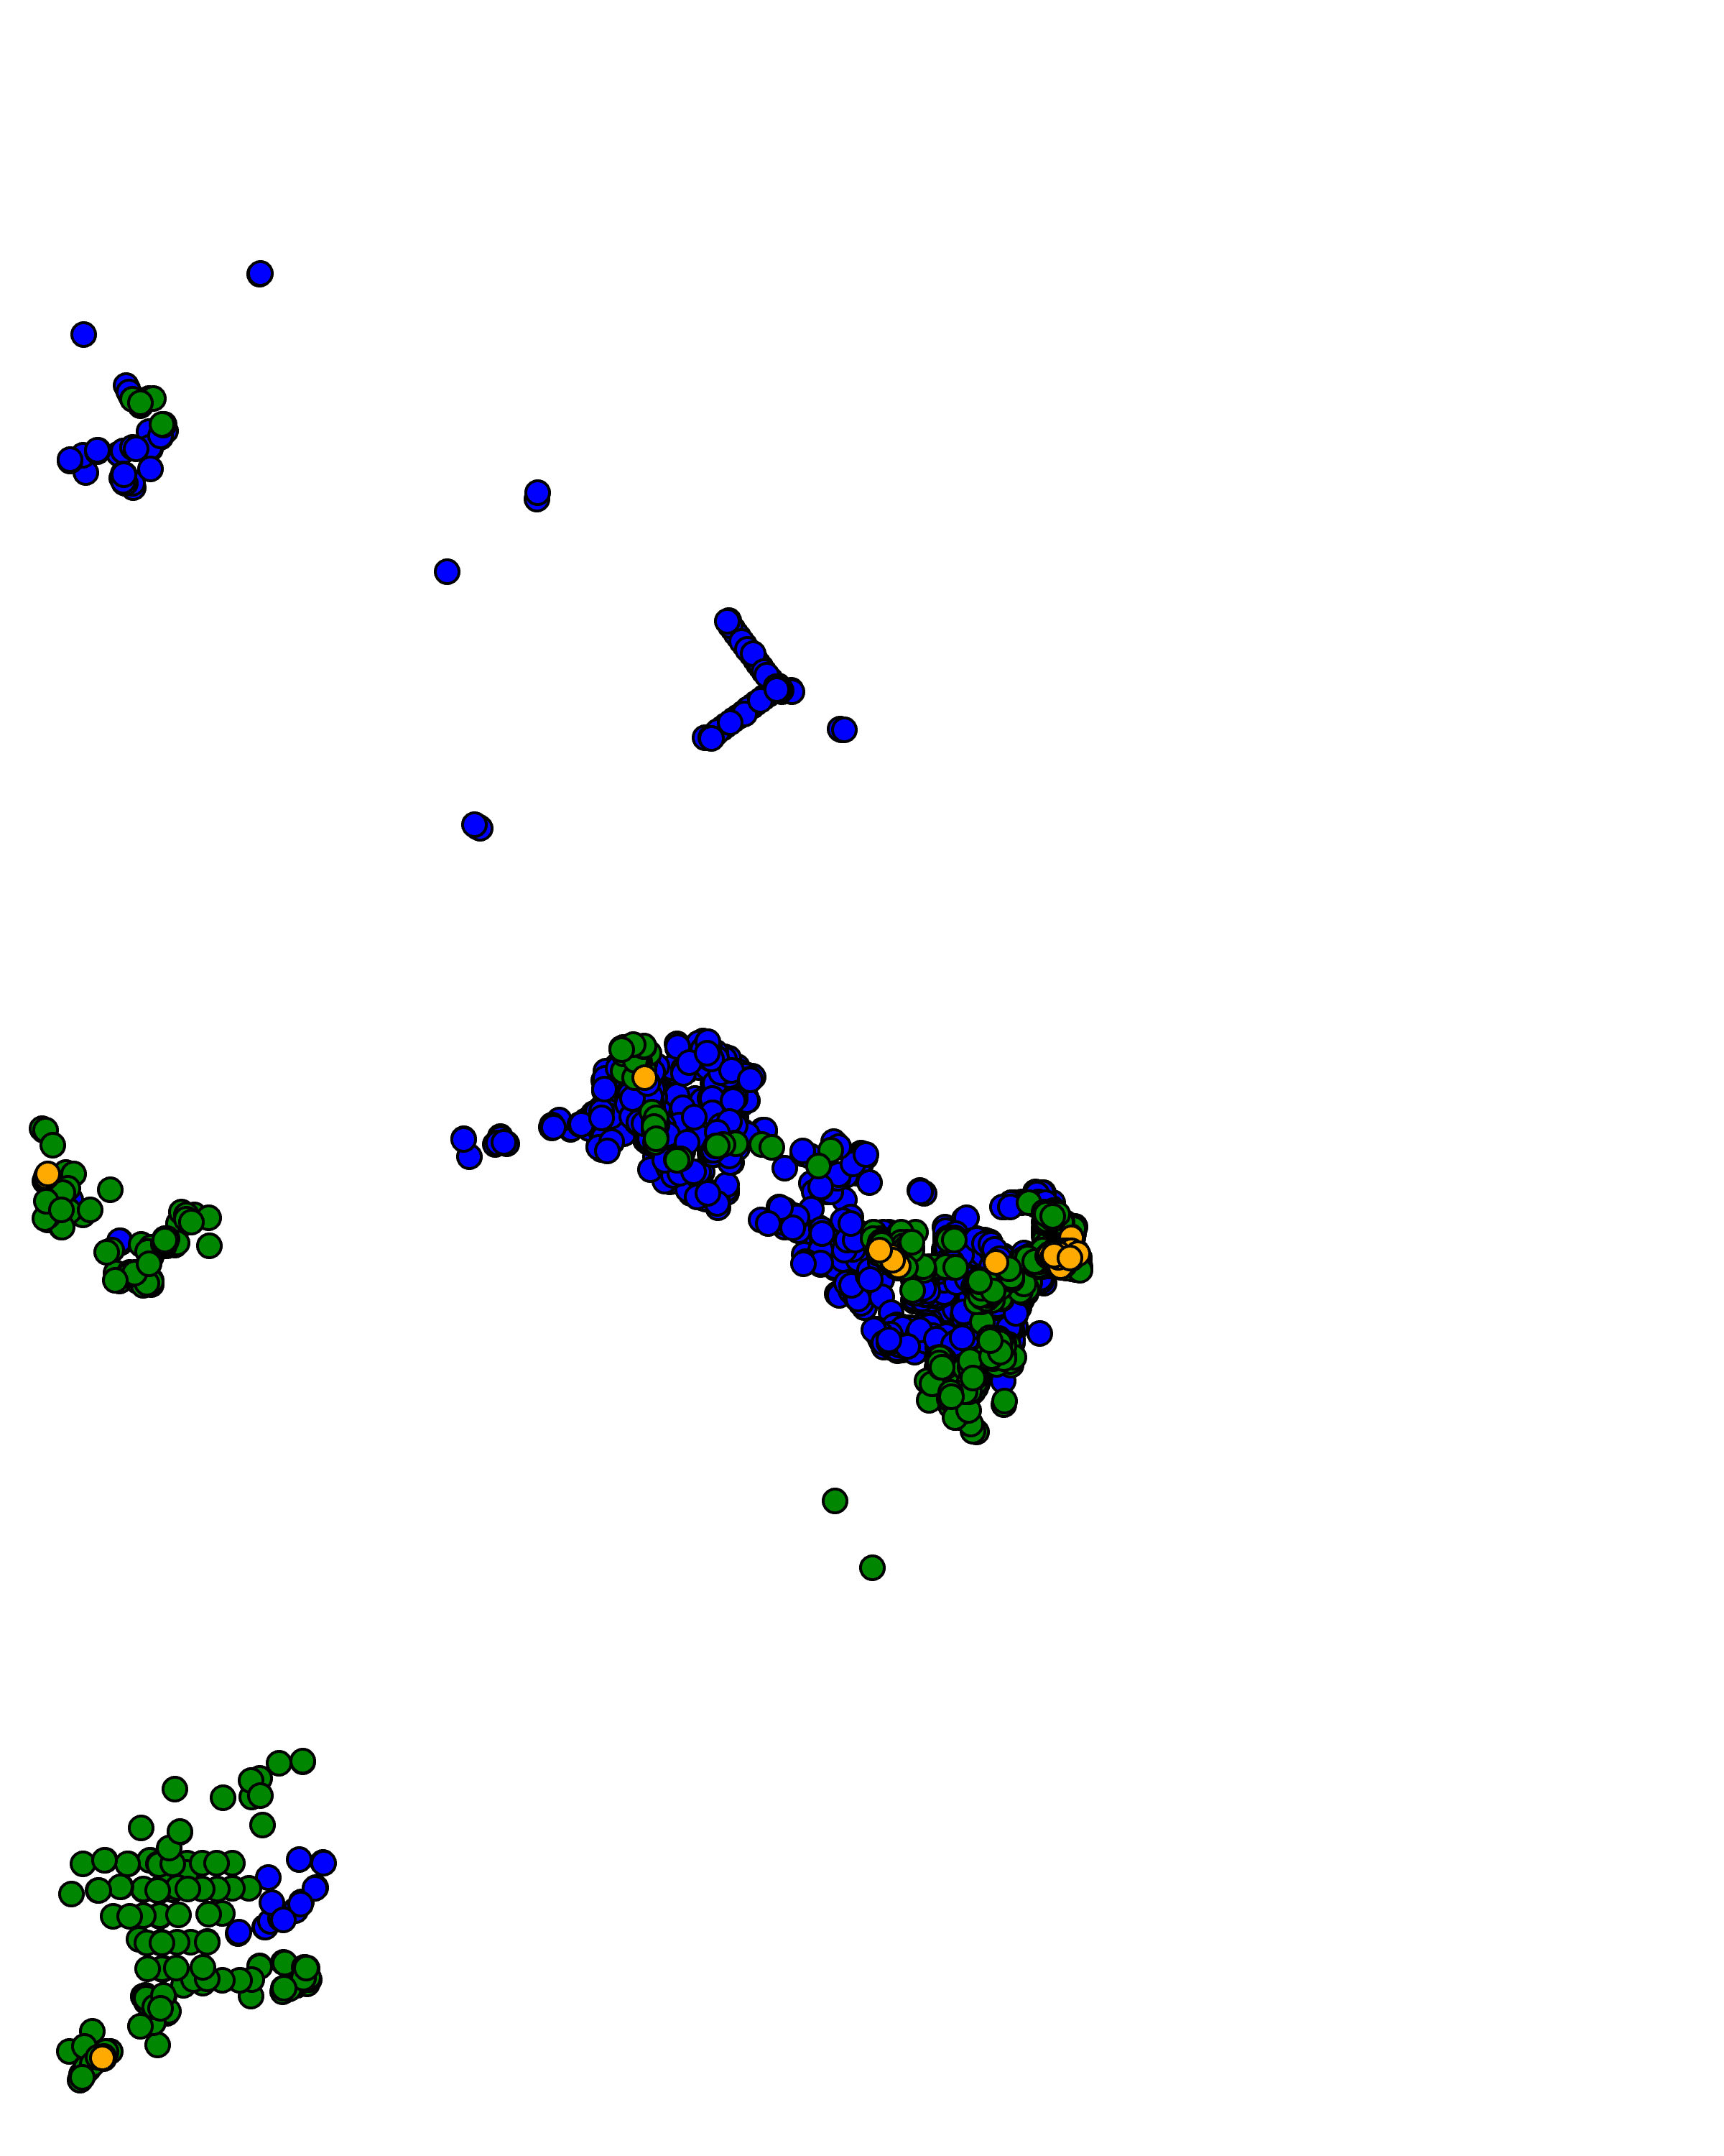
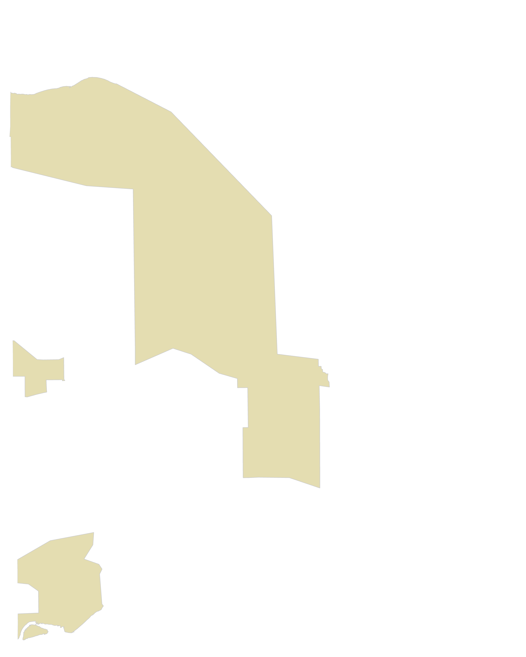
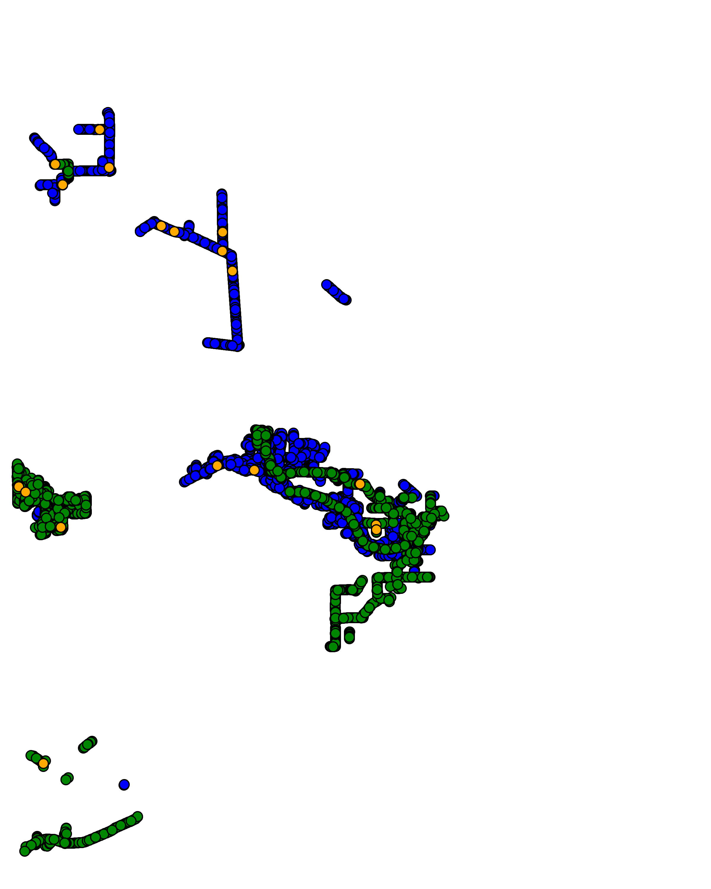
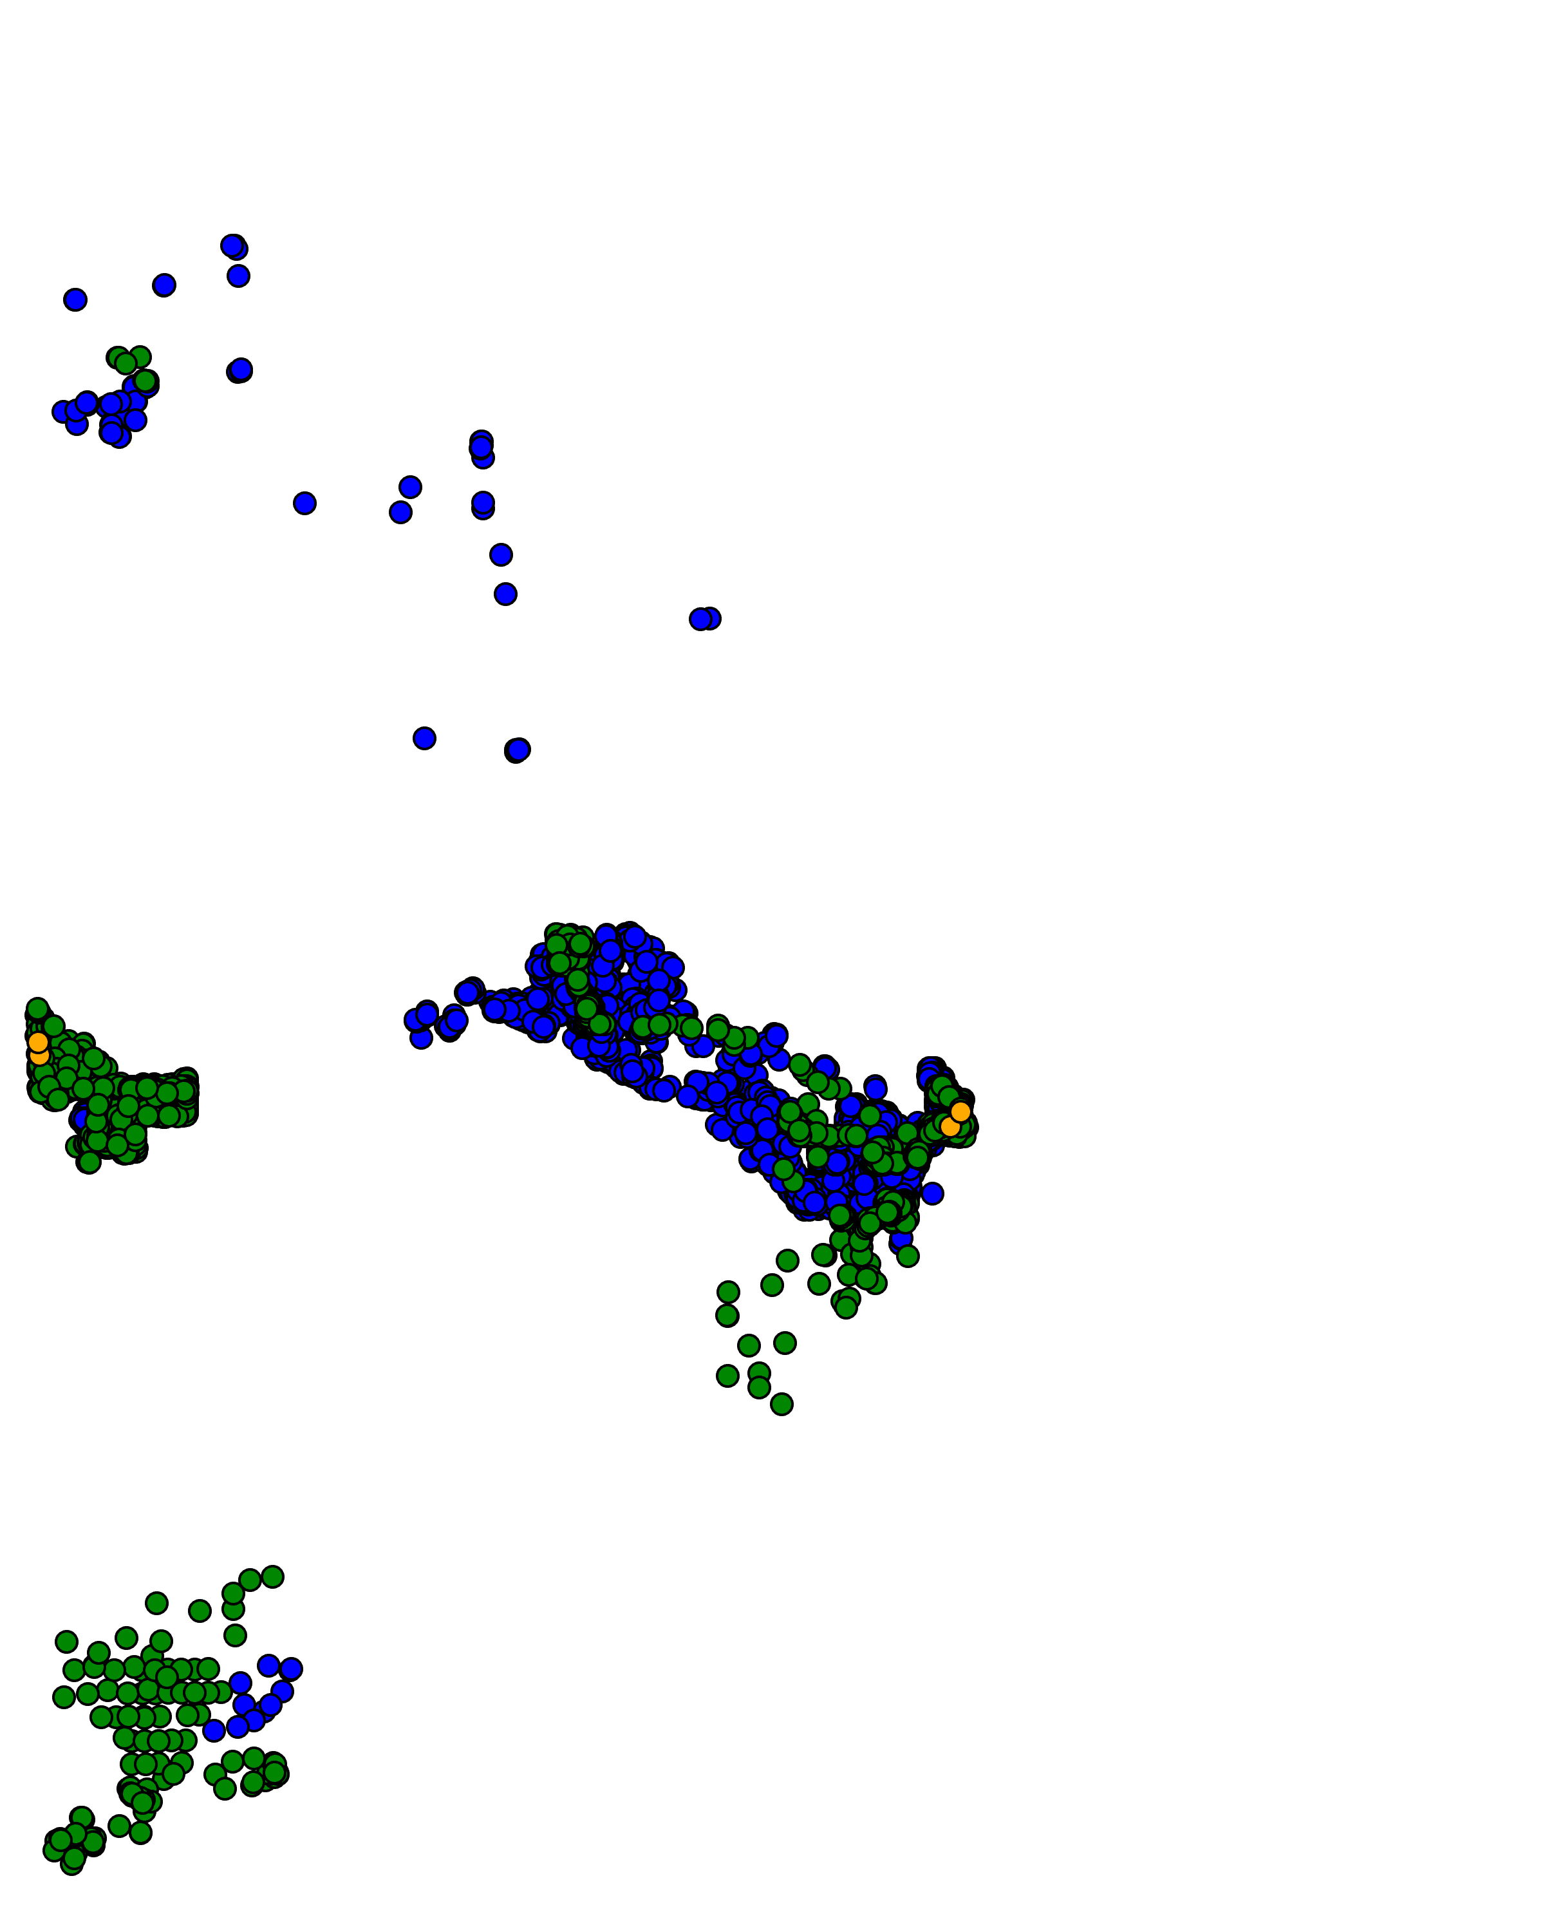
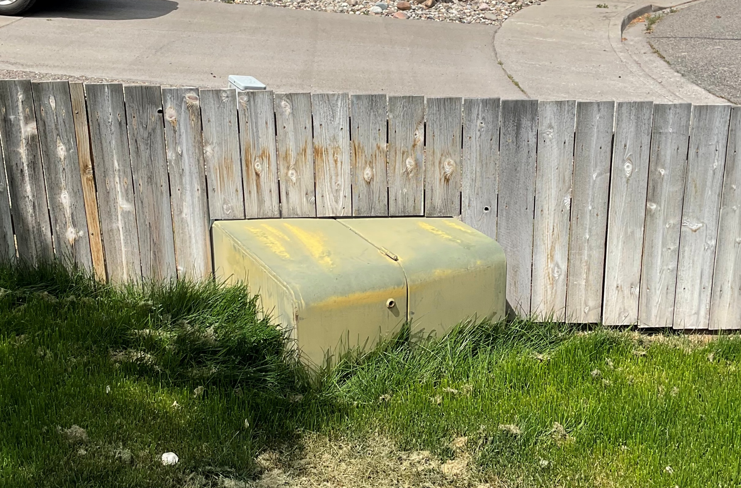
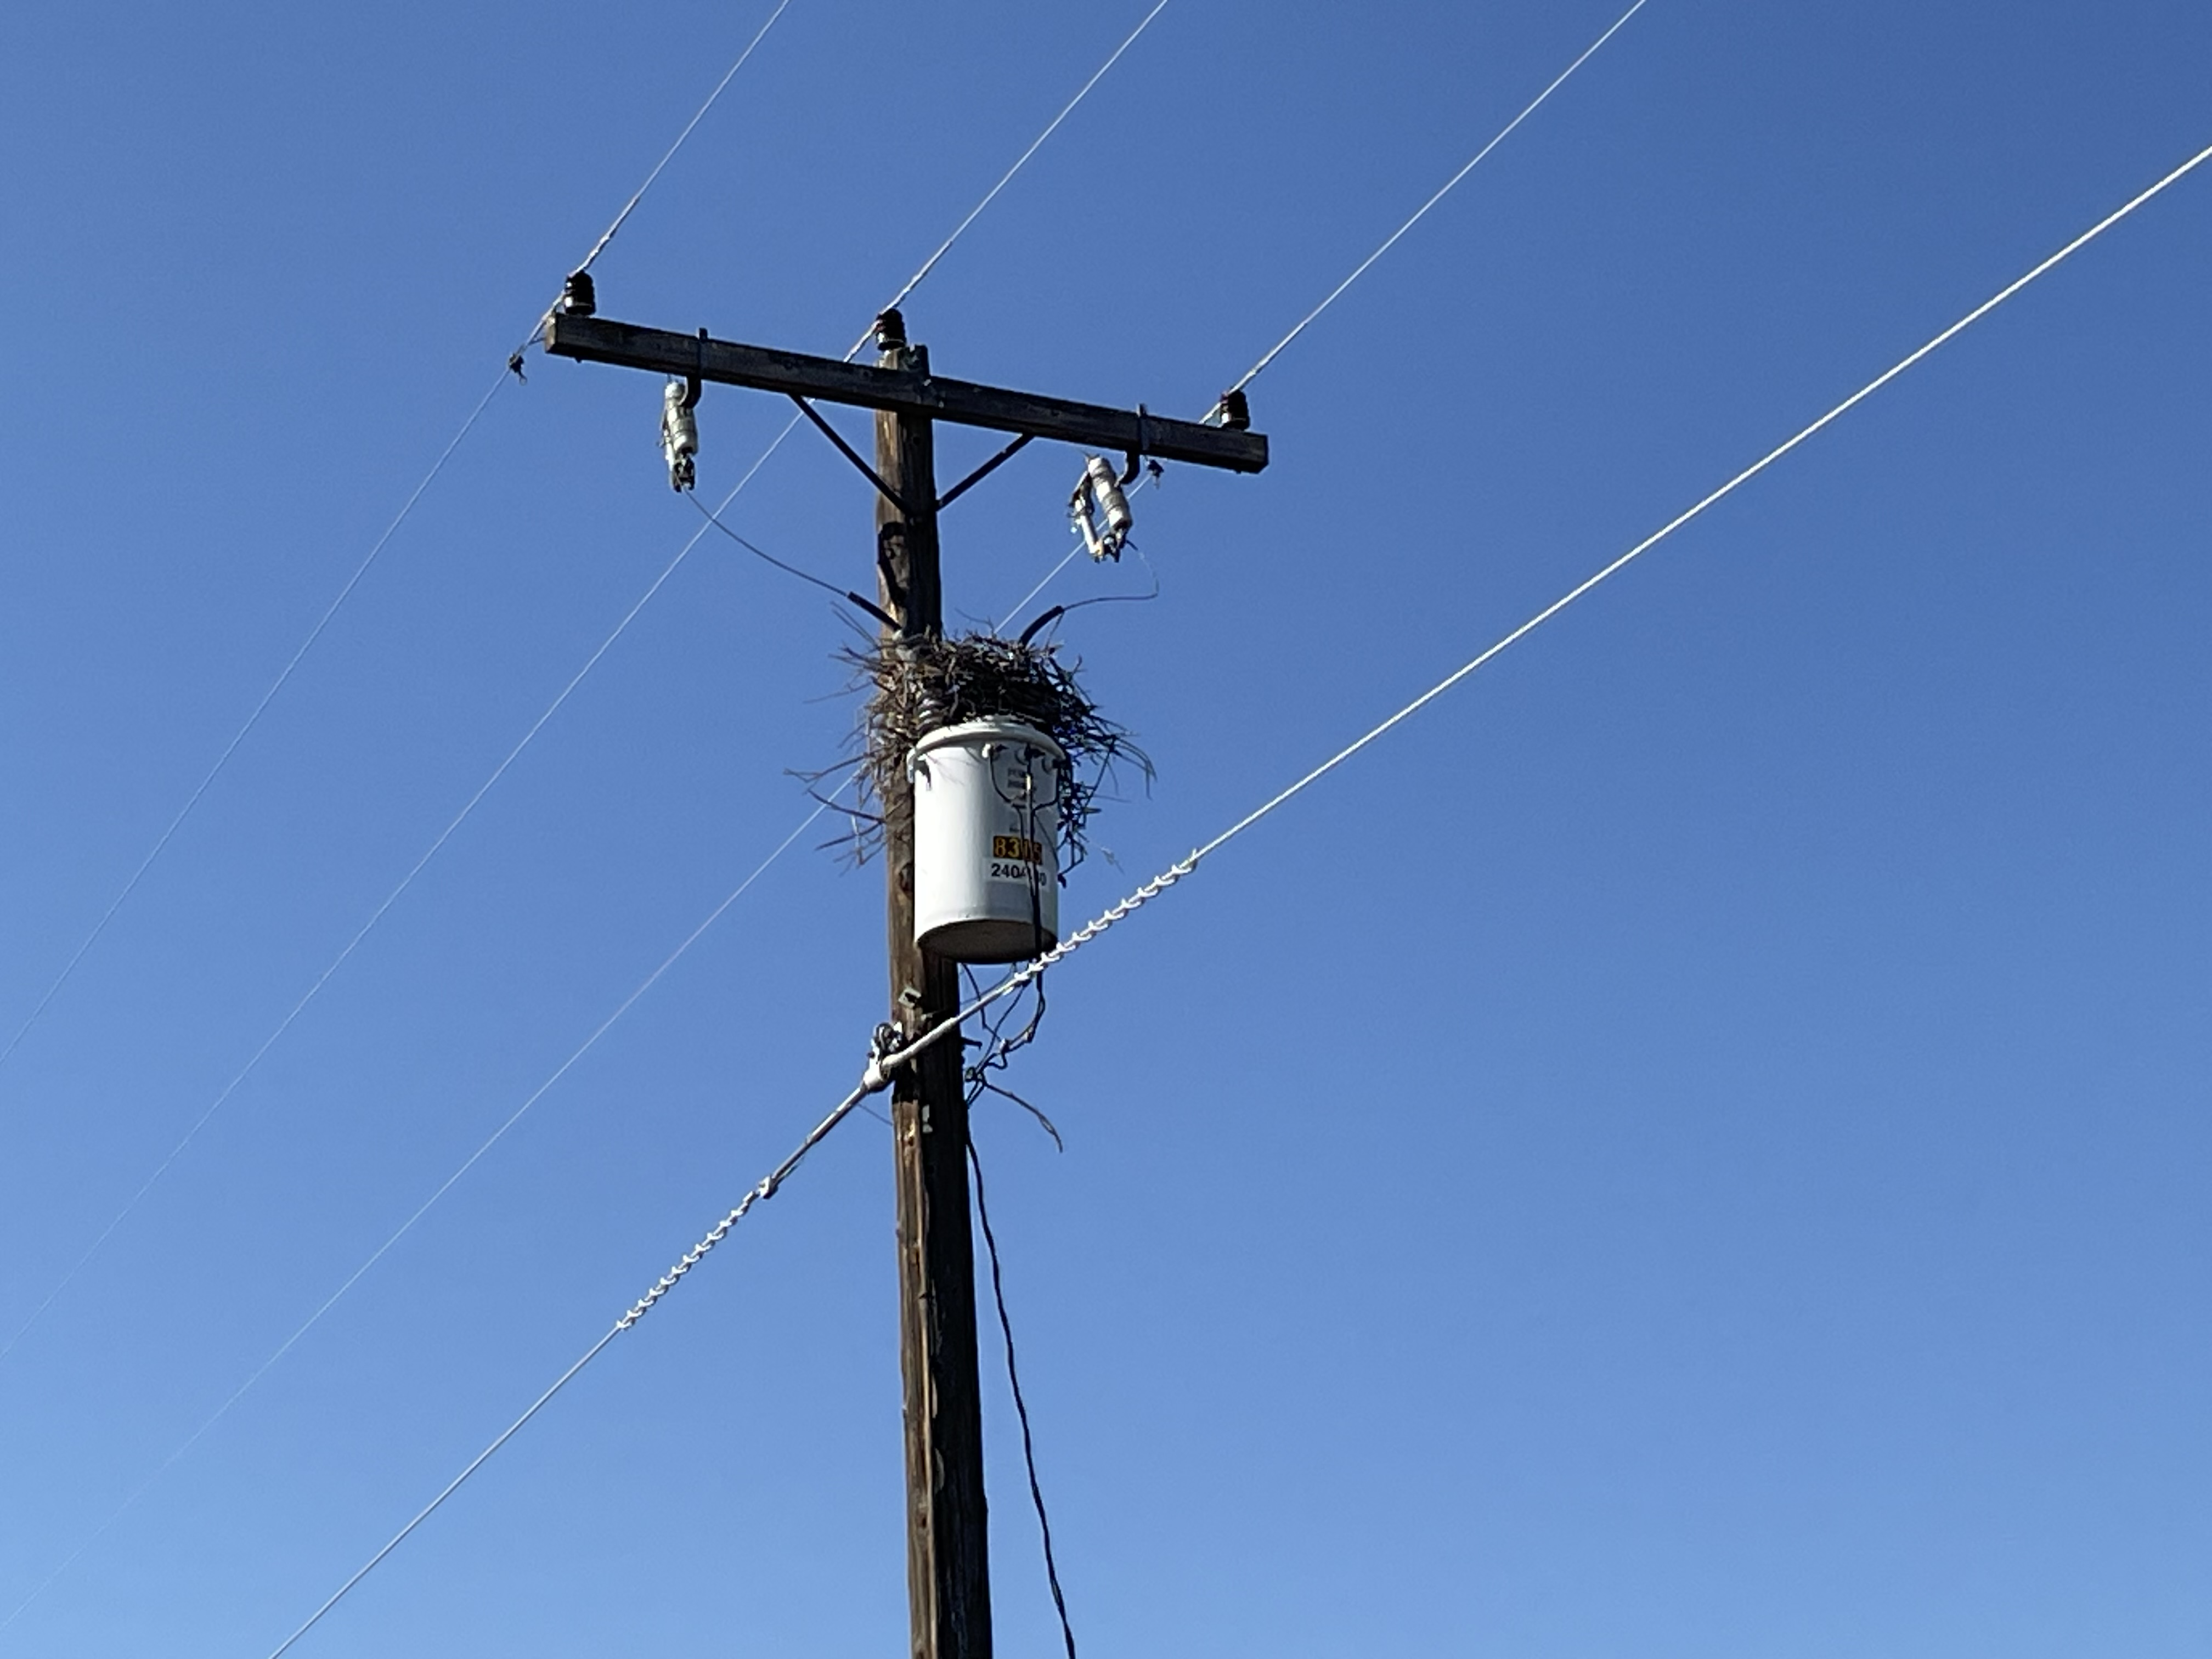
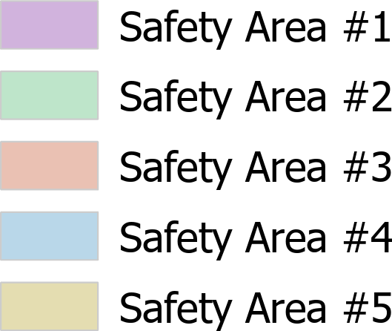
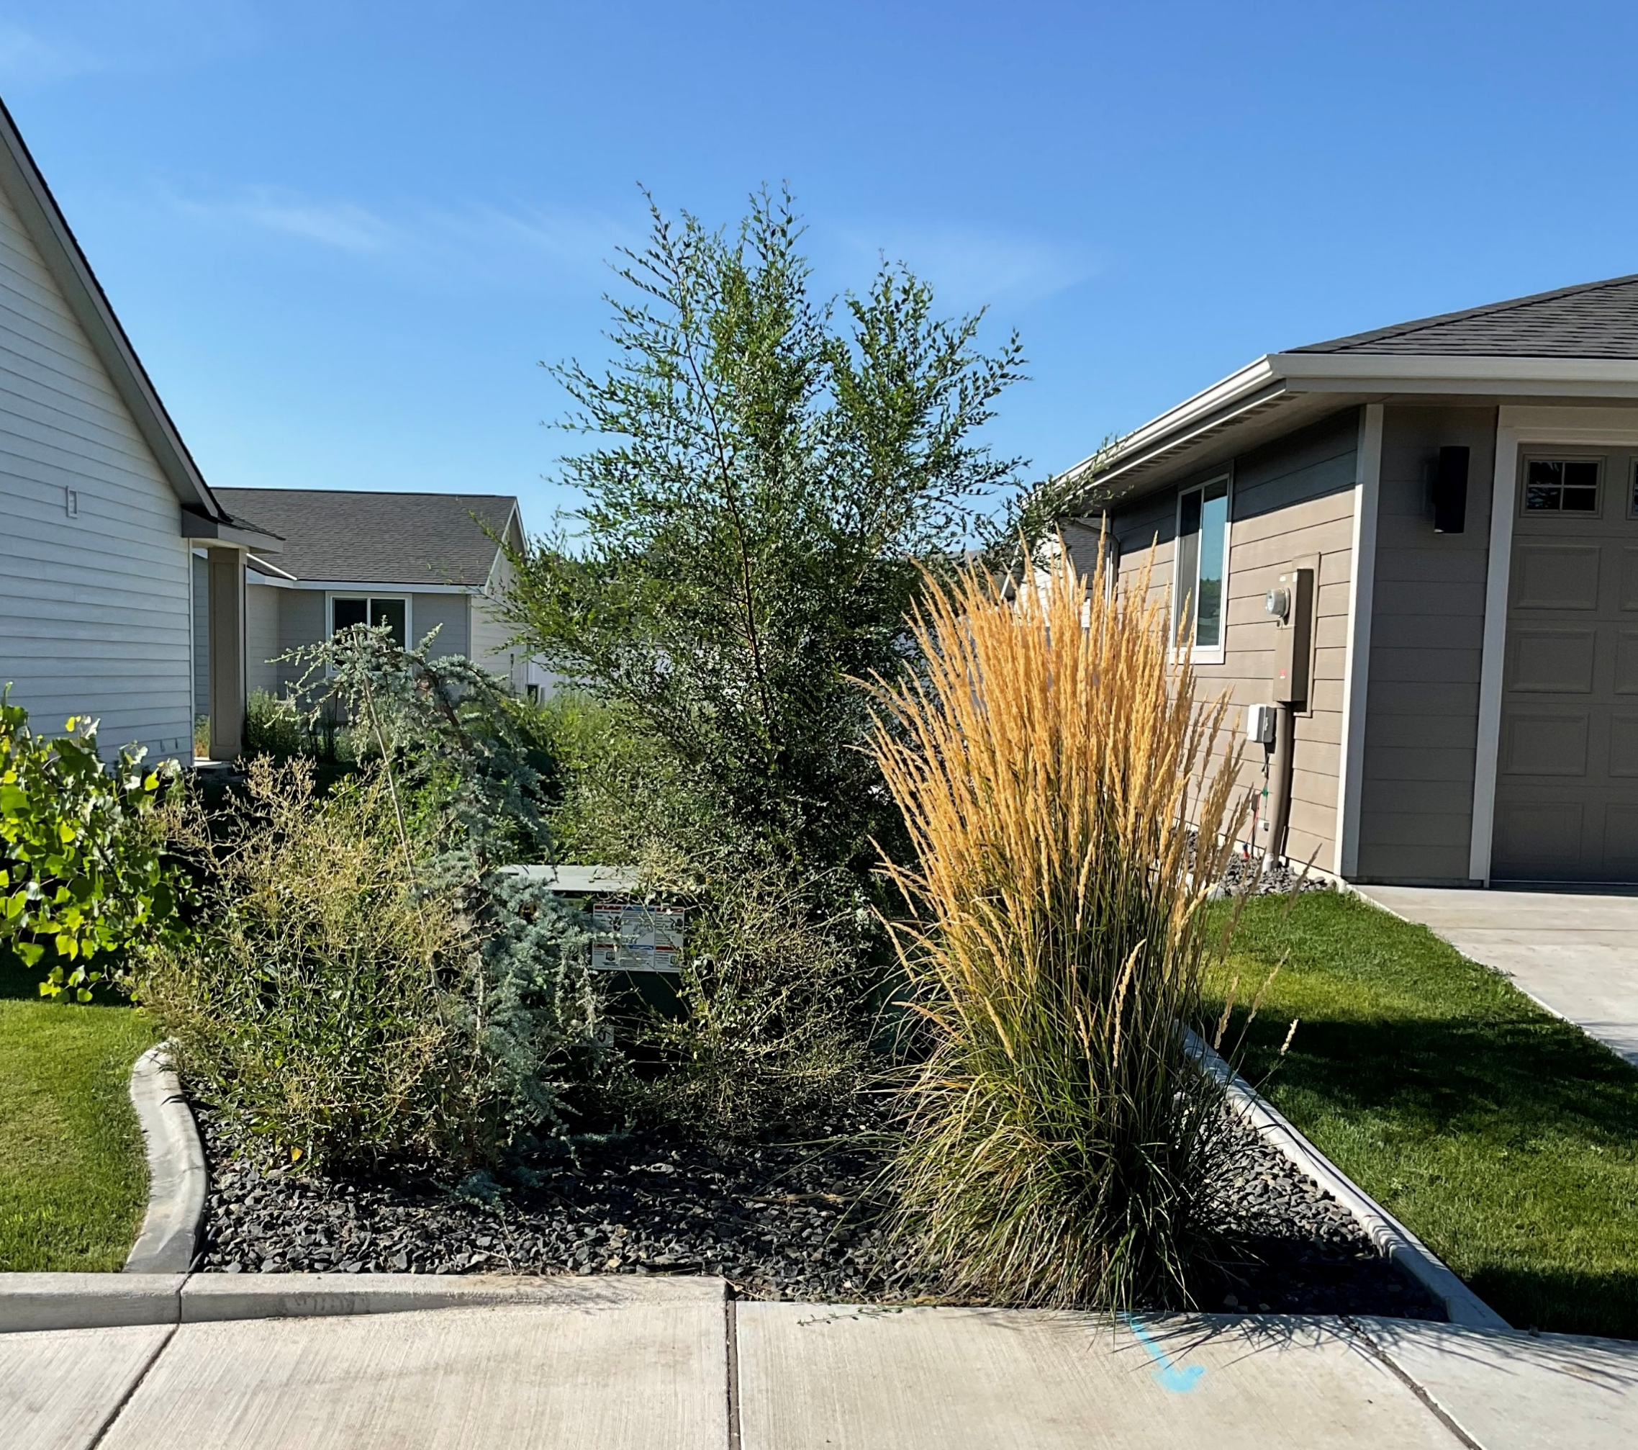
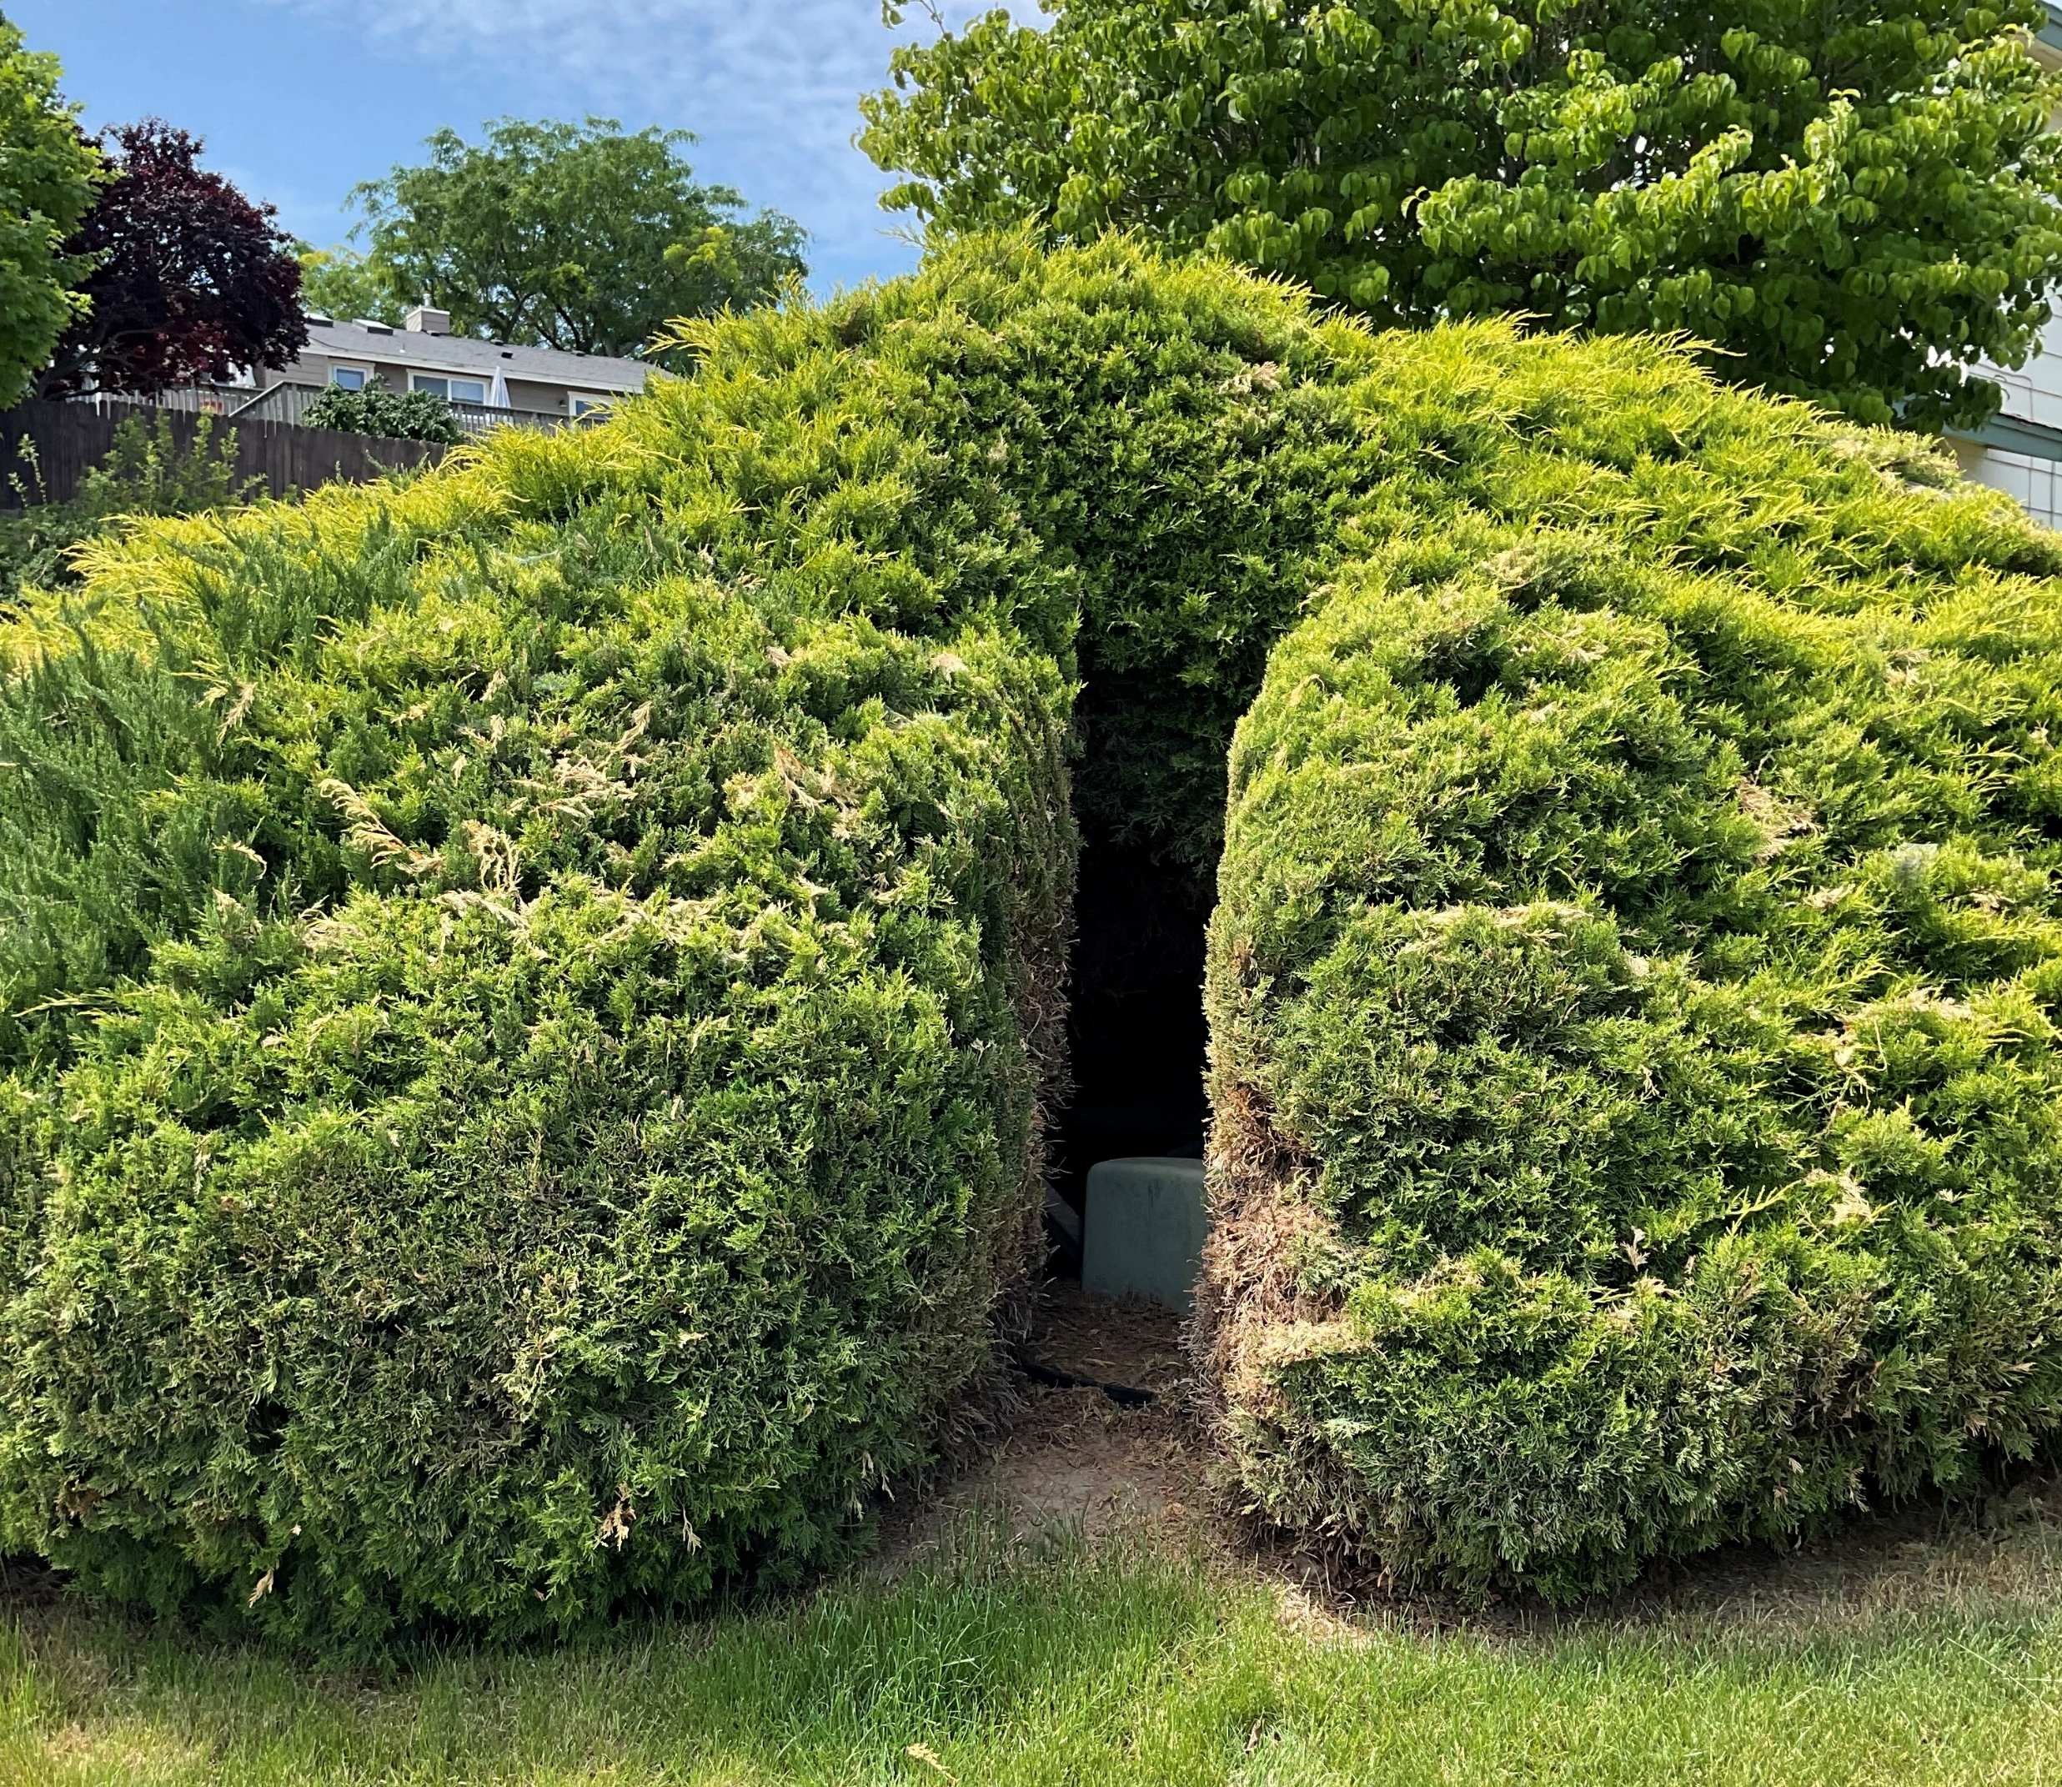
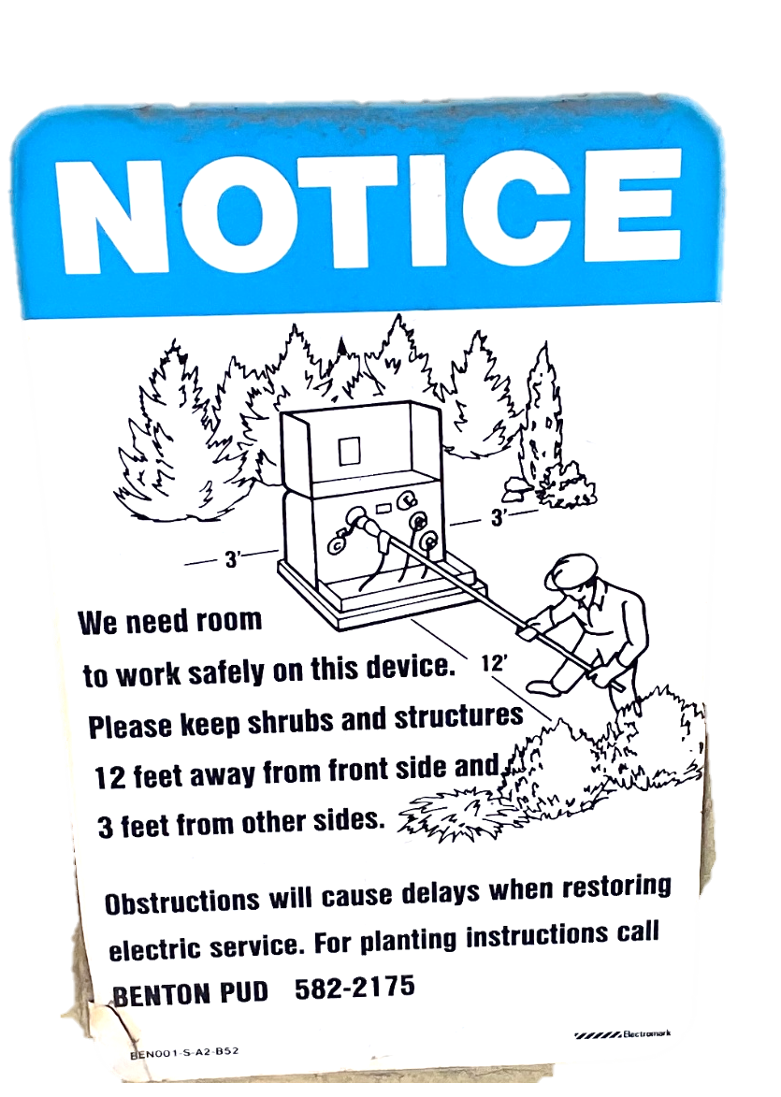
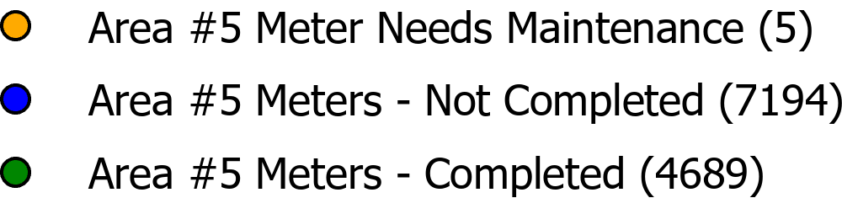
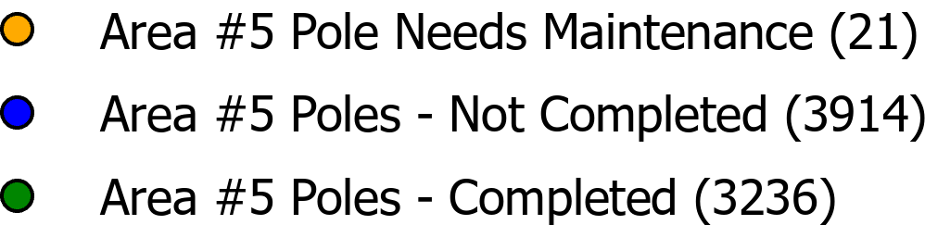

Facility Inspections
5 Year Cycle
  Currently in Safety Area #5
  Visual Inspections of Meters, Poles, & Vaults
YTD COMPLETED
9,925
REMAINING TO BE COMPLETE
14,899
CORRECTIONS NEEDED
68
Notes:
We have typically looking for encroachment, pedestal encroachment, blocked access, Jbox encroachment, bird nest, connectors not taped, meter seals, & vegetation overgrowth.

Slide 14


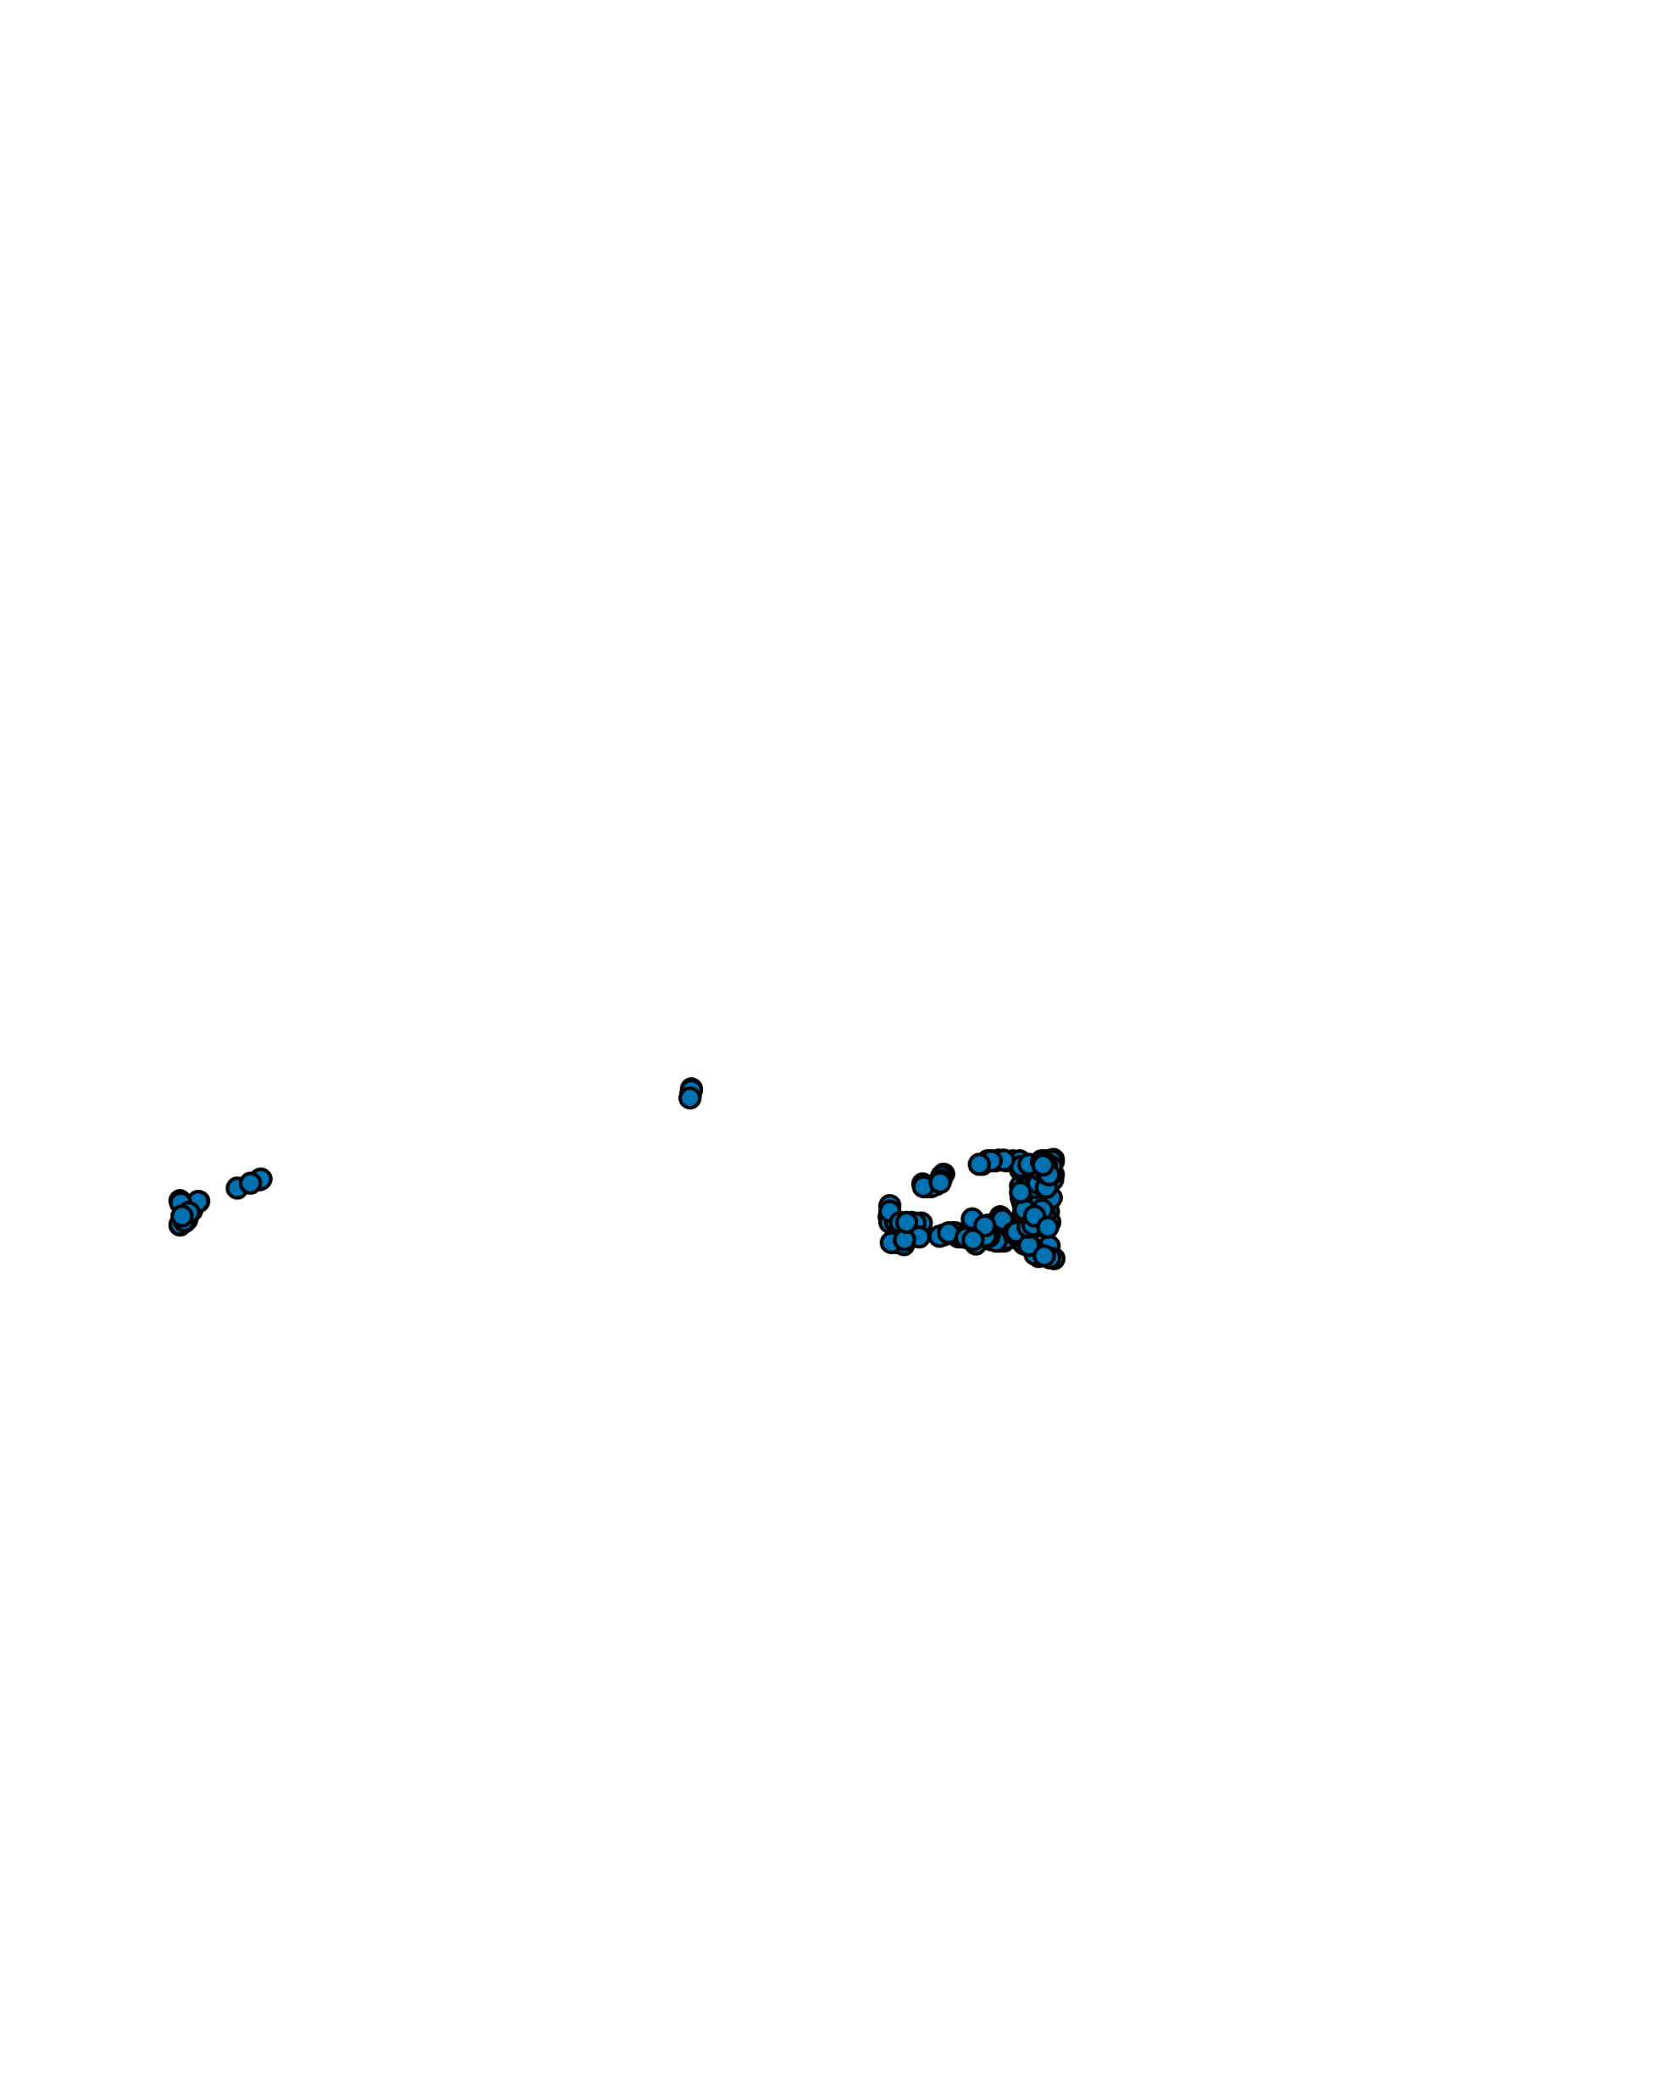

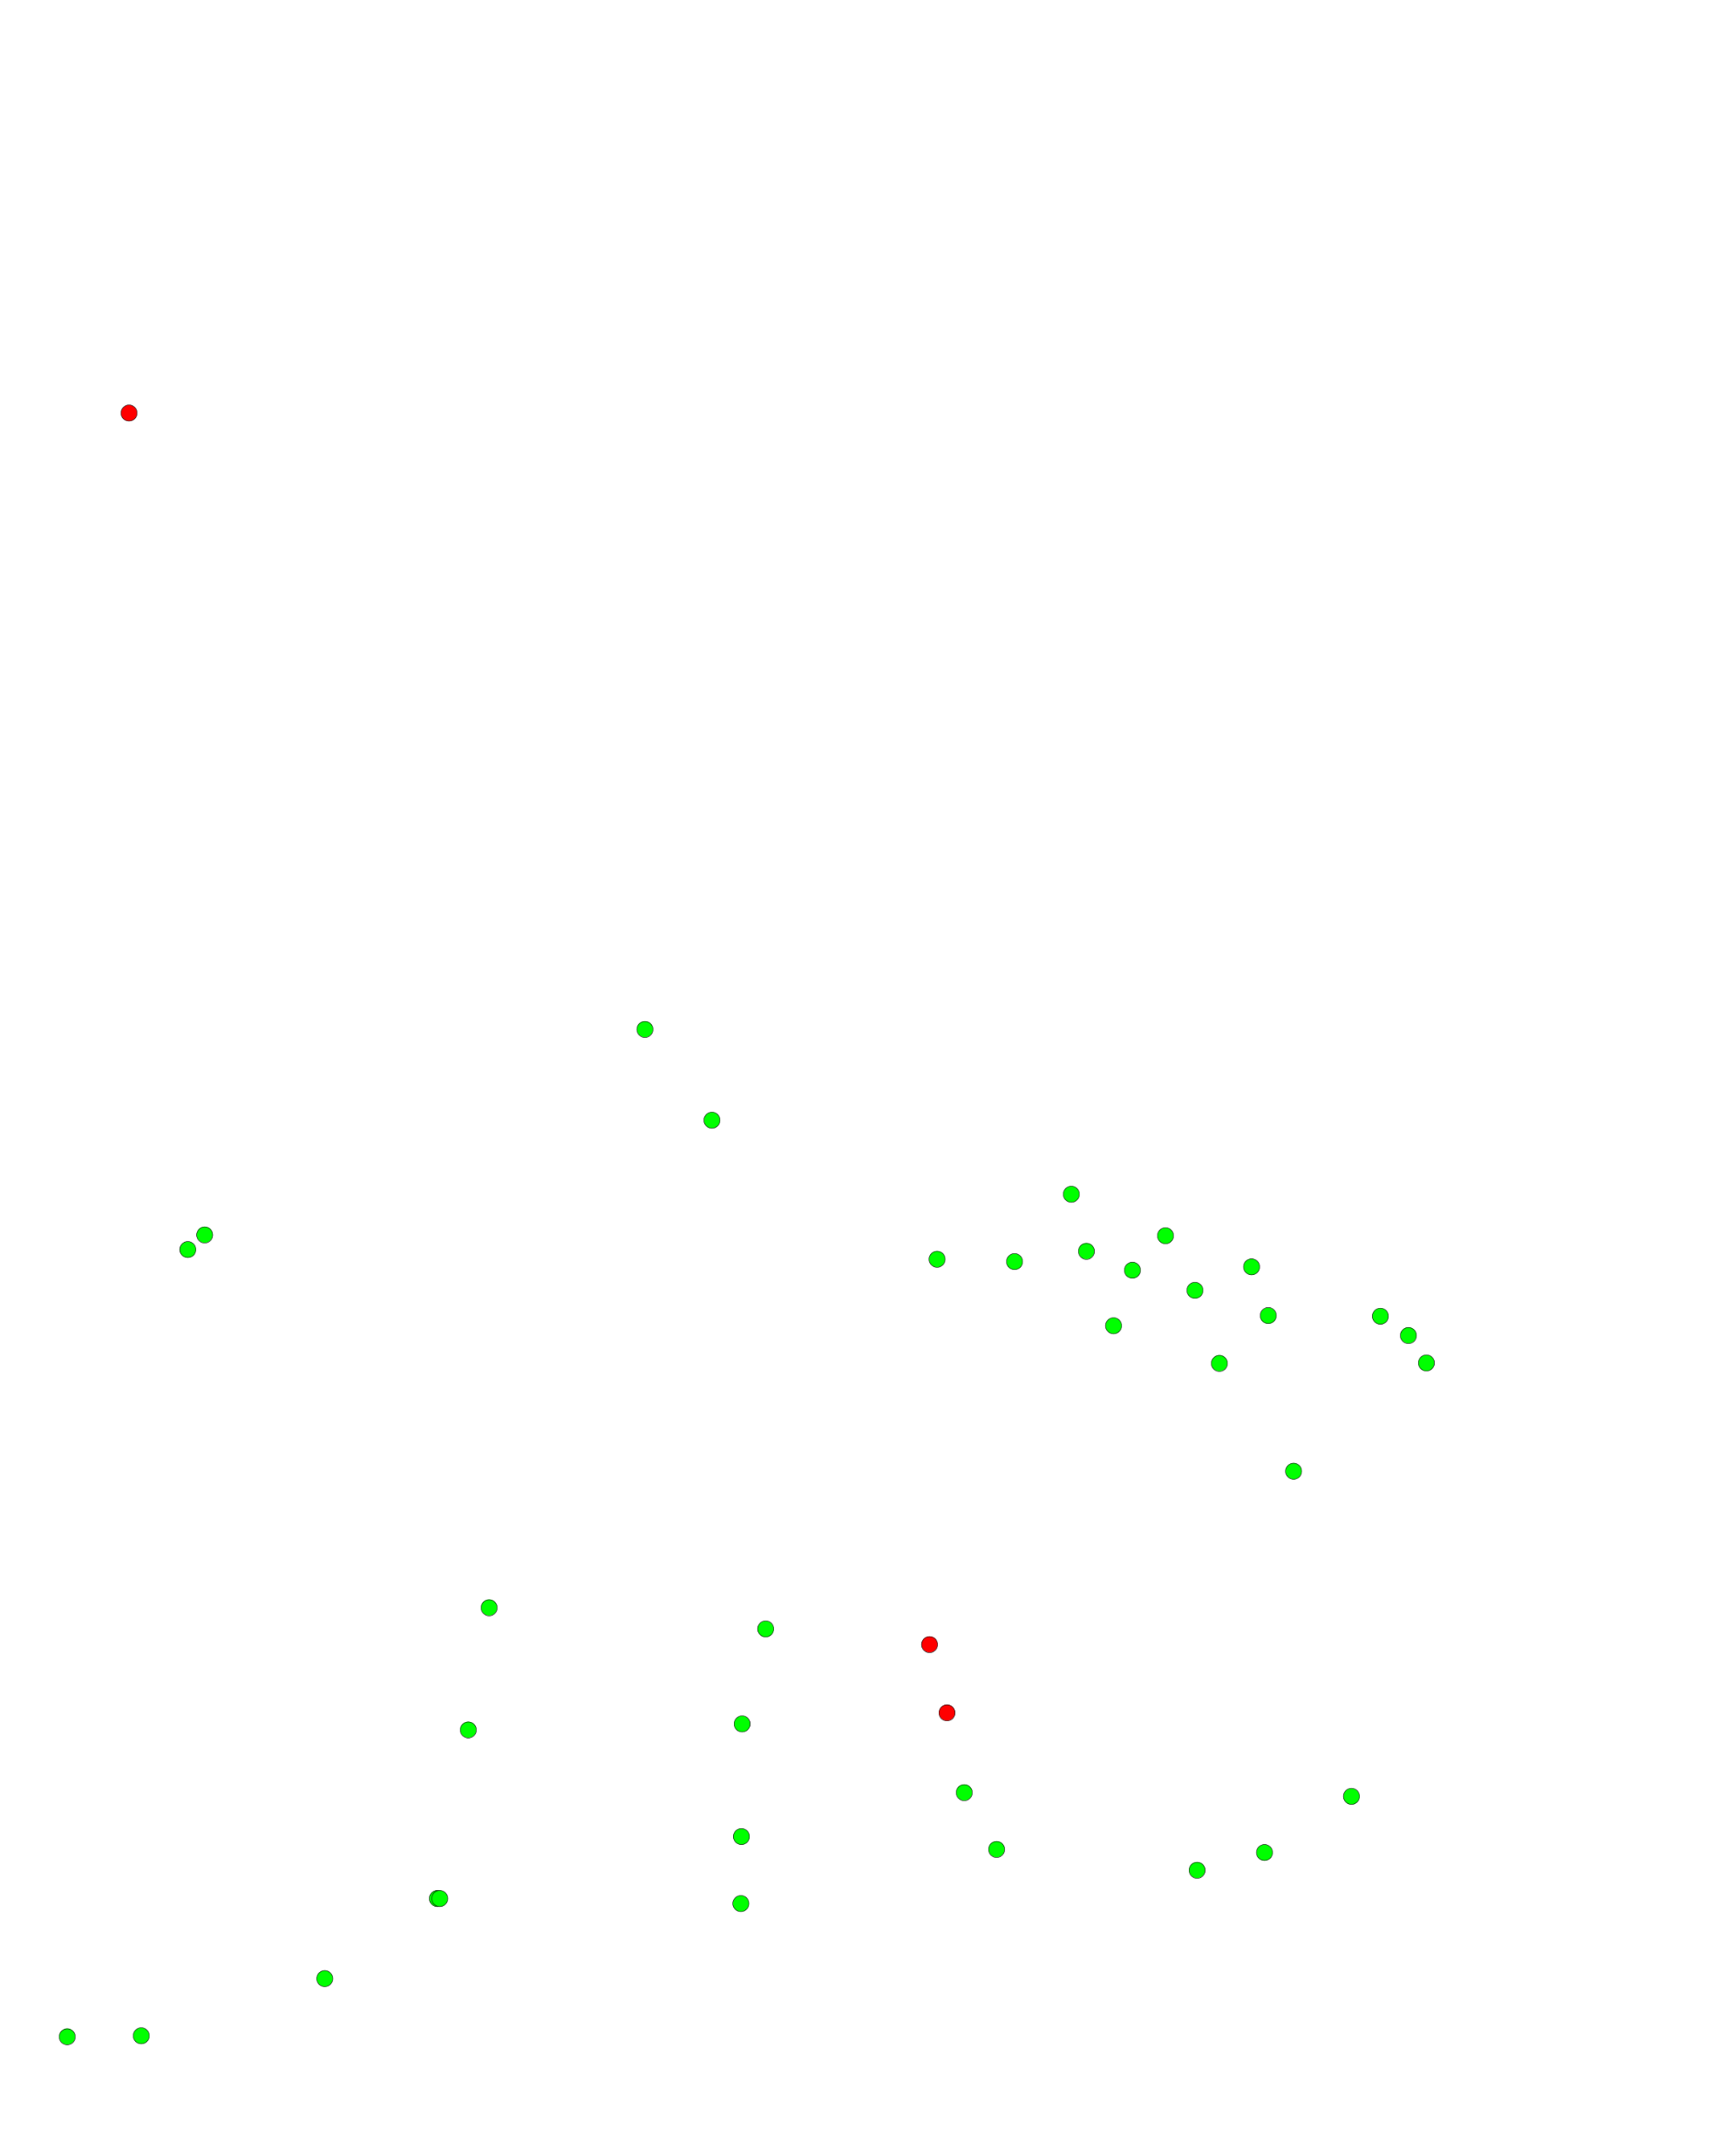
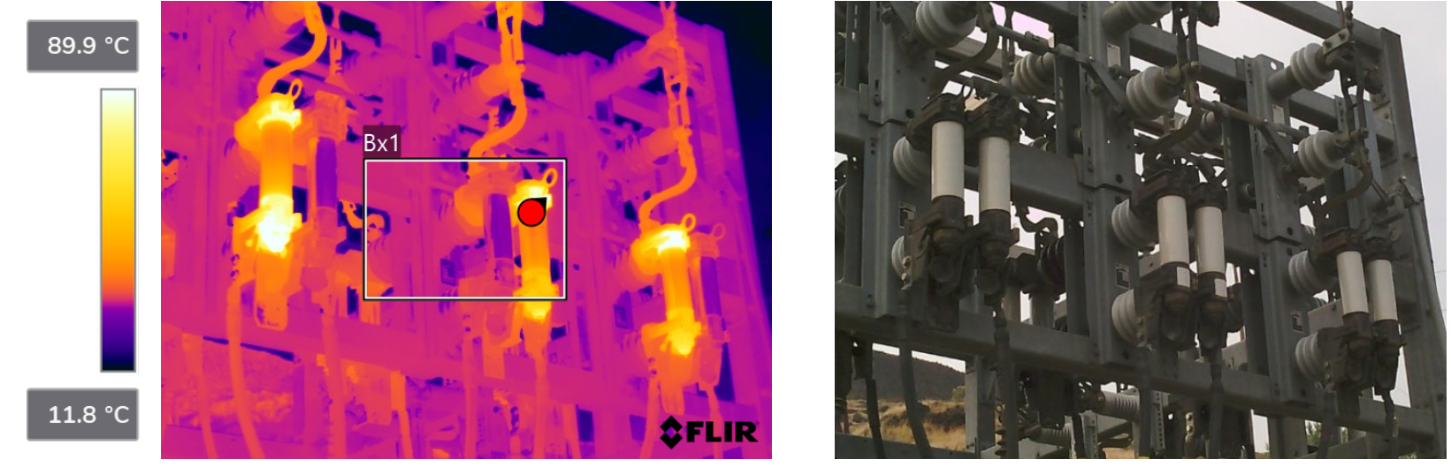
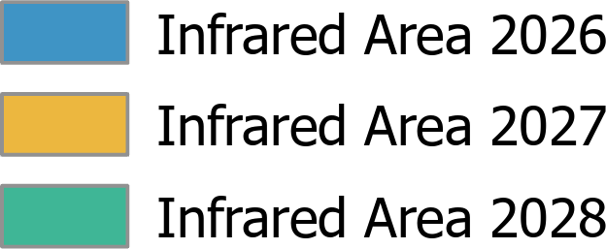

Infrared Inspections
  During peak summer & winter loads
  Substation equipment inspected annually
  Urban overhead & underground feeder components inspected every 3 years
Notes:
UPDATED One Picture 3/27/25
Zapping sounds

Slide 15
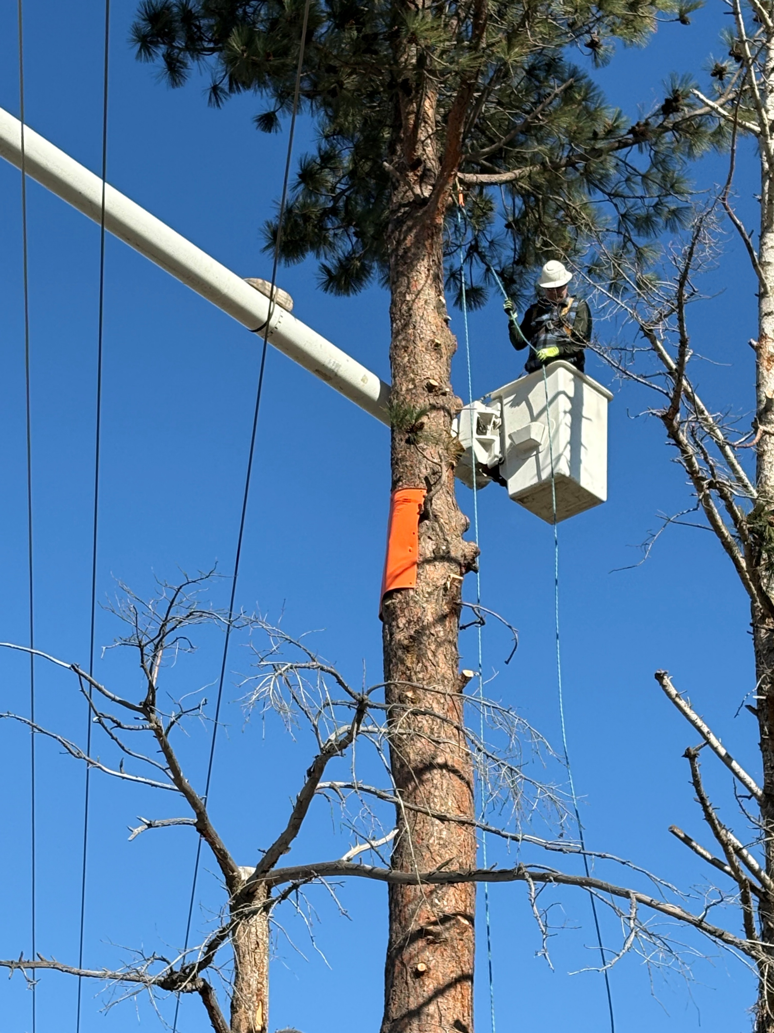
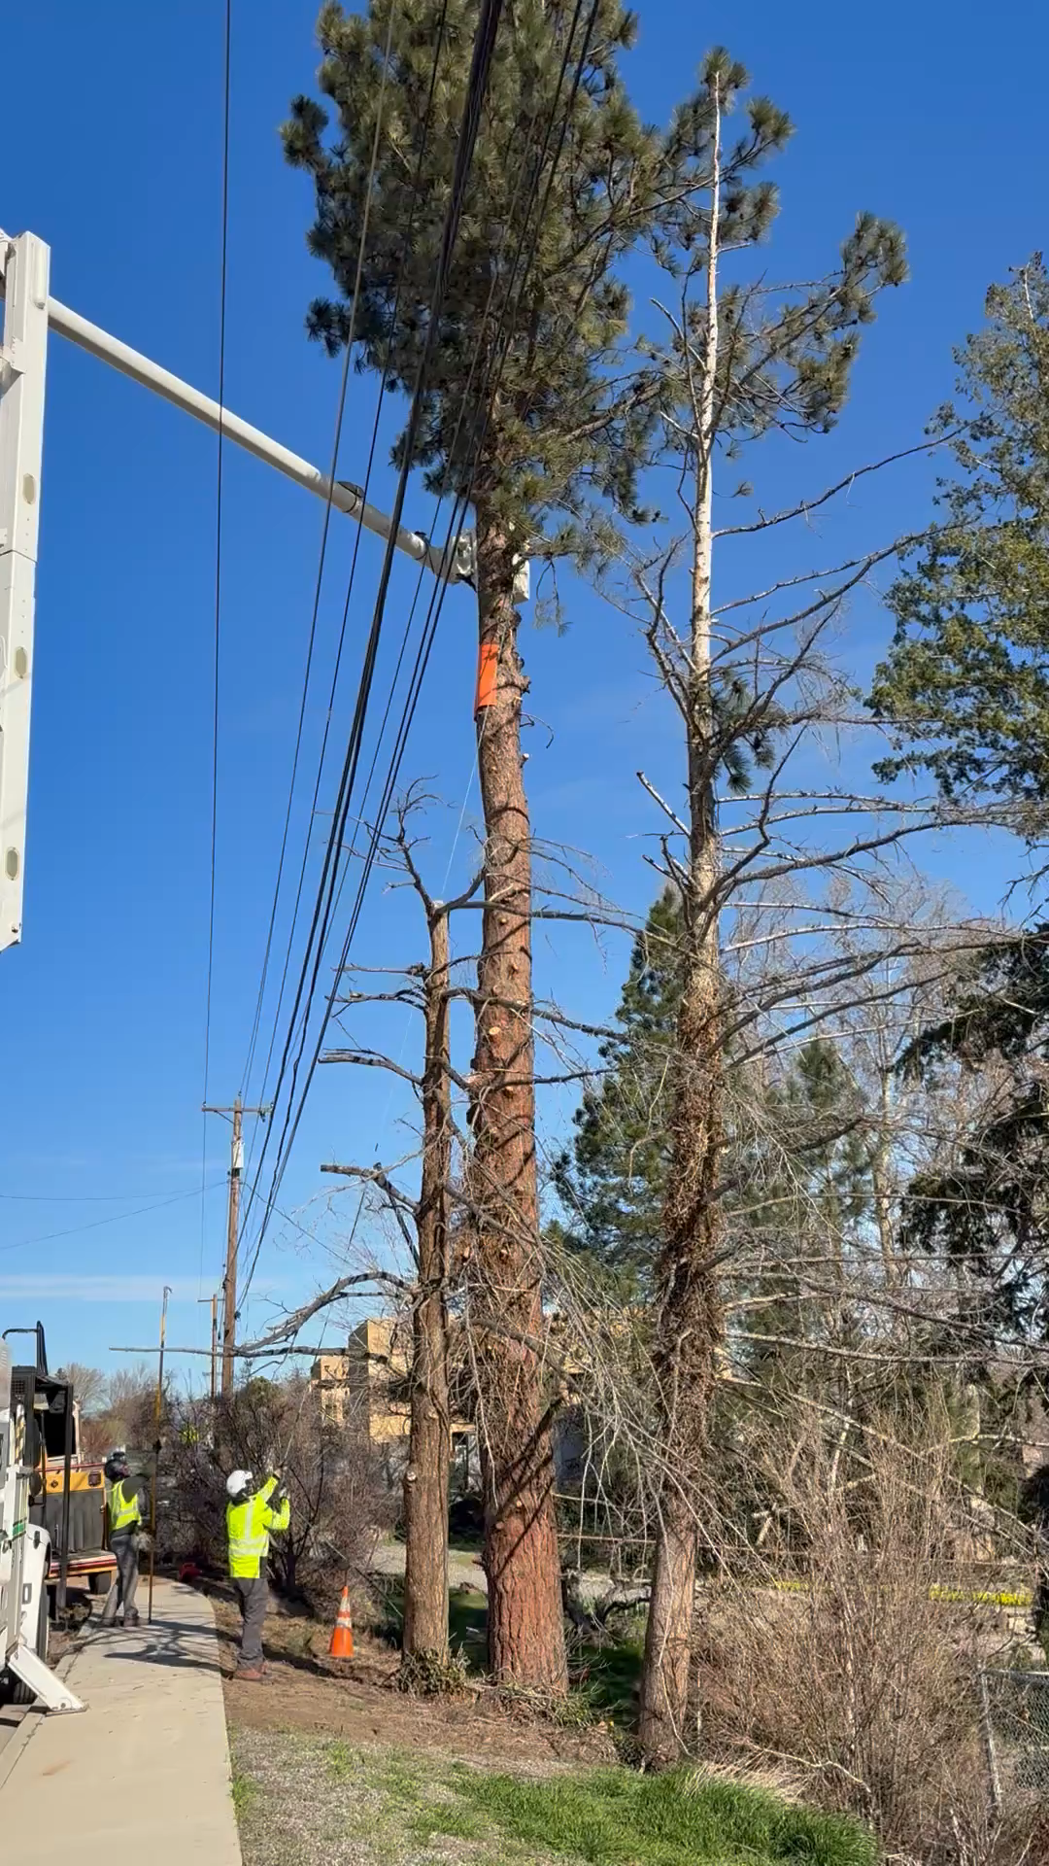
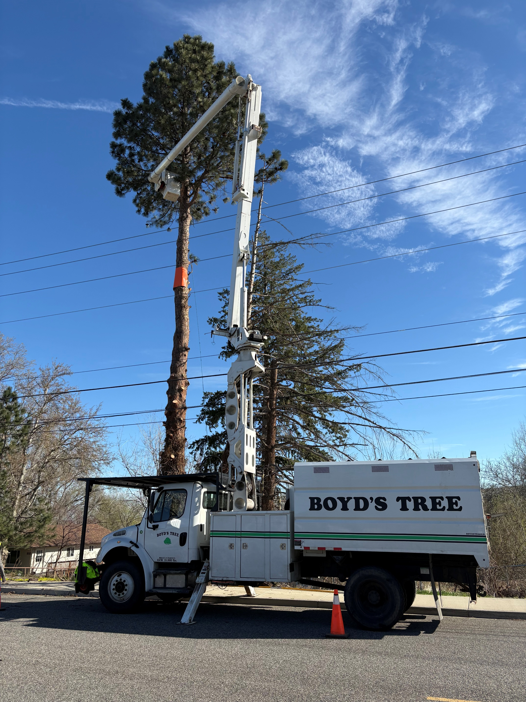
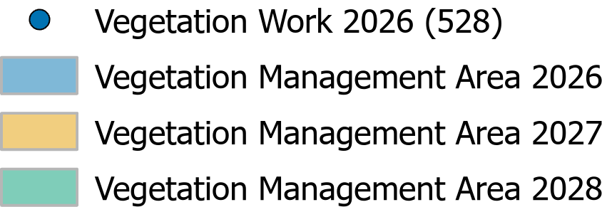
Vegetation Management
Trees pruned on 3-year cycle (fast-growing ~annually)
2025 budget: $795K
  Actual: $756K
  ~ 1.75 crews
2026 budget: $825K
  Projected: $700K
Notes:
Trees are trimmed on a 3-year basis but there are some cycle buster trees that are done annually. Our line clearances tree trimmers have been efficient over the past several years so that we are under budget last year and trending that way for 2026. We will be going out to bid for our 2027 contract

Slide 16
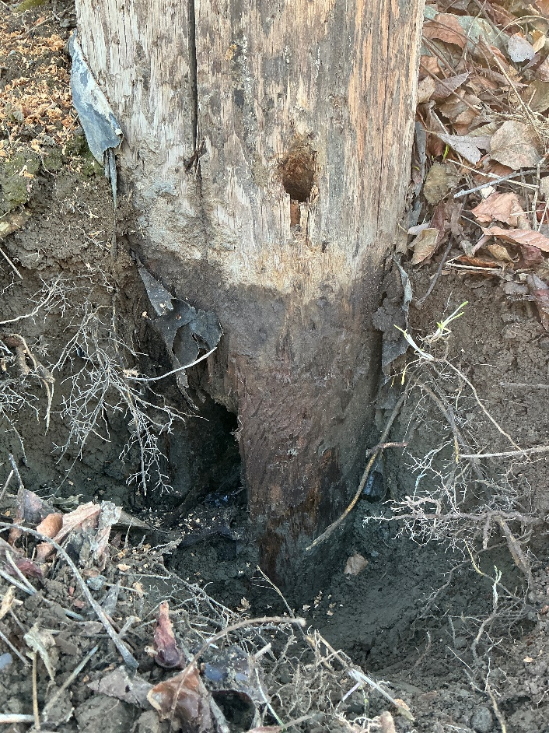
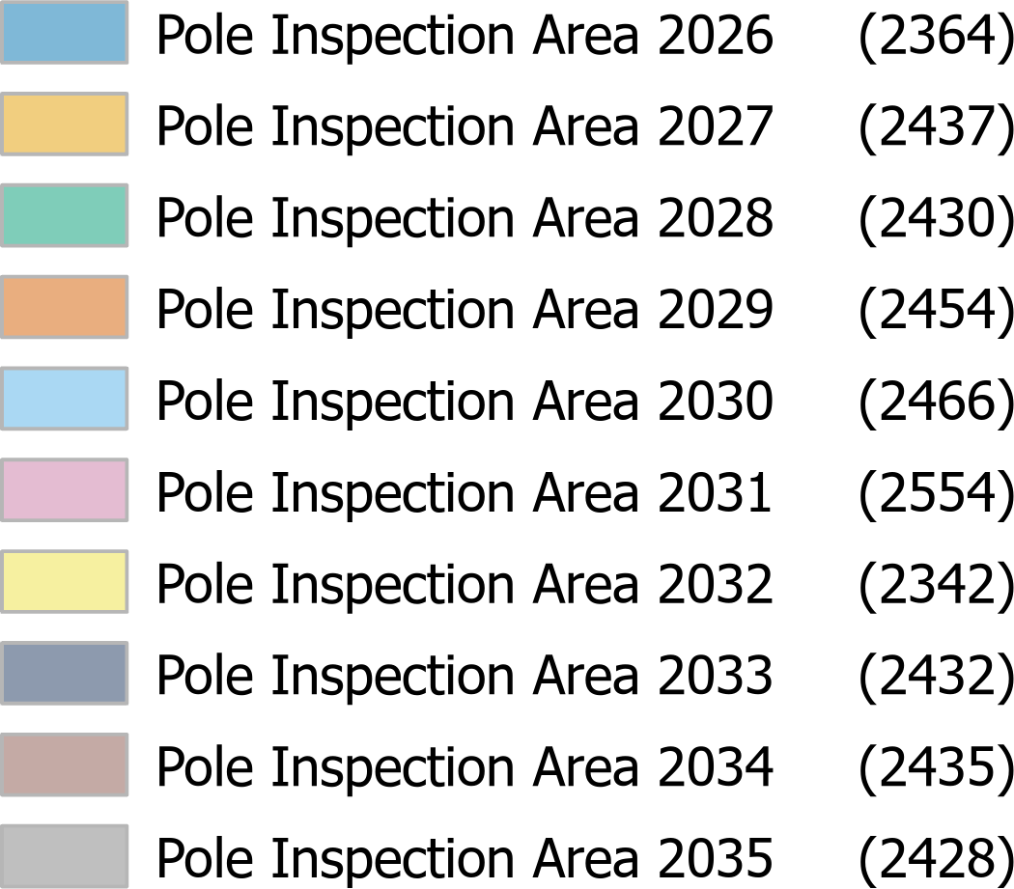
Pole Testing
10-Year Cycle
24,342 Total Poles
  Testing for Pole Decay
Notes:
Reject poles is higher this year, we have been looking into these being the PPL poles that we acquired? As old as 1942
Pole testers inspect poles for decay by sounding with a hammer listening for hollow spots. Then drill pre-determined test holes using a specialized tool to find any decay. They give the pole a pass or fail rating based on the amount of decay they find. If the pole passes, they add fumigant to preserve the pole until the next test cycle. Fumigant can be done every 10 years when the pole is tested. The reasoning behind this is to keep the pole preserved for 50-60 years at minimum. No fumigant is put into the pole if it fails as they plan to replace the pole.
They also perform a visual inspection looking for things like: loose hardware, broken crossarms, missing or damaged ground wires, and loose guy wires.

Slide 17
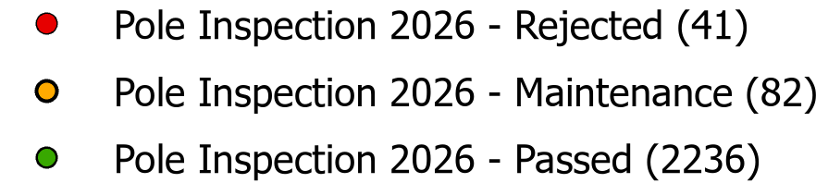
Pole Testing
2026 Pole Testing Expense:
  $182,224
  2,331 poles were tested
  $78 cost per pole
  Reject Poles: 41
    1.7% failure rate (typical <1%)
    Average pole age: 52 years

Slide 18
Asset Maintenance
Transmission Line Framing
Power Transformer Maintenance
Substation/Line Device Maintenance
Nine Canyon Windfarm

Slide 19
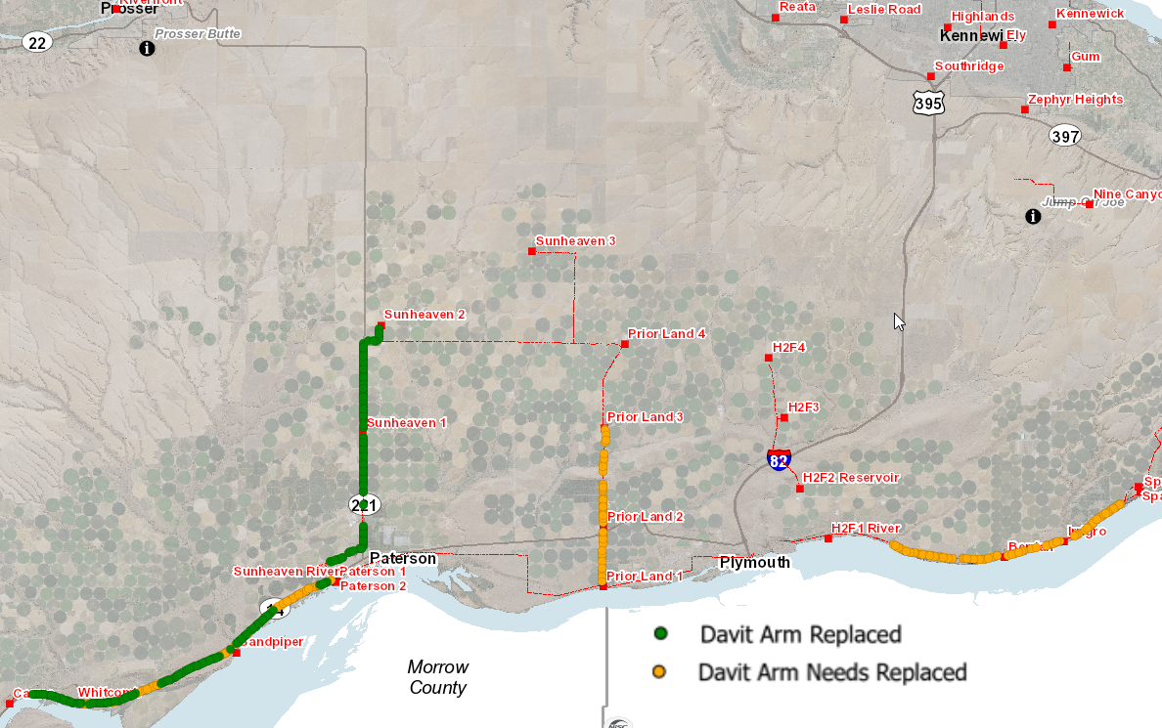
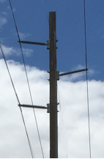
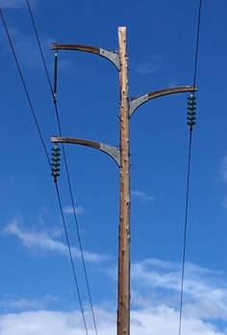
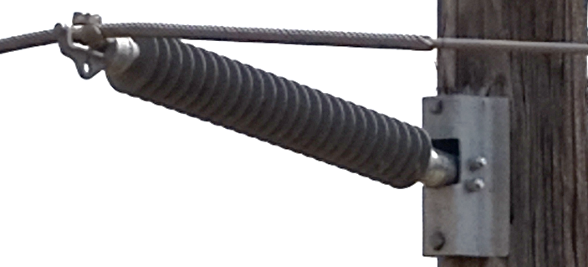
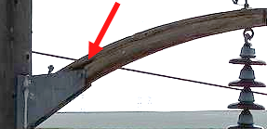
115kV Transmission Framing Replacement
Total Completed Overall
192
Total Remaining
Overall
172
Avg Completed
per Year
50
Avg Cost per replacement
$3,410
Davit
Arm
New Line Post Insulators
Notes:
WO 723689 Replaced 21 Davit arm assemblies Financial ‘Actual Cost $119,895 Construction Actual Material $28,106.69 Construction Actual Material Labor $43,509.16=$71,615.85/21=$34102.28 per pole. These are difficult structures to reach as they are on hillsides behind fences – travel time is a factor as these are work-in jobs along the river as they have time.
Some of the gold poles area actually H structures and have been replaced- I changed the remaining overall number to reflect what I know
We have skipped some areas where access will require roads built.
We’ve also skipped Davit arm angle structures – we are looking into composite davit arms for future replacements.

Slide 20
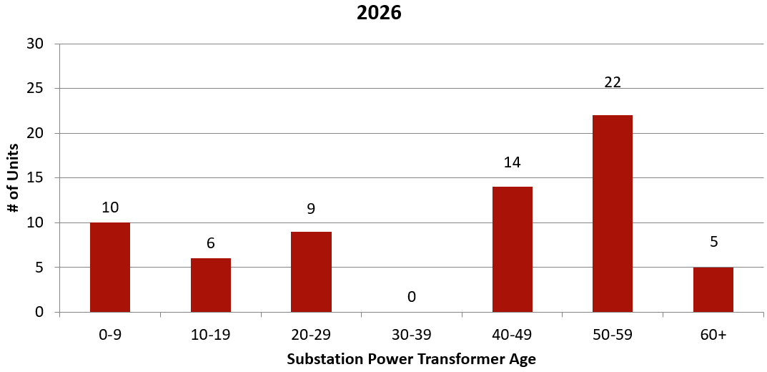
Power Transformer Age
Power Transformer Maintenance
Total Inventory
66
Capital Budget Planning: 2026 – 2046
Current Cost: ~$1.4M each
The 5 Year Capital Plan includes a forecasted $1.8M in 2032+
Revisited annually
Notes:
Our power transformer fleet, while relatively healthy, is aging with the majority being 40 or older.
Current capital planning has a power transformer purchase forecasted in 2032+

Slide 21
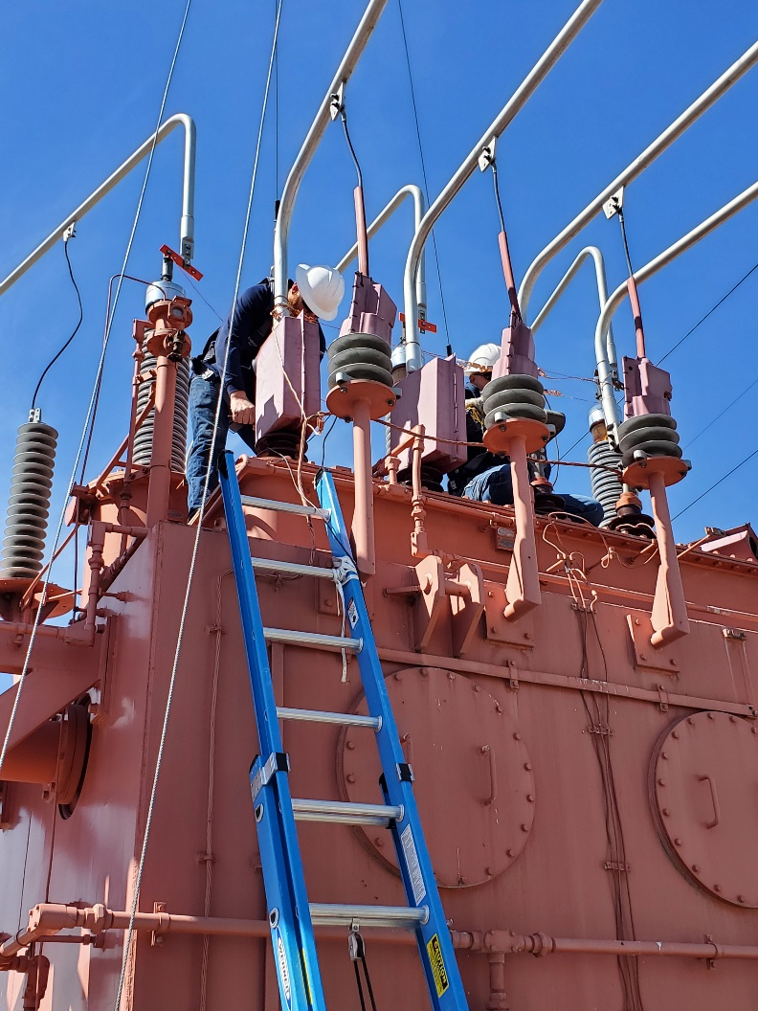
Specialized Electrical Testing
Total Substation Transformers
59
  Measures insulation power factor or dissipation factor to detect hidden damage, moisture, or aging
  Determines replace vs repair actions
  Test: 6-year cycle for Substation Transformers
  Test: 3 to 6-year cycle for 3-phase Substation Voltage Regulators
Total Substation Regulators
15
Complete
7
Remaining
4
Complete
6
Remaining
7
Notes:
The District ranks power transformer & 3 phase regulator health using a combination of Doble Testing and annual Oil sampling results.
This helps in the process of deciding which units to plan for replacement vs other remedial actions such as replacing aged components or processing the oil.
What do each of the colors mean? And the letters?
In the top row Over, HVC1, LVC1, HVC2, LVC2, LVHC, HVSA, LVSA, & EXE are all tests the are part of Doble testing and provide information about the insulation values in the transformer core & components.
The next few columns are related to different types of oil tests. DGA – Dissolved Gas Analysis tells what gases are present in the oil and how much. For example Acetylene indicates arcing in oil, while CO & CO2 can tell the age and rate of aging in the transformer winding’s paper insulation. KF- Karl Fisher Test tells us how much water is in the oil. Water in the oil causes the paper insulation to break down. So if the transformer has water in it it probably has CO & CO2 in it.
The designations (Doble Testing) are I = Investigate, D = Deteriorate, G = good. The designations are based on a massive data base of testing compiled by doble for similar transformers with similar components.
For Oil Testing the designations are AC = Acceptable, QU = Questionable.
Each of the designations is weighted and tallied to give the rankings.

Slide 22
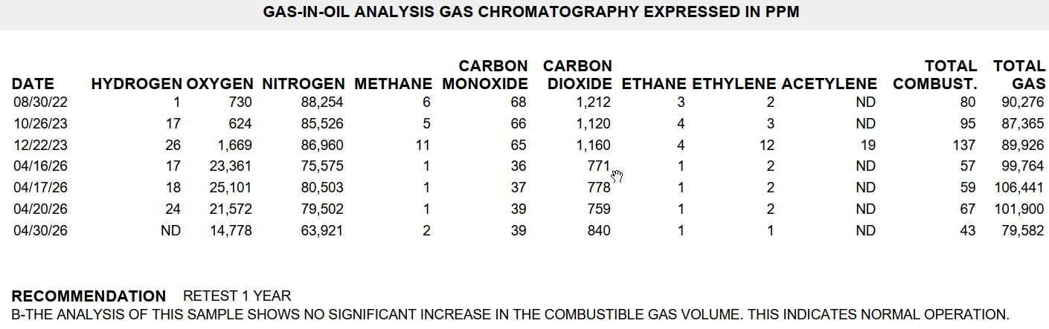
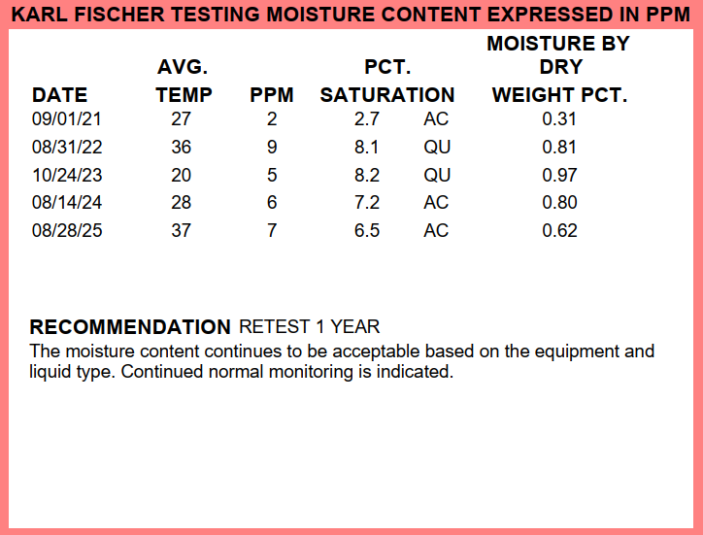
Oil Testing
  Annual cycle for power transformers and voltage regulators
  Electrical test and oil test results are weighted for criticality ranking
Notes:
Karl Fisher – Moisture Results – This unit shower higher moisture in the oil. We used our Dry Max filter unit to process the oil and reduce the moisture to a more typical level.
DGA Results – These are from the repaired Ely Bay 2 unit. Elevated ethylene and acetylene were detected after the event. After repairs and oil processing the levels have returned to normal for this unit.

Slide 23
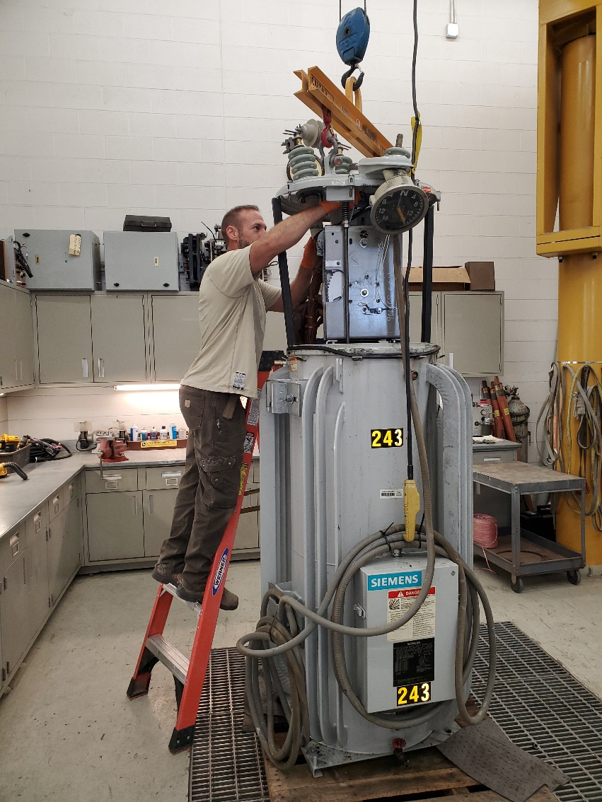
Mechanical Performance Testing
  Test: 2 to 3-year cycle for substation breakers & reclosers
  Test: 10-year cycle or 50,000 operations for line voltage regulators
Total Substation Breakers & Reclosers
126
Total Line Voltage Regulators
158
Complete
17
Remaining
6
Complete
39
Remaining
15

Slide 24
Nine Canyon Substation - Maintenance
2025 Distribution Outages:
  12/24/25 N6B Lockout (Arrester failure)
2026 Distribution Outages
  9/2/2026 N2B and N3B Lockout (Elbow, transformer failure)
2026 Maintenance Activities:
  35kV Breaker Inspections
  Annual Oil Sampling
Nine Canyon Project Life Extension
  Circuit Breaker, Circuit Switcher, Capacitor Bank Controls
  SCADA Communications Infrastructure
Notes:
UPDATED 07/2026
$9,500 a month O&M payment
2026 Maintenance Activities:
35kV Breaker Inspections
Annual Oil Sampling (63 step-up transformers, 3 power transformers)
Nine Canyon Project Life Extension:
End of service life components will need to be modernized:
Circuit Breaker, Circuit Switcher, & Capacitor Bank Controls
SCADA Communications Infrastructure
In 2025 we had to replace a number of rubber goods due to them having a 3 year shelf life. These materials are charged to the O&M portion of the contract upon receipt. This resulted in a negative balance on the contract at the end of 2025 (ENW owing us).
Thus far 2026 has been relatively low on expenses for Nine Canyon. We do have annual testing and oil sampling that will be in September’s billings but overall the balance should recover to close to even for the end of 2026.
If the Life Extension for the project does move forward, we would modernize circuit breaker, circuit switcher, and capacitor bank controls, bring the SCADA communications infrastructure up to the District’s current practices, and do an end of expected service life analysis on the remaining equipment. These costs would be captured in a Capital Project that is billed separately from the O&M costs to ENW.

Slide 25
Questions?

