Slide 1
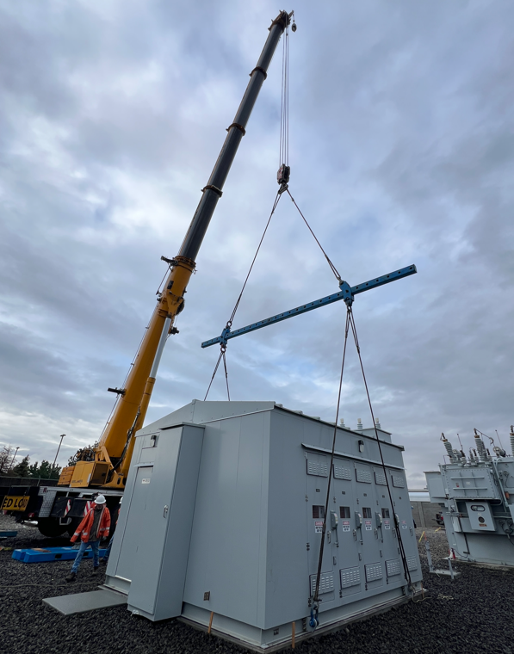

Benton PUD
2026 Five-Year Plan
of Service
(2027 – 2031)
Dax Berven, PE
September 22, 2026
1
Notes:
Commission Approval Presentation:
2026 Five Year Plan of Service (2027– 2031).
Good morning.
Before we get into it, does anyone know what is shown in this picture and where this picture was taken?
Answer –
This is at Vista Substation. Lampson is moving the bay 2 metalclad switchgear, which was placed in service November of 2025.

Slide 2
Presentation Outline
1
Key Takeaways and System Overview
2
Capital Budget Forecast
3
Five-Year Plan Process and Model
4
Distribution planning areas and projects
5
Asset renewal and transmission reliability
Notes:
Presentation overview
Going to cover...

Slide 3
Key Takeaways
Transmission and Distribution
Capital Budgets
✓ Normal operations capacity requirements met
✓ Outage contingency improvements identified
✓ Five-year plan in line with historic spending
✓ More contingency ties / reconductoring
✓ Planned replacement of aging equipment
✓ Less substation capacity being installed
System capacity is adequate for normal operations; the plan is primarily about resilience, contingency support, and targeted asset renewal.
Notes:
Key takeaways are:
- The system meets capacity requirements for normal operations.
- All distribution system improvements are for outage contingencies.
- The 5 year plan expenses are similar to historic plans.
- A focus on more contingency ties/reconductoring, ongoing Planned aging equipment replacement, and Less substation capacity being installed.

Slide 4
Our Mission
We contribute high value to our community and customers by providing energy and related services using reliable and efficient delivery systems.
Notes:
We are committed to maximizing the VALUE to our customers,
The project list is a balance – where both RELIABILITY and VALUE to our customers are considered as we continue to move the system forward into a 21st century grid.
The 5 year plan is one of the best examples of the District’s commitment to reliability.

Slide 5
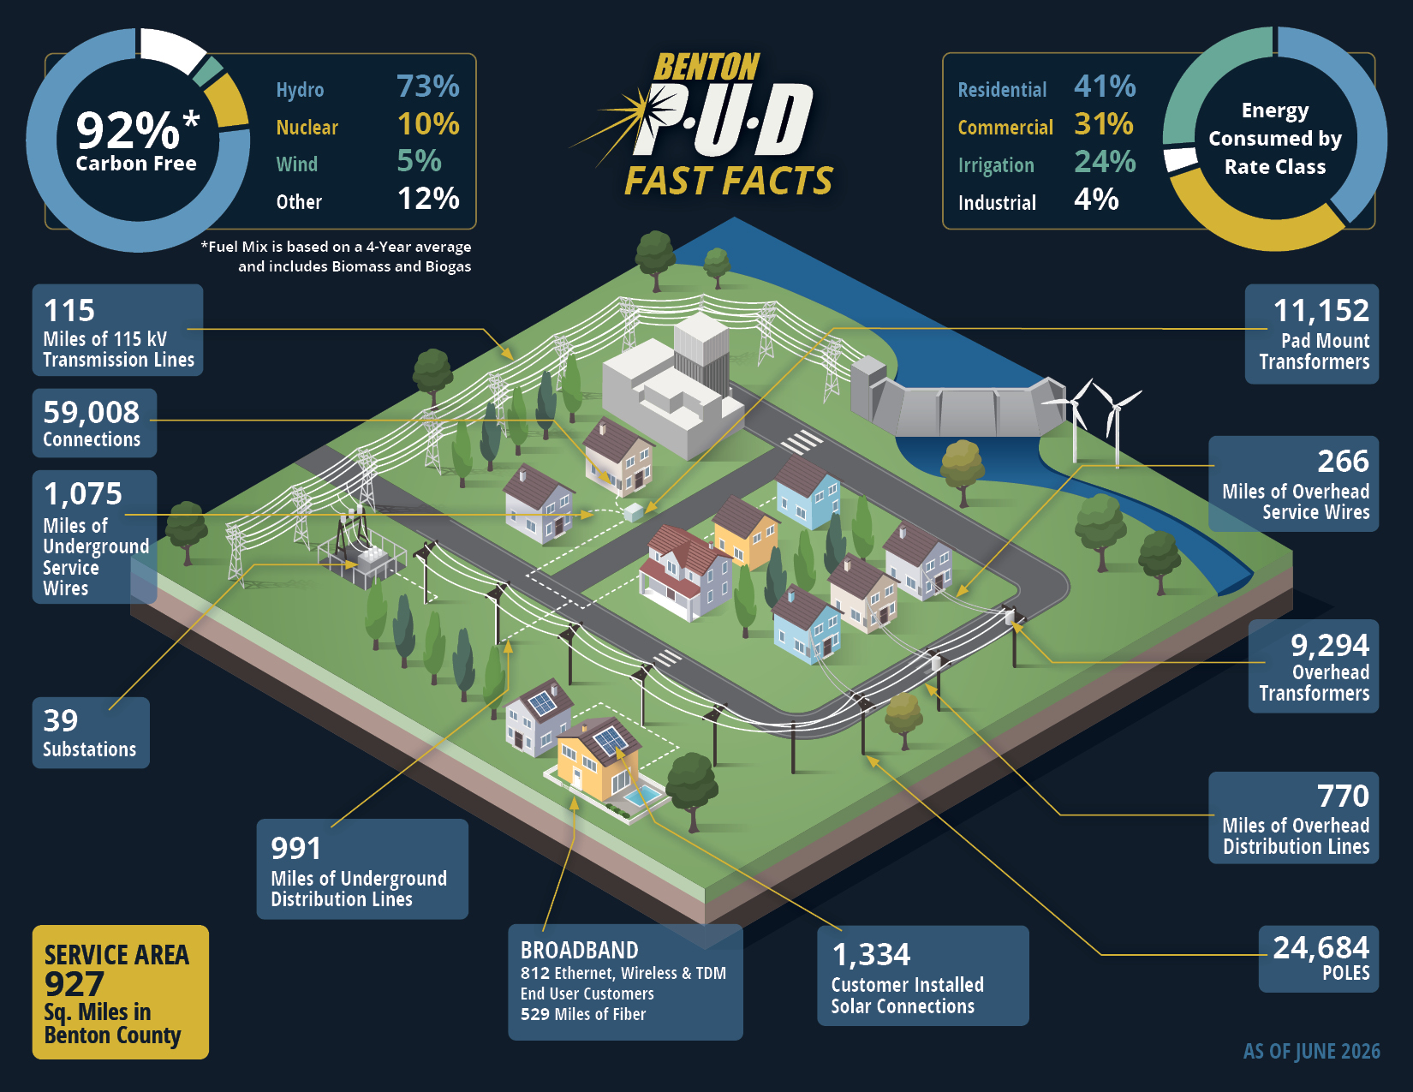
Benton PUD System — Fast Facts
40
57
Substations
Distribution Power
Transformers
59,000+
1,761
Connections
Miles of Primary
Distribution Line
Notes:
The 2026 Fast Facts sheet, just want to highlight a couple things.
Of our now 40 substations we currently have 17 urban substations that have 27 Power Transformers.
Overall, we have 57 distribution Power Transformers, just over 59,000 connections, and approximately 1761 miles of overhead and underground primary lines.

Slide 6
The Five-Year Plan of Service - Distribution
Capacity Analysis
Operating Conditions
+
Plans the distribution system for peak loading.
Evaluates normal configuration and outage contingencies.
Improvement Projects
Identifies system improvements needed to maintain performance.
Priorities & Budgets
Defines project timing and capital planning requirements.
Notes:
The 5 year plan of service…
Performs a capacity analysis and plan for the distribution system during peak summer and winter loading.
It analyzes system performance in both Normal configuration and during Outage contingencies.
The results are taken together to identify system improvement projects.
Which are then prioritized for use in the District’s capital planning process.

Slide 7
Capital Budget Forecast
Forecasted Capital Budget ($K)
Project Type | 2027 | 2028 | 2029 | 2030 | 2031 | 2027-2031 Total
Five Year Plan Distribution | $2,744 | $948 | $2,145 | $926 | $1,702 | $8,465
Substations (Equip./Controls) | $474 | $402 | $499 | $580 | $2,953 | $4,908
Substation (SCADA) | $444 | $86 | $128 | $65 | $50 | $773
Cable Replacement & Voltage Optimization | $1,800 | $1,500 | $1,500 | $1,500 | $1,500 | $7,800
Transmission | $4,560 | $5,401 | $225 | $3,975 | $655 | $14,816
Five Year Plan Total | $10,022 | $8,337 | $4,497 | $7,046 | $6,860 | $36,762
Other Distribution Capital (Line SCADA, Line Ext., etc.) | $12,564 | $10,611 | $10,863 | $14,202 | $11,674 | $59,914
Proposed Distribution & Transmission Capital Plan Total | $22,586 | $18,948 | $15,360 | $21,248 | $18,534 | $96,676
Historical Transmission & Distribution Capital Spending ($K)
 | 2022 | 2023 | 2024 | 2025 | 2026 Amended | 2022-2026 Total
Actual | $17,857 | $20,156 | $28,721 | $26,053 | $24,422 | $117,209
2027 Plan
$10.0M
Driven by trans. and dist. upgrades, including:
Feeder extensions
Reconductoring
Underground cable replacement
Benton PUD
7
Notes:
Summary of Forecasted Distribution Capital Budget:
2027’s plan total of $10 million is largely driven by Transmission and Distribution, with Distribution upgrades primarily being reconductoring of existing lines, feeder extensions, and replacement of aging underground cable.
The Plan and forecasted capital totals for 2027-2031 are more in line with our historic averages.

Slide 8


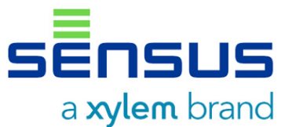



The Five-Year Plan Process - Distribution
SCADA
AMI
Mapping
and Staking
MDMR2
PWR MGMT
CUST. ENG.
MDM
Electric System Model
Notes:
The Plan process begins with a download from GIS to build the system model.
Load Data from BPA, our SCADA system, and customer billing information are used to seed the model for analysis. We have continued to improve the time synchronization between load data sources. This has helped simplify producing the model and more importantly it has led to more fine tuning each Plan cycle – which generates a model that is not overly conservative.
Power Management generates an overall system growth forecast and Customer Engineering provides known customer projects which are used to determine where and how much growth we anticipate having over the next 5 years.

Slide 9
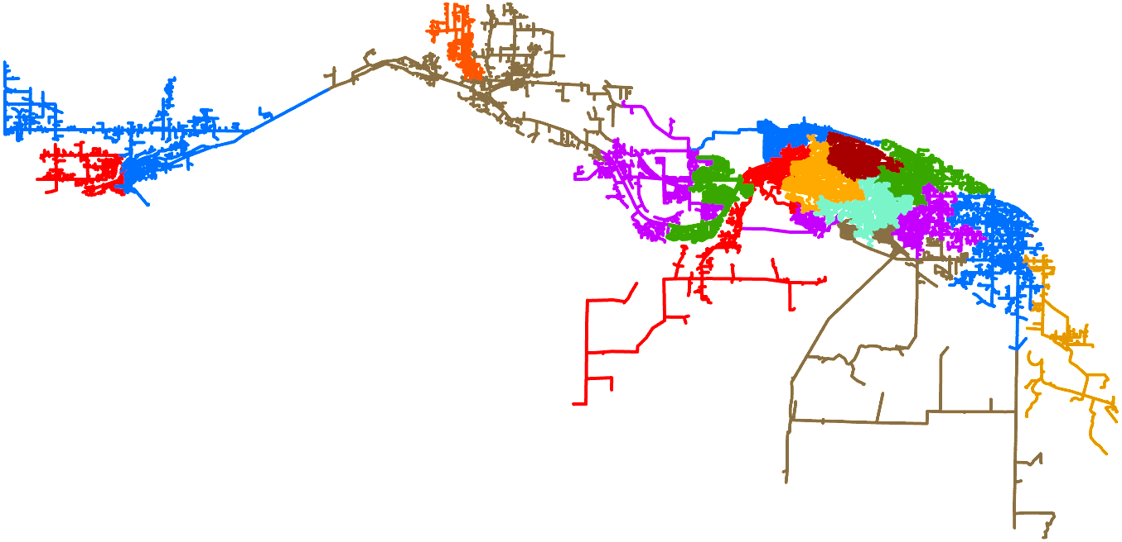
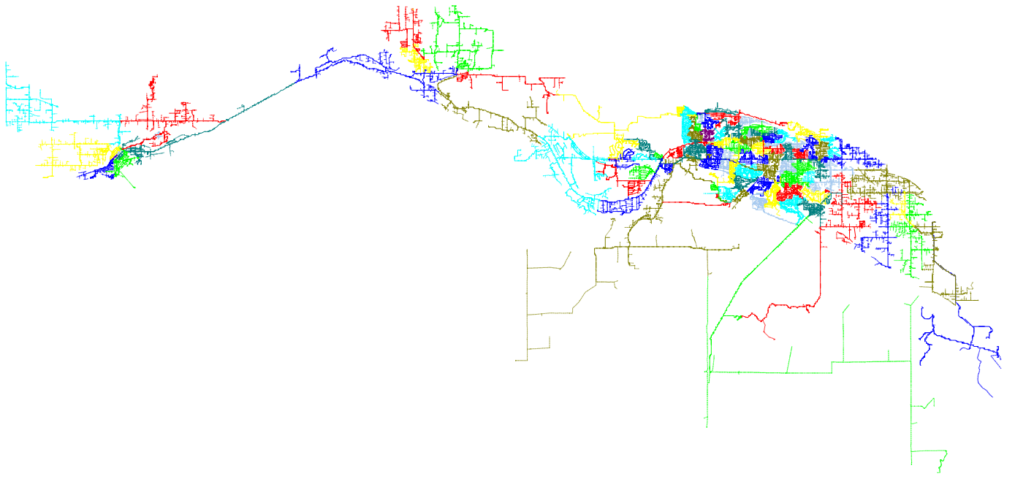
The Five-Year Plan Process - Distribution
Prosser Area
Benton
City Area
System model
Load data + growth forecast + known customer projects
West Kennewick Area
Farm planning area studied annually as part of the Large Irrigator Plan
East Kennewick Area
Notes:
The result is an accurate model for our 90 urban distribution feeders.
*click*
We break these down into the East Kennewick, West Kennewick, Benton City, and Prosser urban planning areas.
The Farm planning area is studied separately as part of the annual Large Irrigator Plans.
Next we will step through each urban region and give a little overview starting with East Kennewick.

Slide 10
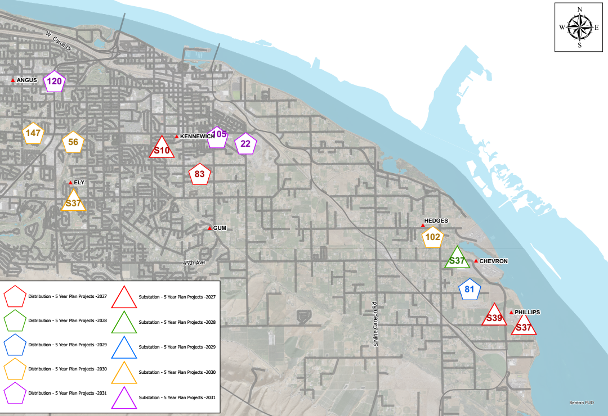
East Kennewick $1.5M
East Kennewick Distribution Capital Budget Forecast ($K)
Project Type | 2027 | 2028 | 2029 | 2030 | 2031 | 27-31 Total
Sub. Controls Upgrades | 42.3 | - | - | - | - | 42.3
Battery Replacement | 24.6 | 25.4 | - | 27.6 | - | 77.7
SCADA Upgrades | 55.3 | - | - | - | - | 55.3
Kennewick East Dist. | - | - | 410.7 | 272.3 | 616.7 | 1,299.7
 |  |  |  |  | Total | 1,474.9
Bridge to Bridge Project
Planning Focus
Bridge to Bridge
$668.7k
Finley Growth Area
Finley Growth Area
SCADA / aging equipment
Notes:
The colors represent Priority. Red and Green are known needs scheduled for the 2027 and 2028, while Blue, Gold, and Purple will be studied again in the next plan cycle to reevaluate timing.
For the East Kennewick region, the two main areas when talking about growth are the Port’s Bridge to Bridge project and the Finley area. Growth on Bridge to Bridge has remained very small. We are seeing a bit of growth east of bridge to bridge.
In Finley we have continued to see incremental growth near Game Farm Rd and recently completed extending a feeder from Zephyr Heights substation to provide additional contingency support to the area.
With that extension completed the near term of the plan is focused on SCADA improvements and replacement of aging substation equipment.

Slide 11
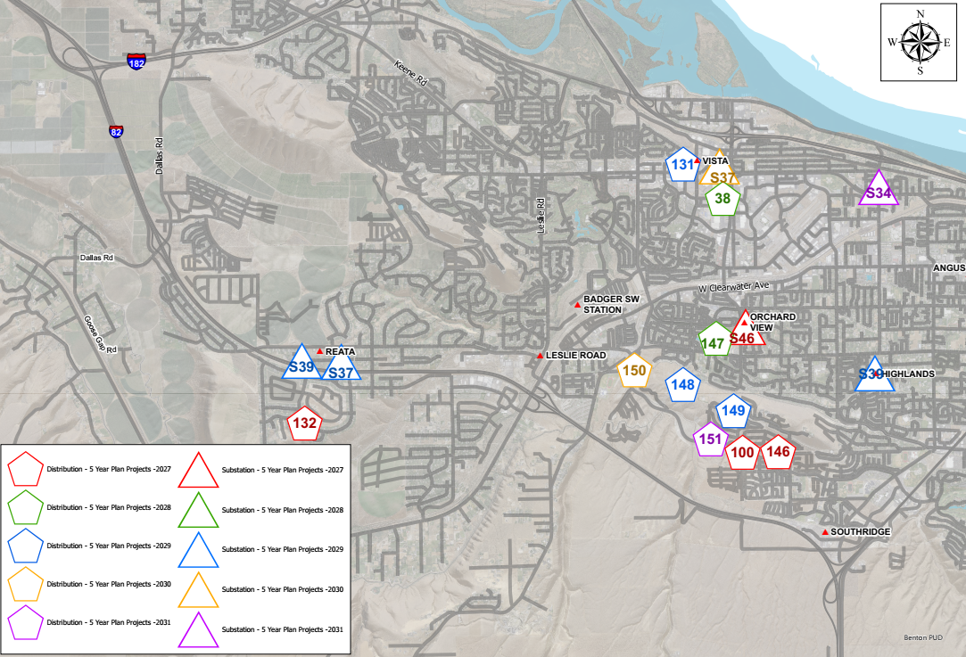
West Kennewick $7.1M
West Kennewick Distribution Capital Budget Forecast ($K)
Project Type | 2027 | 2028 | 2029 | 2030 | 2031 | 27-31 Total
Power Xfmr Replacement | 126.2 | - | - | - | - | 126.2
Battery Replacement | - | - | 20.6 | 24.6 | - | 45.2
SCADA Upgrades | - | - | 62.5 | - | - | 62.5
New Substation | - | - | - | - | 2,770.5 | 2,770.5
Kennewick West Dist. | 522.9 | 667.0 | 1,572.9 | 654.1 | 724.4 | 4,141.2
 |  |  |  |  | Total | 7,145.6
Vista Field
$2,770.5k
Badger Canyon
Planning Focus
Southridge
Vista Field
Southridge
$2,813.2k
Notes:
For West Kennewick the areas on the radar are Southridge, Vista Field, and Badger Canyon.
For Badger Canyon, subdivision fill-ins are the primary load growth, but that growth has slowed. In the long term about half the land that could feasibly be developed in the main portion of the canyon still remains. The District is continuing to evaluate available property in the area for a future substation to support the long term growth potential and contingency support needs of the area.
We have been seeing consistent residential growth in the Southridge area. The City of Kennewick’s Urban Growth Area expansion to the south of I-82 is progressing through getting city services available. We are well positioned to serve continued growth in the area via Southridge substation, the Ridgeline substation property, and we will be bringing additional feeder support from Orchard View substation.
Vista Field is slowly trying to gain momentum. We have been seeing some commercial growth around the area but that is more associated with the convention center expansion; with limited growth within Vista Field itself. We previously added a feeder in the area to support the short to medium term development. For long term growth we have the Edison St. property, which is currently scheduled for construction in 2031 but timing will be reevaluated in the next plan cycle to see if the momentum at Vista Field accelerates.
Other infrastructure improvements in the area include replacing the Power Transformer at Orchard View bay 1, additional feeder ties near the mall, and substation SCADA improvements.

Slide 12
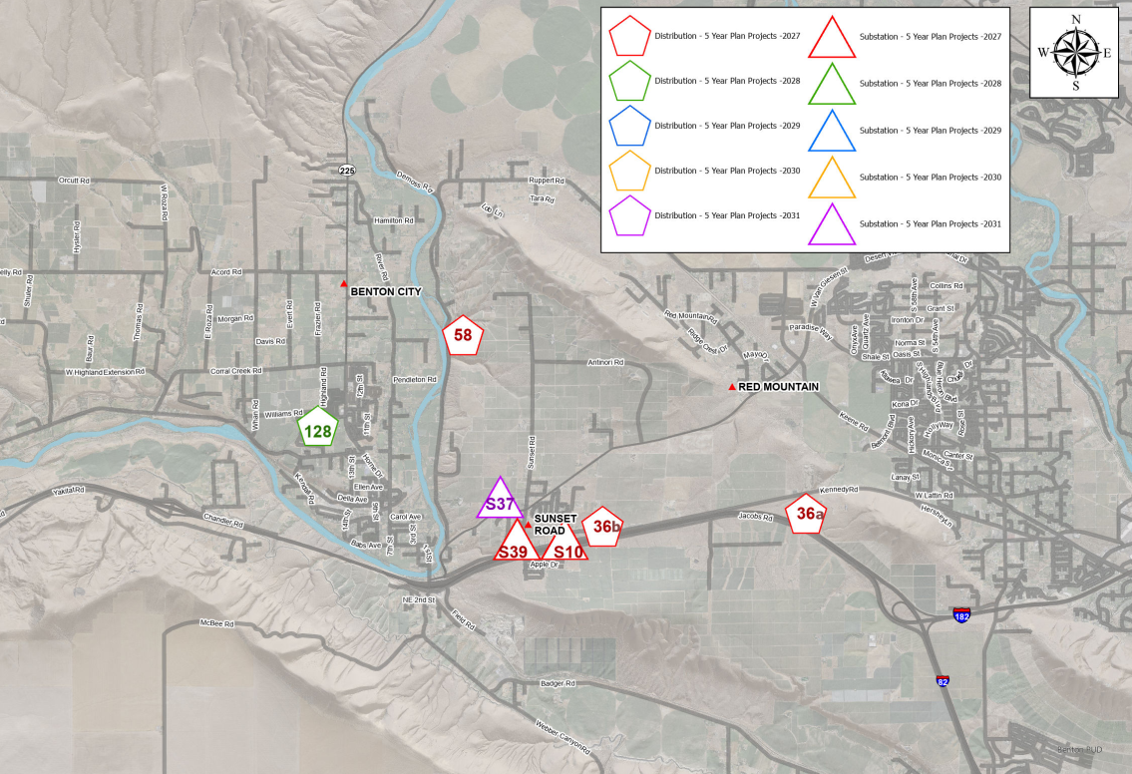
Benton City $2.0M
Benton City Distribution Capital Budget Forecast ($K)
Project Type | 2027 | 2028 | 2029 | 2030 | 2031 | 27-31 Total
Sub. Controls Upgrades | 165.5 | - | - | - | - | 165.5
Battery Replacement | - | - | - | - | 20.6 | 20.6
SCADA Upgrades | 36.2 | - | - | - | - | 36.2
Benton City Dist. | 1,519.8 | 280.9 | - | - | - | 1,800.7
 |  |  |  |  | Total | 2,023.0
Planning Focus
Benton City Growth Area
$280.9k
Red Mountain Growth Area
$1,194.1k
Red Mountain growth
Contingency switching
Sunset Road modernization
Notes:
In the red mountain area growth has slowed for us as development has pushed north and east into Benton REA’s service territory. However development has picked up a bit for us within Benton City.
This growth has continued to result in contingency switching limitations in the area. We are currently working on the second phase of extending a feeder out of Benton City substation into the Red Mountain area to alleviate those limitations.
We are also modernizing the bay controls & SCADA at Sunset Road substation and extending Sunset Road feeder #3 as part of the Sunset-Dallas transmission line.

Slide 13
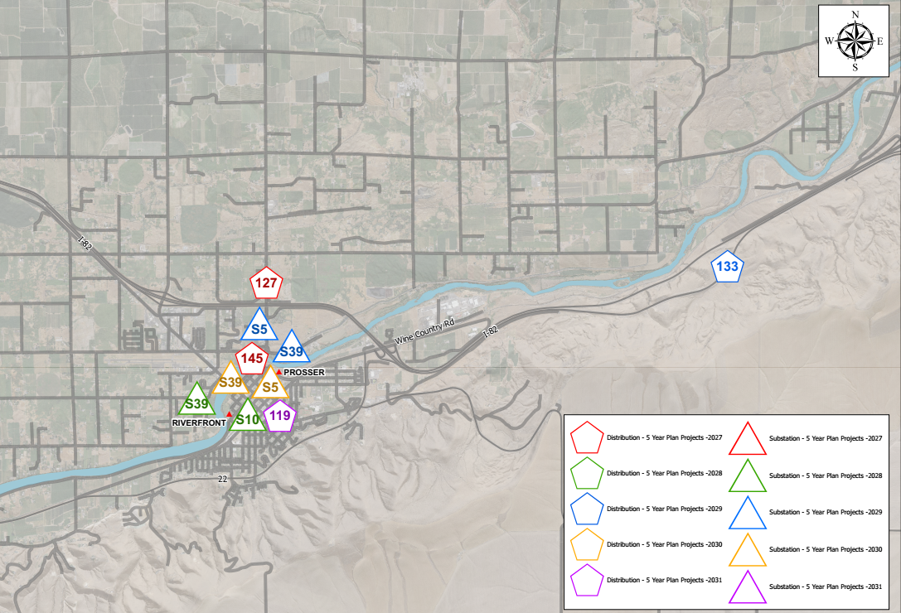
Prosser $2.3M - Distribution
Prosser Distribution Capital Budget Forecast ($K)
Project Type | 2027 | 2028 | 2029 | 2030 | 2031 | 27-31 Total
Sub. Controls Upgrades | - | 261.6 | - | - | - | 261.6
Power Xfmr Protection | - | - | 363.3 | 412.6 | - | 775.9
SCADA Upgrades | - | 36.1 | 15.0 | 15.0 | - | 66.1
Prosser Dist. | 690.8 | - | 161.1 | - | 361.0 | 1,212.9
 |  |  |  |  | Total | 2,316.4
Planning Focus
Aging infrastructure
Reliability upgrades
Notes:
For the Prosser area most of the wider area growth has been occurring within Benton REA’s territory. We have seen some growth start to pickup for us to the north-west around the Hospital which resulted in the need to upgrade feeder PSR-2 back closer to the substation for contingency support.
The majority of the other projects within Prosser are focused on replacing/modernizing aging infrastructure and reliability improvements.

Slide 14
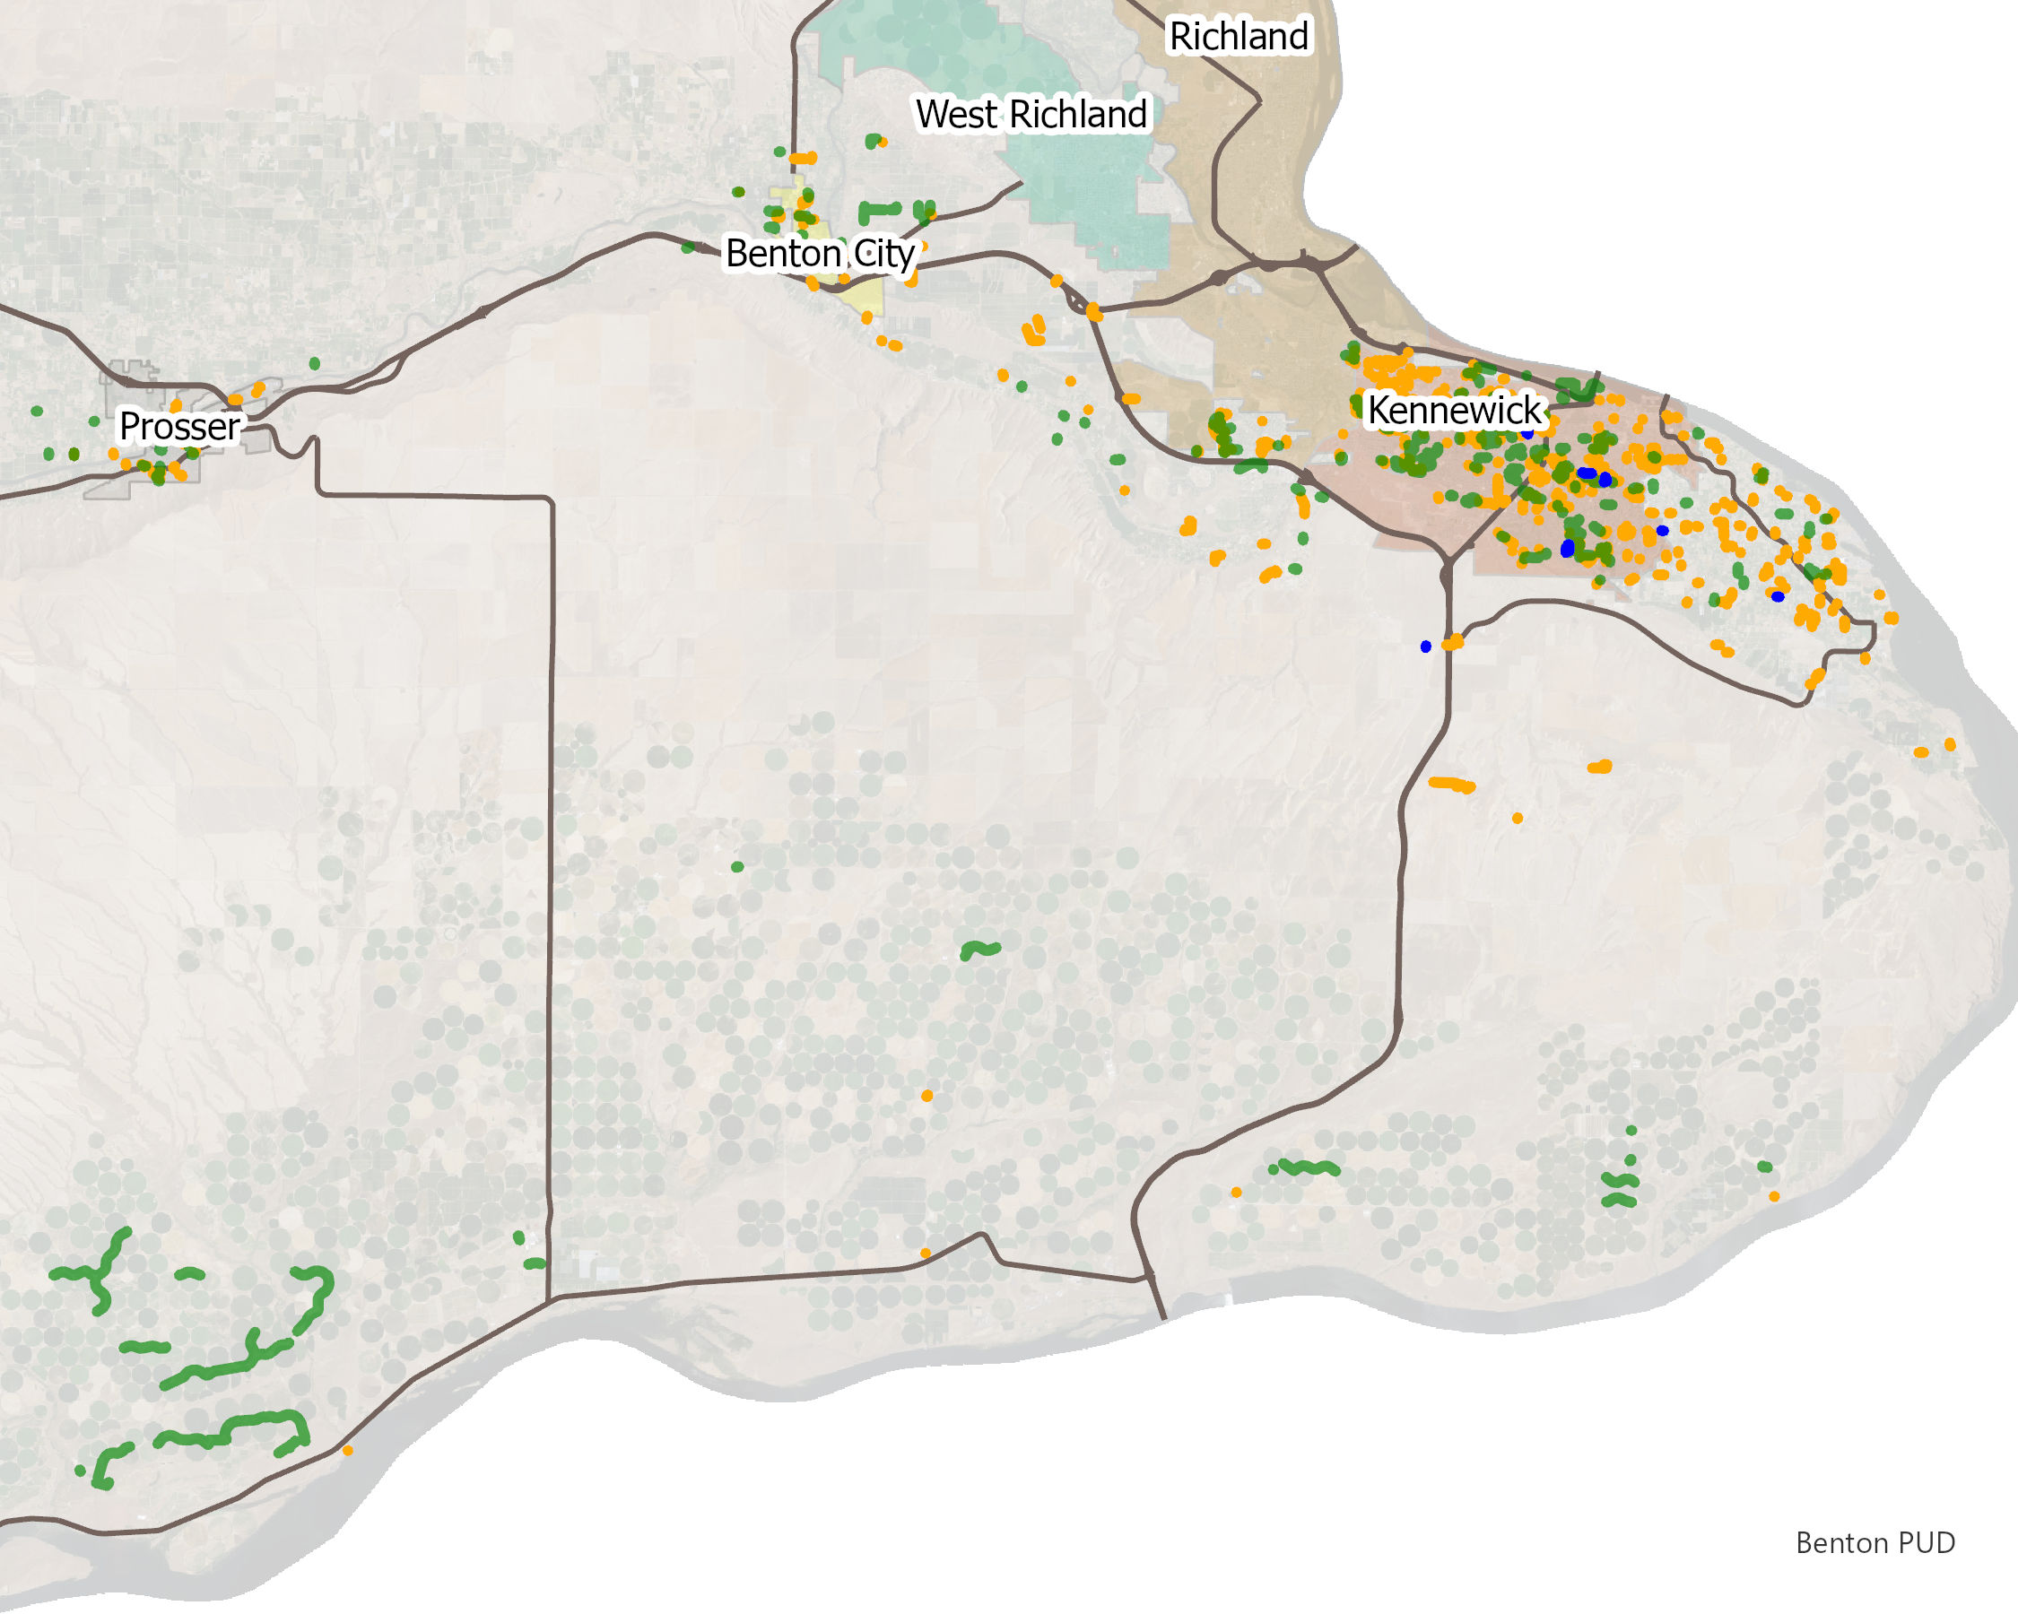
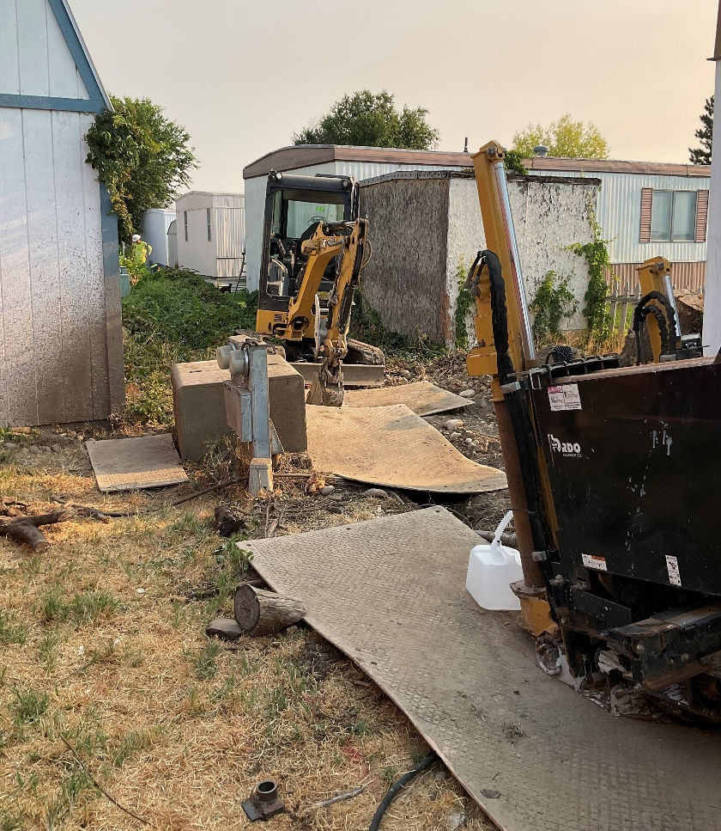
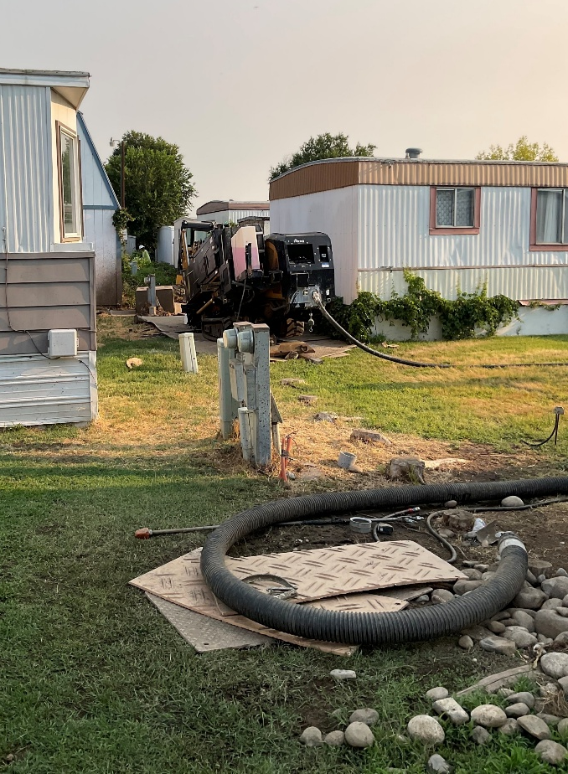
Underground Cable Replacements
Historical Cable Replacement
 | 2022 | 2023 | 2024 | 2025 | 2026 YTD | 2026 Pending | 2022-2026 Total
Actual Spending ($K) | $1,765 | $2,008 | $2,680 | $1,972 | $812 | $1,044 | $10,281
Cable Replaced (Ft) | 26,891 | 25,599 | 14,180 | 12,873 | 8,713 | 10,555 | 98,811
Replaced 2016-2025
Capital Budget Planning: 2026 – 2046
Current Cost: ~$1.4M each
The 5 Year Capital Plan includes a forecasted $1.8M in 2032+
Revisited annually
Pending 2026 Replacement
Remaining ALCN
Cable Priority
Previous faults
ALCN / HM
ALCN cable replacements are 40% complete
Projected Cable Replacement
 | Feet per Year | ALCN Feet Remaining | Years to Completion
Direct Bury and Injected Cable | 14K | 200,485 | 14.3
Cable in Conduit | 25K | 47,479 | 1.9
Notes:
Another system reliability improvement is proactive replacement of aging underground cable. We prioritize by cable type and whether it is direct buried, injected, or in conduit. If any cable has 3 or more recorded faults on it, then it moves up in priority regardless of other factors. An additional benefit is the replacement process installs conduit for any direct buried cable to facilitate replacements in the future.
*click*
By the end of 2026 we are projecting to have replaced approximately 99k ft of underground cable over the last 5 years, which is about 40% of the ALCN cable on the system. We have about 200k ft of direct buried and injected ALCN cable left to replace which is expected to take about 14 years as we continue to move through portions of the system that are rocky or are back of lot construction where access can be challenging.
*click*
And here are a couple examples of rocky/limited access.

Slide 15
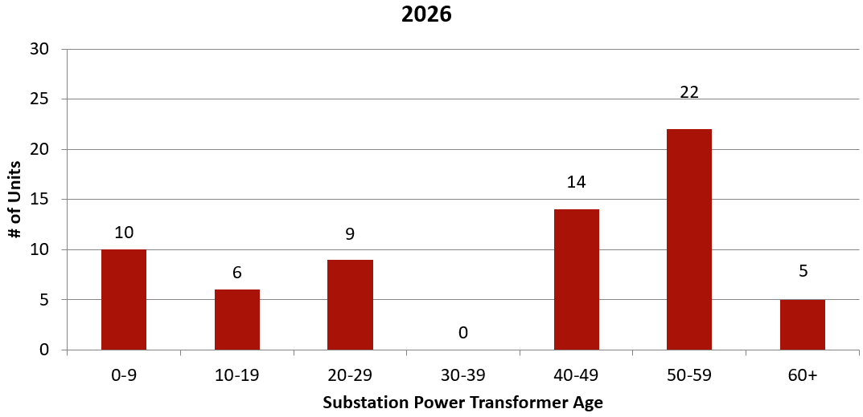
Power Transformer Age
Power Transformer Replacements
Total Inventory
66
Current Cost: ~$1.4M each
The 5 Year Capital Plan includes a forecasted $1.8M in 2032+
Revisited annually
Notes:
Moving to power transformers – our fleet continues to test as relatively healthy but it continues to age with a majority of the units being greater than 40 years old.
*click*
Current capital planning has a power transformer purchase in the forecast beyond 2031. In the event a power transformer changeout was necessary we have our mobile substation and we have a spare power transformer on hand for each configuration that’s on the system.

Slide 16
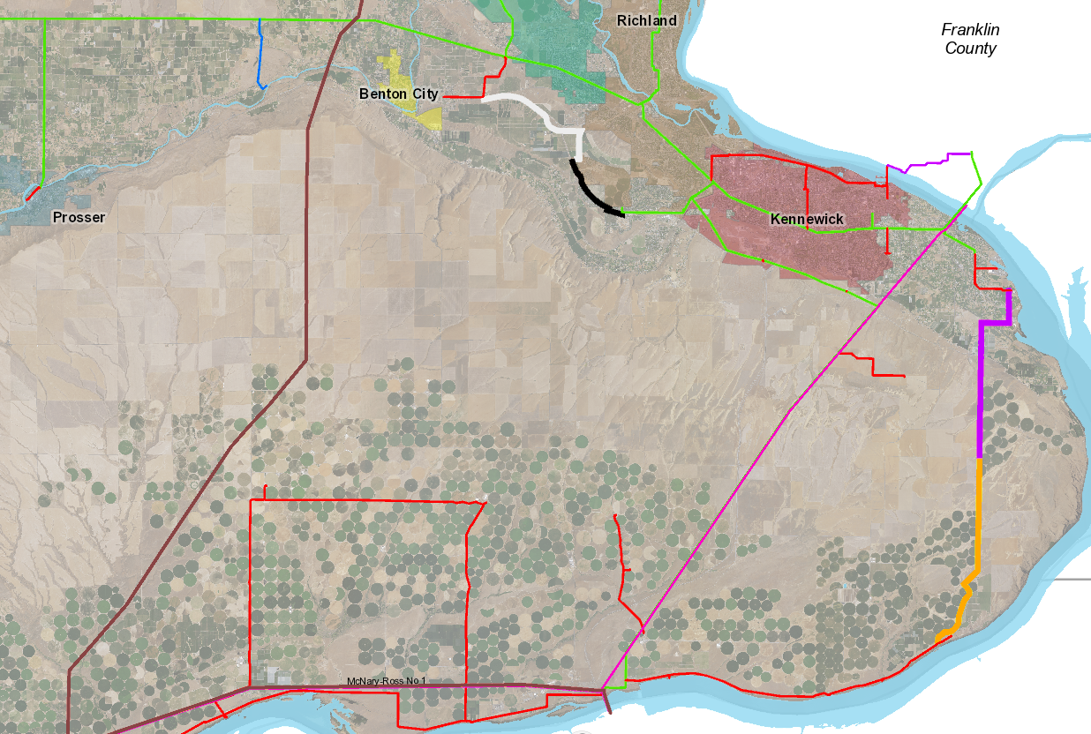
Transmission Reliability Improvement Projects
115-kV Transmission Lines for Redundancy
Sunset-to-Dallas 2026/2027
Budget: $4.8M
Reata-to-Dallas
Completed (Richland)
Faulted Circuit Indicators
Second Source to Prosser
2030+
Budget: $5.2M
River System 3rd Injection Point
Spaw-to-Phillips
Completed 2024
Sunheaven2-to-Prior4
Completed
BPA McNary POD
Completed
13
Benton PUD
16
Notes:
For the Transmission system we continue to modernize by building on previously completed projects to provide additional system reliability.
*click*
Construction on Sunset to Dallas is scheduled to start in the next month.
We are continuing to partner with BPA and Benton REA on the second source for Prosser. Our first choice is to extend a line from Riverfront substation to meet Benton REA’s proposed Mabton line at their planned Byron substation west of Prosser. The next alternative is to extend a line from BPA’s Webber substation.
With Webber under construction we are also evaluating a 3rd source into the River system which would leverage the recently completed Sunheaven #3 line.
*click*
Faulted Circuit Indicators are used by the Crews to more quickly identify the line section a fault is in and then sectionalize it for repairs. We have begun a phased installation across both the District’s and BPA’s 115kV transmission system in the area with an initial focus being BPA’s Grandview-Red Mountain line which has had some reliability issues over the last few years. The installations will be a mix of local notification (blinking) and SCADA integrated units.
(TRIP 2.0 for 2028 POS)

Slide 17
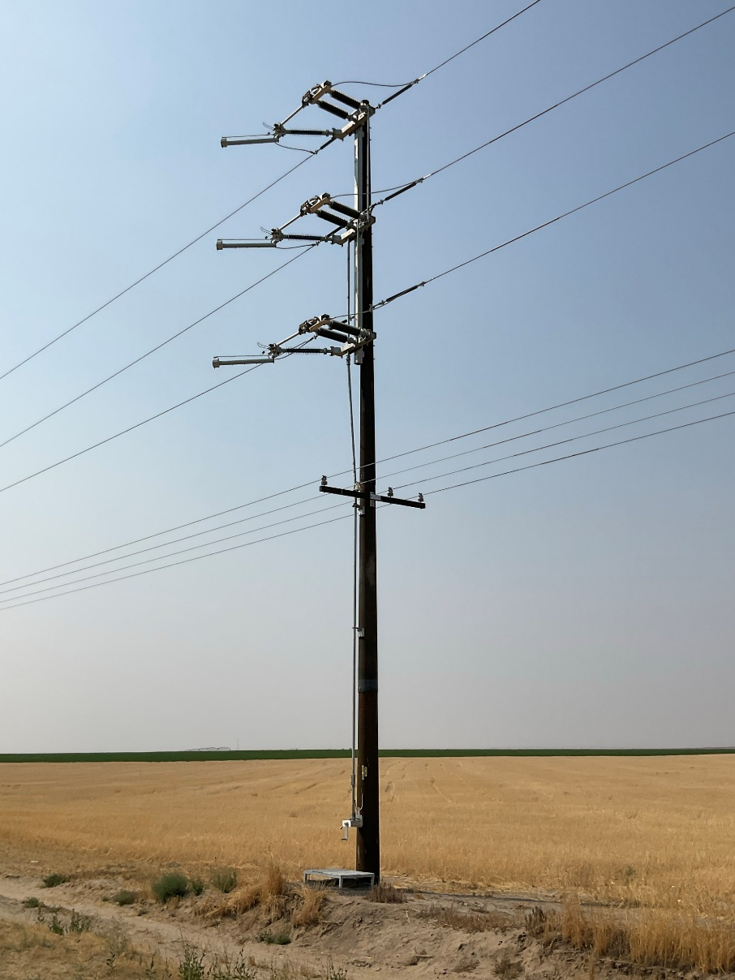
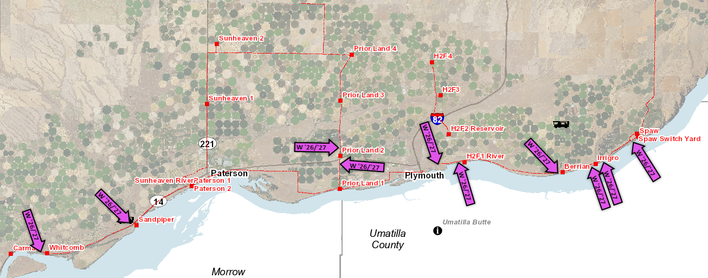
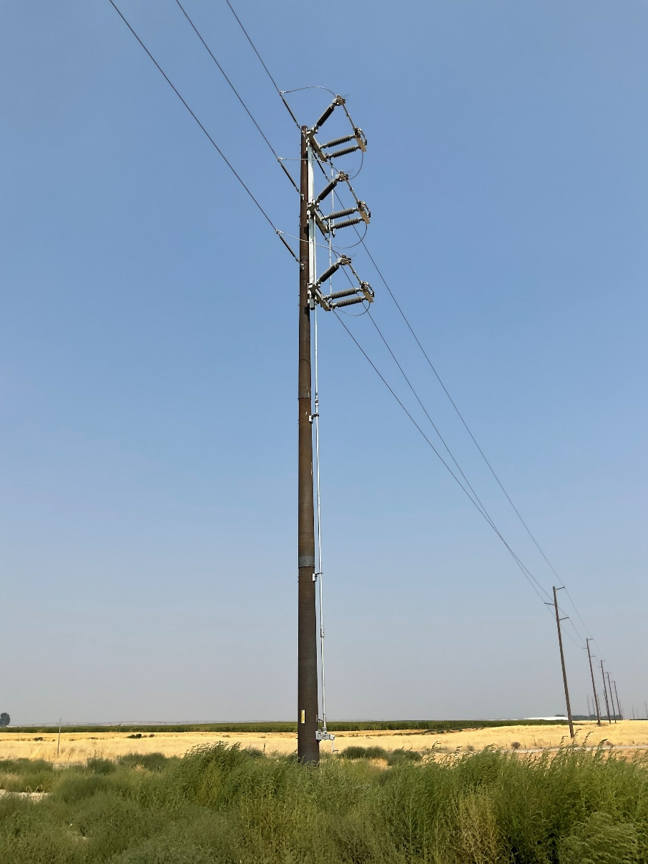
115kV Switch Upgrades/Installs
10 Switch Locations scheduled for Winter 26/27
Capital Budget:
2026 amended: $563K
2027: $522K
17
Notes:
To support sectionalizing, we have 10 transmission switch installs scheduled for this winter. 1 (Berrian tap) is a replacement and 9 are new locations.
These will further facilitate isolating line sections during outages and where we have loops available will be used for isolating line sections for scheduled maintenance such as the Davit arm replacements.
*click*
A couple examples of typical switches.

Slide 18
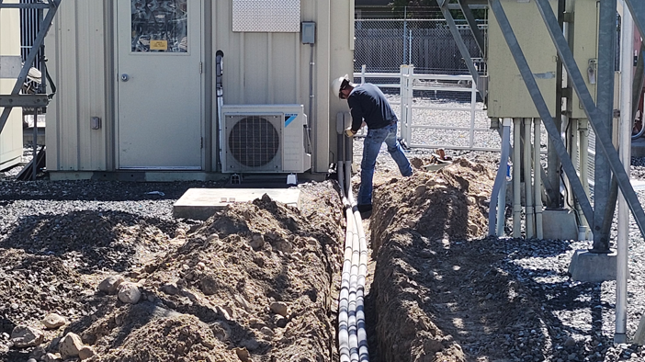
Questions?
Notes:
Does anyone know what is shown in this picture and where this picture was taken?
Answer: The Crew is installing Conduit as part of relay upgrades at Angus Bay 2 which was completed in May of 2025. This project wrapped up a 5-year long effort to modernize Angus Substation with the replacement of 9 feeder breakers, protective relaying for all 3 bays, regulator controls upgrades, and all the SCADA equipment.
Are they any questions?

Slide 19
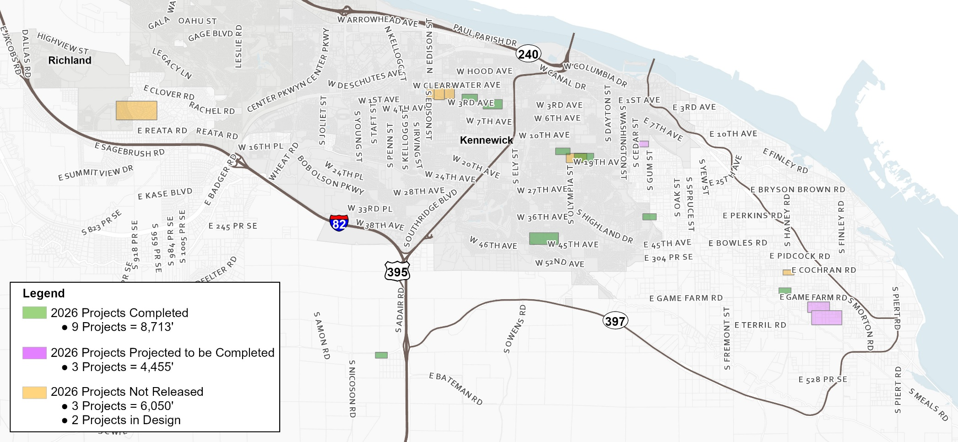
Underground Cable Replacement
2026 (as of Aug. 1, 2026) Completed: 8,713 ft $886K
2026 Projected in Progress: 4,455 ft $286K
      Total: $1.17M
Projected Cable Replacement by Contractor:
  14.3 years to complete (based on current 14k ft/yr avg.)
    Direct Buried Cable: 96,500 ft
    Injected Cable: 103,985 ft
Projected Cable Replacement by BPUD:
  2 Yrs to complete (based on current 25K ft/yr avg.)
    Cable in Conduit: 47,479 ft
Need overview using a map showing cable replaced by year, when did we start, how much cable we have left to replace, what we are doing this year,
Costs: show (Tableau screenshot?) of YOY spending on off-the-dock cable replacement, current budget, where we are at,
How much cable (ft) have we replaced, how much are we doing each year, how much do we have to go
What is criteria to replace cable” i.e. segments with >2 faults, HM weight (ALCN) cable, DB, XLP
Spent
$886k
Budget
$1.7M

